Slide 1
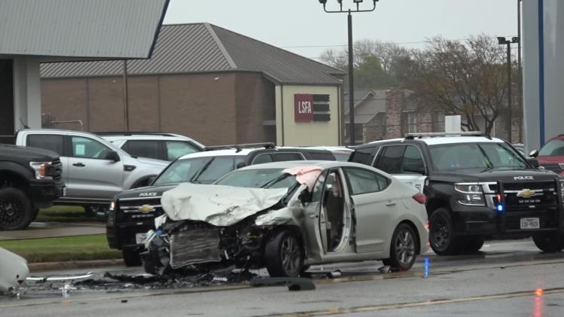


Misdemeanors Matter

Slide 2
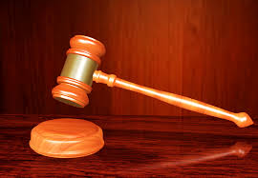
What is a Misdemeanor?
A misdemeanor is a crime punishable by a fine, jail time for a period of up to a year, or both
Felonies, on the other hand, carry fines and prison time of a year or more

Slide 3
While “less serious” than felonies, misdemeanors are STILL SERIOUS!

Slide 4
Texas Misdemeanors Examples
Class C: DUI (under 21), theft, minors consuming or possessing alcohol, public intoxication, criminal trespass, moving violations
Class B: DWI (first), minors possessing drugs, vandalism, evading arrest on foot
Class A: DWI (second), assault with bodily injury, possession of 2-4 ounces of marijuana, unlawfully carrying a weapon
What is the maximum fine for a Class C Misdemeanor?

Slide 5

Court Imposed Misdemeanor Penalties in Texas
Class C Misdemeanor: Fine up to $500*
Class B Misdemeanor: Fine up to $2,000, jail up to 180 days, up to two years community supervision (probation)
Class A Misdemeanor: Fine up to $4,000, jail up to one year, up to two years community supervision (probation)
*If offense located in the penal code
Sec. 12.41(3), Penal Code: Offenses outside the penal code can be classified as “Class C Misdemeanor” if the punishment is fine-only.

Slide 6
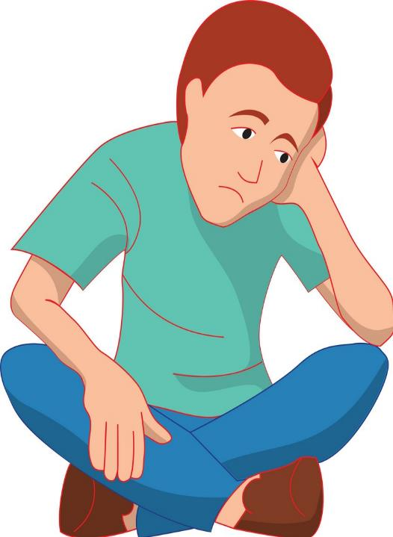
Further Misdemeanor Consequences to the Defendant
Non-court imposed consequences of misdemeanors might include:
Increased car insurance premiums
Attorney fees to be paid by the defendant
Inclusion of the offense on the defendant’s criminal record
Social stigma
Various DL-related consequences from DPS
Notes:
Talking Points:
What other consequences can you think of?
Do you have any personal experiences of people you know committing a misdemeanor? What were the negative consequences?

Slide 7
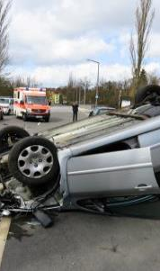
Misdemeanor Consequences to Society
The following traffic misdemeanors effectively illustrate the negative consequences misdemeanors have on society:
Impaired Driving
Speeding
Red Light Running
No Seatbelt

Slide 8
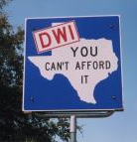
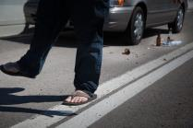
DUI and DWI (Alcohol)
2023
40,901 people were killed in U.S. motor vehicle crashes (4,291 in TX)
12,429 involved alcohol (1,957 in TX)
Source: National Highway Traffic Safety Administration
Notes:
Talking Points:
These statistics do not include deaths related to driving under the influence of drugs. Do you think the number would be greater if we include drugged driving?

Slide 9
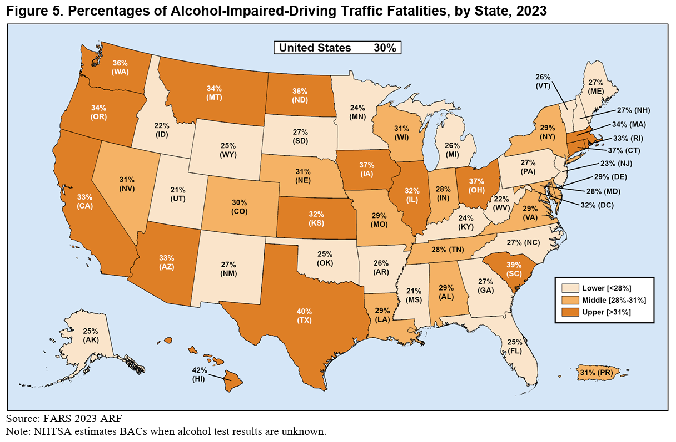

Slide 10
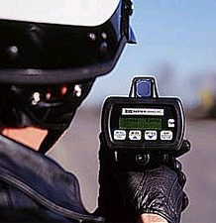
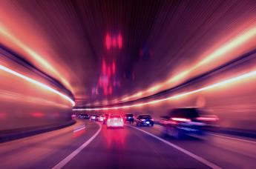
Speeding
Speeding is involved in about 1/3 of all traffic fatalities
What did COVID shutdowns tell us about speeding?
Source: National Highway Traffic Safety Administration

Slide 11
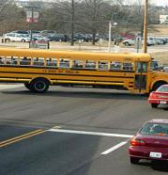
Red Light Running
In 2020, 928 U.S. red light running deaths
Over 150,000 serious injuries annually
1 in 3 people reported having run a red light in the 30 days prior to the report
Texas outlawed red light cameras in 2019
Sources: National Highway Traffic Safety Administration; Federal Highway Administration

Slide 12

Seat Belts
Roughly 50% of people that die on roads aren’t belted
Seat belts save about 15,000 lives per year
How might not wearing a seatbelt affect other vehicles?
Source: Insurance Institute for Highway Safety, U-Haul, NHTSA

Slide 13
Misdemeanor Consequences to Society
Annually, traffic crashes have an estimated economic impact of $340,000,000,000.00! on society
Who benefits here?
Source: NHTSA
Notes:
Talking Points:
Do you see how committing misdemeanors can affect others? Do you think this is unfair to those who follow the law?
What could you do with $242 billion dollars? What could society/government with this amount of money if it did not go toward traffic crashes?
What are some of the places this money goes? Answers: medical care, court costs, insurance, law enforcement.

Slide 14
The Vital Role of Municipal Courts in Texas
Defendants are still alive = behaviors can be corrected!
Year | Total TX Traffic Fatalities | New Municipal Court Non-Parking Traffic Case Filings
2019/FY2019 | 3,623 | 3.6 Million
2020/FY2020 | 3,896 | 2.769 Million
2021/FY2021 | 4,489 | 2.418 Million
2022/FY2022 | 4,481 | 2.631 Million
2023/FY2023 | 4,291 | 2.741 Million
2024/FY2024 | 4,150 | 2.774 Million
Sources: Annual Statistical Reporting of the Texas Judiciary (OCA), TxDOT

Slide 15
Citation Impact on Safety Studies
2014 Journal of Policy and Management
1% increase in tickets = .28% decline in crashes (Massachusetts)
2008 Towson University
Each increase of 100 tickets = 12% fewer accidents; increasing fine amounts had little to no effect
2021 Manhattan Institute 2002 to 2004 increased traffic tickets by 229% = Injuries dropped 9.3% and fatalities dropped 42% (Fresno, CA)

