Slide 1

Texas S.B. 30:
The Community Safety Education Act
Proper interaction with peace officers

Slide 2
Purpose
The term "peace officer" is used to describe anyone who has statutory law enforcement powers.
Citizens may interact with peace officers in a variety of situations, some of them stressful.
In 2017, the Texas Legislature passed the Community Safety Education Act requiring high school students to receive instruction on how to properly interact with law enforcement officers.
The purpose of the instruction is for the safety of citizens and officers alike.

Slide 3
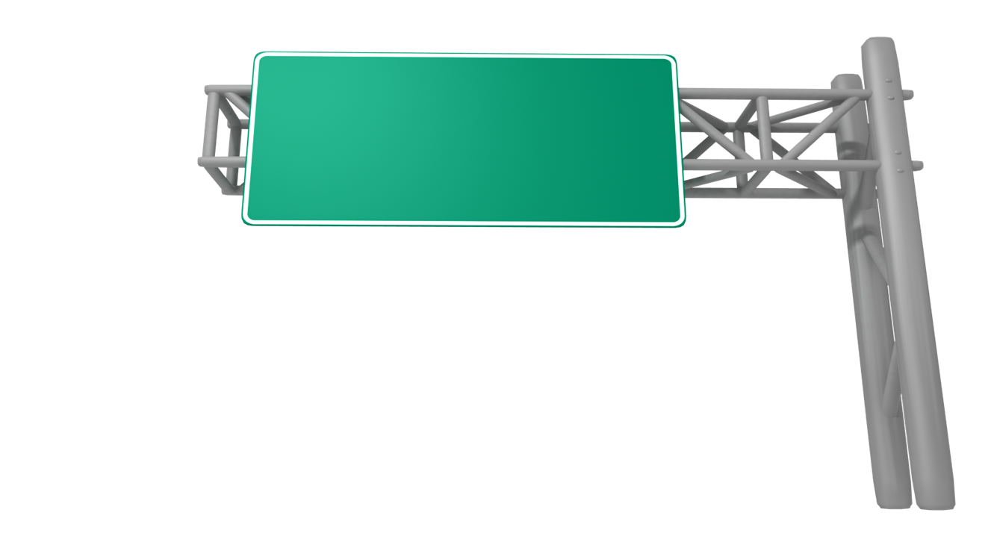
Two trivia questions
What is the most common reason for contact with the police?
A TRAFFIC STOP
What do all of the following people have in common (besides being killers)?
  Timothy McVeigh (the Oklahoma City bomber)
  David “Son of Sam” Berkowitz (a serial killer)
  Mohammed Atta (ringleader of the 9/11 attacks)
Hint: Preceding their arrests, they all came to the attention of law enforcement through…
A ROUTINE TRAFFIC STOP

Slide 4


Rights and responsibilities
In every officer & citizen interaction, you have certain rights and responsibilities.
For example, you may have the right to record the interaction with your cell phone…
But you also have a responsibility to consider the safety of everyone involved. If you pull your cell phone out of your pocket and point it at an officer, they may NOT KNOW it’s a cell phone!
https://www.piqsels.com/en/public-domain-photo-jcfma
https://www.needpix.com/photo/795174/camera-forest-man-outdoors-person-photographer-trees-free-pictures-free-photos

Slide 5

The iceberg analogy
A law enforcement officer’s actions during a traffic stop are like an iceberg.
The driver only sees what is happening on the surface, but there is a lot going on in the officer’s mind below the surface.
Officer and civilian safety are the #1 priority.

Slide 6

video
https://youtu.be/_IS6euS8QSo
https://youtu.be/Fi60a-W0Qsc
(Both links will show the same video. Two links provided in case one does not work.)
As you watch the video, please complete the handout.

Slide 7

QUESTIONS
Read the “20 Tips for Interacting with Law Enforcement”
What questions do you have?
QUESTIONS?

Slide 8

assessment
Thank you for your participation!
You will now take a follow-up POST-TEST to assess your understanding.
If you have remaining questions, please ask!

