Slide 1
Bureaucracy Excitement
Where are government departments housed, anyway?

Slide 2
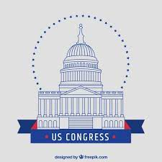

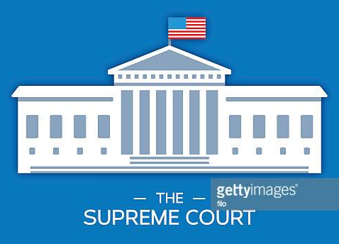
Legislative
Executive
Judicial
Let’s take a look! Take your best guess at where each descriptor is housed within the branch of government.
Government of the United States
Notes:
https://docs.google.com/presentation/d/17EQIqBASOHI9Rzn-CVQozbgIiCxqSgBl9NXG227cY_s/edit?usp=sharing

Slide 3
Administrative Office of the United States Courts
Legislative
Executive
Judicial
Architect of the Capitol
Consumer Product & Safety Commission
Territorial Courts
Equal Employment Opportunity Commission
Government Accountability Office
United States Court of Appeals for Armed Forces
5th Circuit Court of Appeals
Central Intelligence Agency
Federal Housing Finance Agency
Office of Management & Budget
Office of Special Counsel
Library of Congress
National Security Council
Government of the United States
Council of Economic Advisers
Appropriations Committee
Select Committee on Intelligence
Department of Justice
Federal Election Committee
Government Publishing Office
Notes:
https://docs.google.com/presentation/d/17EQIqBASOHI9Rzn-CVQozbgIiCxqSgBl9NXG227cY_s/edit?usp=sharing

Slide 4
Your Observations?
Notes:
Questions for Discussion after the activity:
Did any of the items listed sound familiar to you?
Are there any you are 100% confident you placed in the correct column? If so, which one(s)?
Any you have no idea on?
What are your overall impressions from having sorted these entities?

Slide 5
Legislative
Executive
Judicial
Central Intelligence Agency
Appropriations Committee
Consumer Product & Safety Commission
Administrative Office of the United States Courts
Architect of the Capitol
Department of Justice
Department of Transportation
Territorial Courts
Government Accountability Office
Equal Employment Opportunity Commission
Government Publishing Office
United States Court of Appeals for Armed Forces
Federal Election Committee
Library of Congress
Federal Housing Finance Agency
5th Circuit Court of Appeals
National Security Council
Select Committee on Intelligence
Office of Management & Budget
Office of Special Counsel
Government of the United States KEY

Slide 6

Have you heard the term Bureaucracy before? What do you think it means?

Slide 7
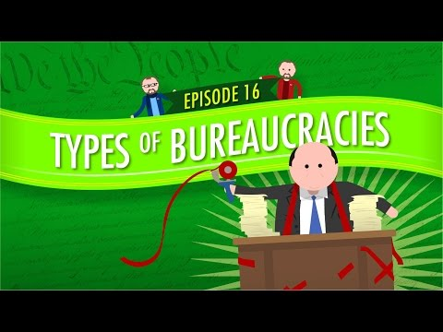
Notes:
https://youtu.be/tIvUo3bP4Eo (about 6 min.)

Slide 8
Bureaucracy
Administrative agencies designed to maintain uniformity and control within an organization.

Slide 9

Our Government is filled with bureaucracy!
But how many administrative agencies are there and where are they housed within our government?

Slide 10
FOR EXAMPLE...
The Legislative Branch has multiple offices in addition to Congress itself - Do you know of any Legislative Offices?
On top of that, there are...
20 Standing and 5 Non-Standing Committees in the HOUSE
16 Standing and 5 Non-Standing Committees in the SENATE
&

Slide 11
A Standing Committee...
A Non-Standing Committee...
Is a permanent committee that meets regularly
Is created for a specific purpose, and is then dissolved
Let’s take a look...
Notes:
are formed as per decision of council, they continue for full term of 3 years or till council continues. groups are created for specific purpose / job / activity / advisory etc and then it will be dissolved. Like recently icai formed group to review exam paper evaluation.

Slide 12
Legislative Branch
House
Architect of the Capitol
Congressional Budget Office
Government Accountability Office
Government Publishing Office
Library of Congress
United States Botanic Garden
The Congress
Senate
20 COMMITTEES
Agriculture
Appropriations
Armed Services
Budget
Education and Labor
Energy and Commerce
Ethics
Financial Services
Foreign Affairs
Homeland Security
House Administration
Judiciary
Natural Resources
Oversight and Reform
Rules
Science, Space, and Technology
Small Business
Transportation and Infrastructure
Veterans Affairs
Ways and Means
5 NON-STANDING COMMITTEES
Climate Crisis
Economic Disparity and Fairness in Growth
Human Rights
Intelligence
Modernization of Congress
16 COMMITTEES
Agriculture, Nutrition, and Forestry
Appropriations
Armed Services
Banking, Housing and Urban Affairs
Budget
Commerce, Science and Transportation
Energy and Natural Resources
Environment and Public Works
Finance
Foreign Relations
Health, Education, Labor, and Pensions
Homeland Security and Governmental Affairs
Judiciary
Rules and Administration
Small businesses and Entrepreneurship
Veterans Affairs
5 NON-STANDING COMMITTEES
Aging
Ethics
Indian Affairs
Intelligence
International Narcotics Control (caucus)

Slide 13

What about the Judicial Branch?
What does its structure look like?

Slide 14
Judicial Branch
Supreme Court of the United States
Administrative Office of the United States Courts
Federal Judicial Center
Territorial Courts
United States Courts of Appeals
United States Court of Appeals for the Armed Forces
United States Court of Appeals for Verteral Claims
United States District Courts
United States Court of Federal Claims
United States Court of International Trade
United States Sentencing Commission
United States Tax Court

Slide 15
Well that one didn’t look too complicated
This whole BUREAUCRACY thing is a breeze to understand!!

Slide 16

The Executive must be easy!?
Well… not so fast. This one gets a little more complicated.
Before we investigate, let’s explore some terminology...

Slide 17
1
3
DEPARTMENT
INDEPENDENT AGENCY
2
4
EXECUTIVE OFFICE
REGULATION
EXECUTIVE BUREAUCRACY
A sector that deals with a particular area of interest. Housed in the Executive Branch and headed by a Cabinet Secretary.
Created by Congress & independent of the executive. Intended to enforce regulations free of political influence.
Staff that directly support the work of the President and serve at his/her pleasure.
A rule, or mechanism that limits, steers, or otherwise controls social behavior. Often enacted by an administrative agency.

Slide 18
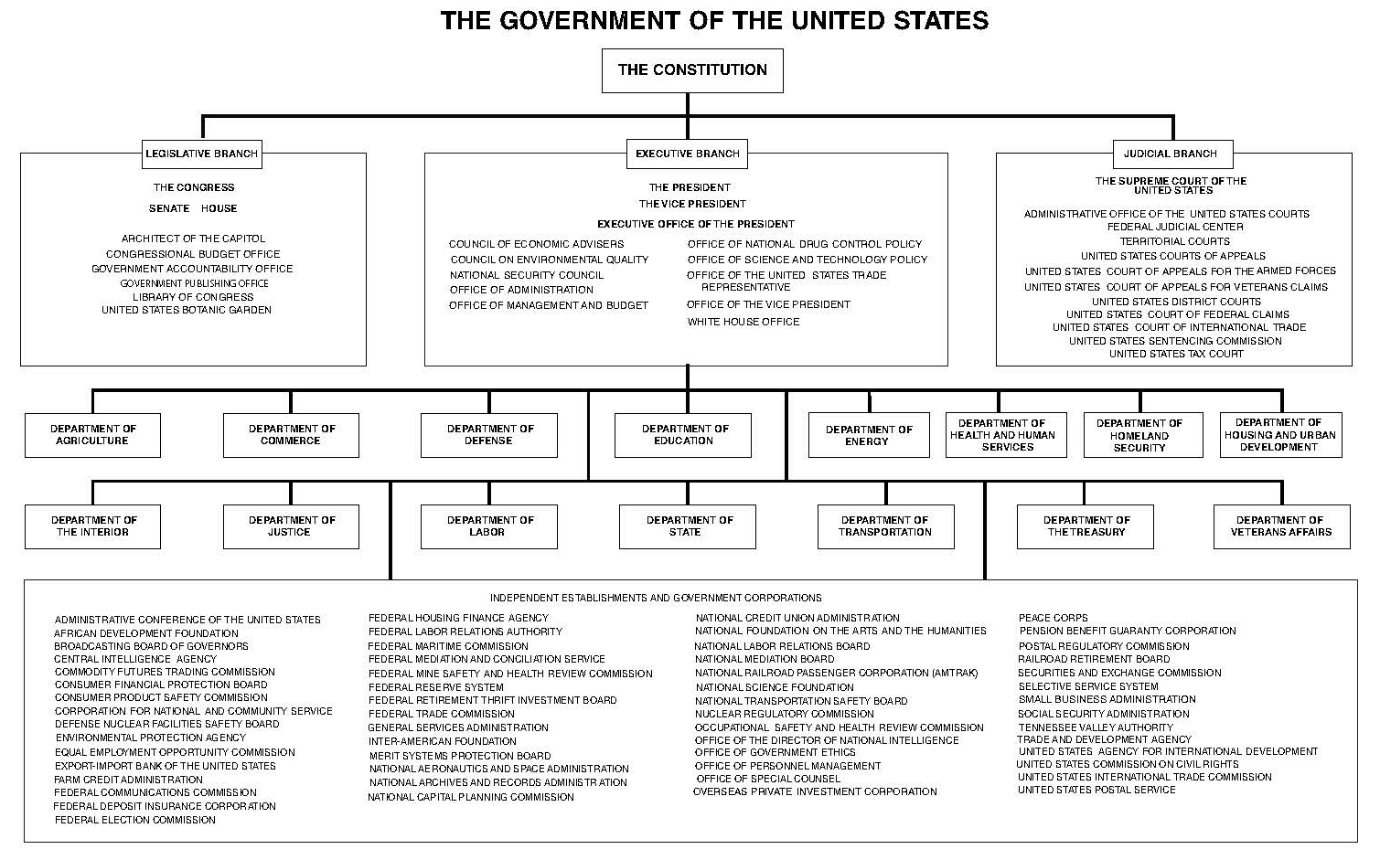
Executive Branch
Whoa!!

Slide 19
Did you know...
The largest agencies are the 15 Executive Departments, each led by an appointed member of the President’s Cabinet (called “Secretaries”). These people serve at the “pleasure of the President.”
Most agencies fall under one of these Executive Departments. (For example, the FBI falls under the DOJ.)
But some agencies are “Independent Agencies,” intended to be free of political control.

Slide 20
AN INDEPENDENT AGENCY IS...
CREATED BY THE LEGISLATURE
HOUSED IN THE EXECUTIVE BRANCH
HOLDS THE POWER OF FEDERAL LAW
They are created through statutes passed by the legislative branch, but are housed under the executive branch.
However, they are intended to function separate of executive oversight to free themselves from political influence.
Their rules/regulations hold the power of federal law.
Examples of Independent Agencies include the EPA, CIA, FBI, FEC, and the SEC to name a few
Notes:
Independent regulatory agencies are federal agencies created by an act of Congress that are independent of the executive departments. Though they are considered part of the executive branch, these agencies are meant to impose and enforce regulations free of political influence.

Slide 21
Feeling overwhelmed yet?
NOT TO WORRY!
Did you know that there is LITERALLY a Government Manual that outlines every aspect of the federal government, including all of these agencies?!

Slide 22

LET’S EXPLORE SOME OF THESE AGENCIES
Take a few short minutes to explore the Government Manual online - mark your observations on your Handout.

Slide 23
WHAT did you DISCOVER?
In small groups, share your findings with your peer(s).

Slide 24
Time to put your understanding of bureaucracy to the test.
Visit the Government Manual website and….
explore the Department of Transportation website,
then answer the questions on your Handout.

Slide 25
3 Branches of Bureaucracy
Now that you know the complexities of these governing bodies, do a search to complete the table on your Handout.
LEGISLATIVE | EXECUTIVE | JUDICIAL

Slide 26
Bureaucracy Questions
What are the benefits to bureaucracy? What are the drawbacks?
If you could add a governing agency, which agency would you create and why?
If you had the power to remove one of the offices, which office would you remove and why?
If you were selected to be an intern at an agency, which one would you hope to serve and why?
Notes:
Are they effective/necessary?

