Slide 1
Today’s Warm-Up:
Run Outside
Do 10 Jumping Jacks
Then complete the warm up question
Notes:
https://docs.google.com/forms/d/e/1FAIpQLSfHAMvfRMz8cV6kpGKH2a6ymNrlWRv0JAgPhrraqisKY2g0YA/viewform?usp=sf_link

Slide 2
Did you complete the activity?
Why or why not?

Slide 3
So where do
LAWS
come from?
Why do we have them?
What is their purpose?

Slide 4
Red
What does the color RED mean?
WHY?
Green
What does the color GREEN mean?
Notes:
🍐 This is a Pear Deck Text Slide
🍐 To edit the type of question, go back to the "Ask Students a Question" in the Pear Deck sidebar.

Slide 5
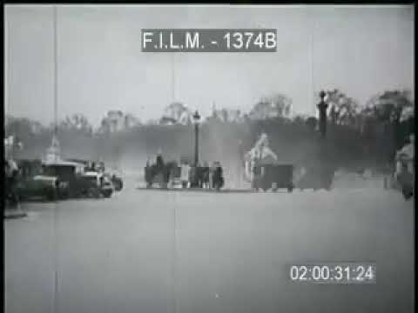

Slide 6
Who creates all these laws?
Where do they come from?

Slide 7
Review of the Federal Government:
Laws come from these familiar places:
THE CONSTITUTION
LEGISLATIVE BRANCH
EXECUTIVE BRANCH
CONGRESS
PRESIDENT
JUDICIAL BRANCH
SUPREME COURT

Slide 8
BUT WAIT!
I thought only the Legislature ACTUALLY MAKES the laws, and the President makes some policies, and that the Supreme Court just makes… well...decisions.
HOW DO THEY ALL “MAKE LAW???”

Slide 9
SPOILER ALERT!!!!
“Laws” come from each branch!
THE CONSTITUTION
LEGISLATIVE BRANCH
EXECUTIVE BRANCH
CONGRESS
PRESIDENT
JUDICIAL BRANCH
SUPREME COURT

Slide 10
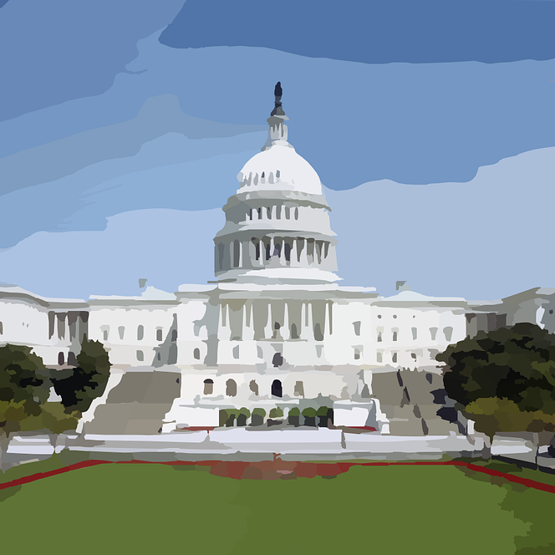
The truth is, ALL 3 BRANCHES take actions that have the EFFECT OF LAW.
Whether it’s a law passed by Congress or a Supreme Court decision or a regulation passed by an Agency in the Executive Branch… each of these things has the EFFECT OF LAW on our lives.

Slide 11
Let’s look at each of the
4 MAIN SOURCES OF LAW, more specifically:
1. THE CONSTITUTIONS
Federal and State
2. STATUTES & ORDINANCES
3. ADMINISTRATIVE REGULATIONS
Made by U.S. Congress & State Legislatures
Made by Federal & State Executive Agencies
4. CASE LAW (PRECEDENT)
Made by Federal and State Court Decisions

Slide 12
The Constitutions
The U.S. Constitution is the “Supreme Law of the Land,” and is therefore above every other type of law.
All other laws must conform to the Constitution.
The courts have the power of Judicial Review and
can strike down laws that are deemed
unconstitutional.
Each state also has a constitution that closely mirrors the structure of the U.S. Constitution.

Slide 13
Compare The U.S. & Texas Constitutions.
What differences do you notice?
U.S. Constitution | Texas Constitution
Legislative Branch Executive Branch Judicial Branch Interstate Relations Amending Misc. Provisions Ratification Amendments Bill Of Rights (1-10) Other amendments | Bill of Rights The Powers of Government Legislative Department Executive Department Judicial Department Suffrage Education Taxation and Revenue Counties Railroads Municipal Corporations Private Corporations Spanish and Mexican Land Titles (repealed Aug 5, 1969) Public Lands and Land Office Impeachment General Provisions Mode of Amending the Constitution
Interactive chart by University of Texas and Texas Legislature National Archives

Slide 14
Statutory Law
Statute: an act of law passed by the legislature
(to proscribe conduct, define crimes, create
government bodies, appropriate money, etc).
Statutes are codified (written & numbered)
For example 21 U.S.C. Ch 13 is
The Controlled Substances Act

Slide 15
Statutory Law
The U.S. Congress and the Texas Legislature both pass statutory laws. U.S. statutes apply to the whole country whereas Texas statutes only apply to Texas.
Laws passed by local governments (such as the City Council) are called Ordinances.

Slide 16
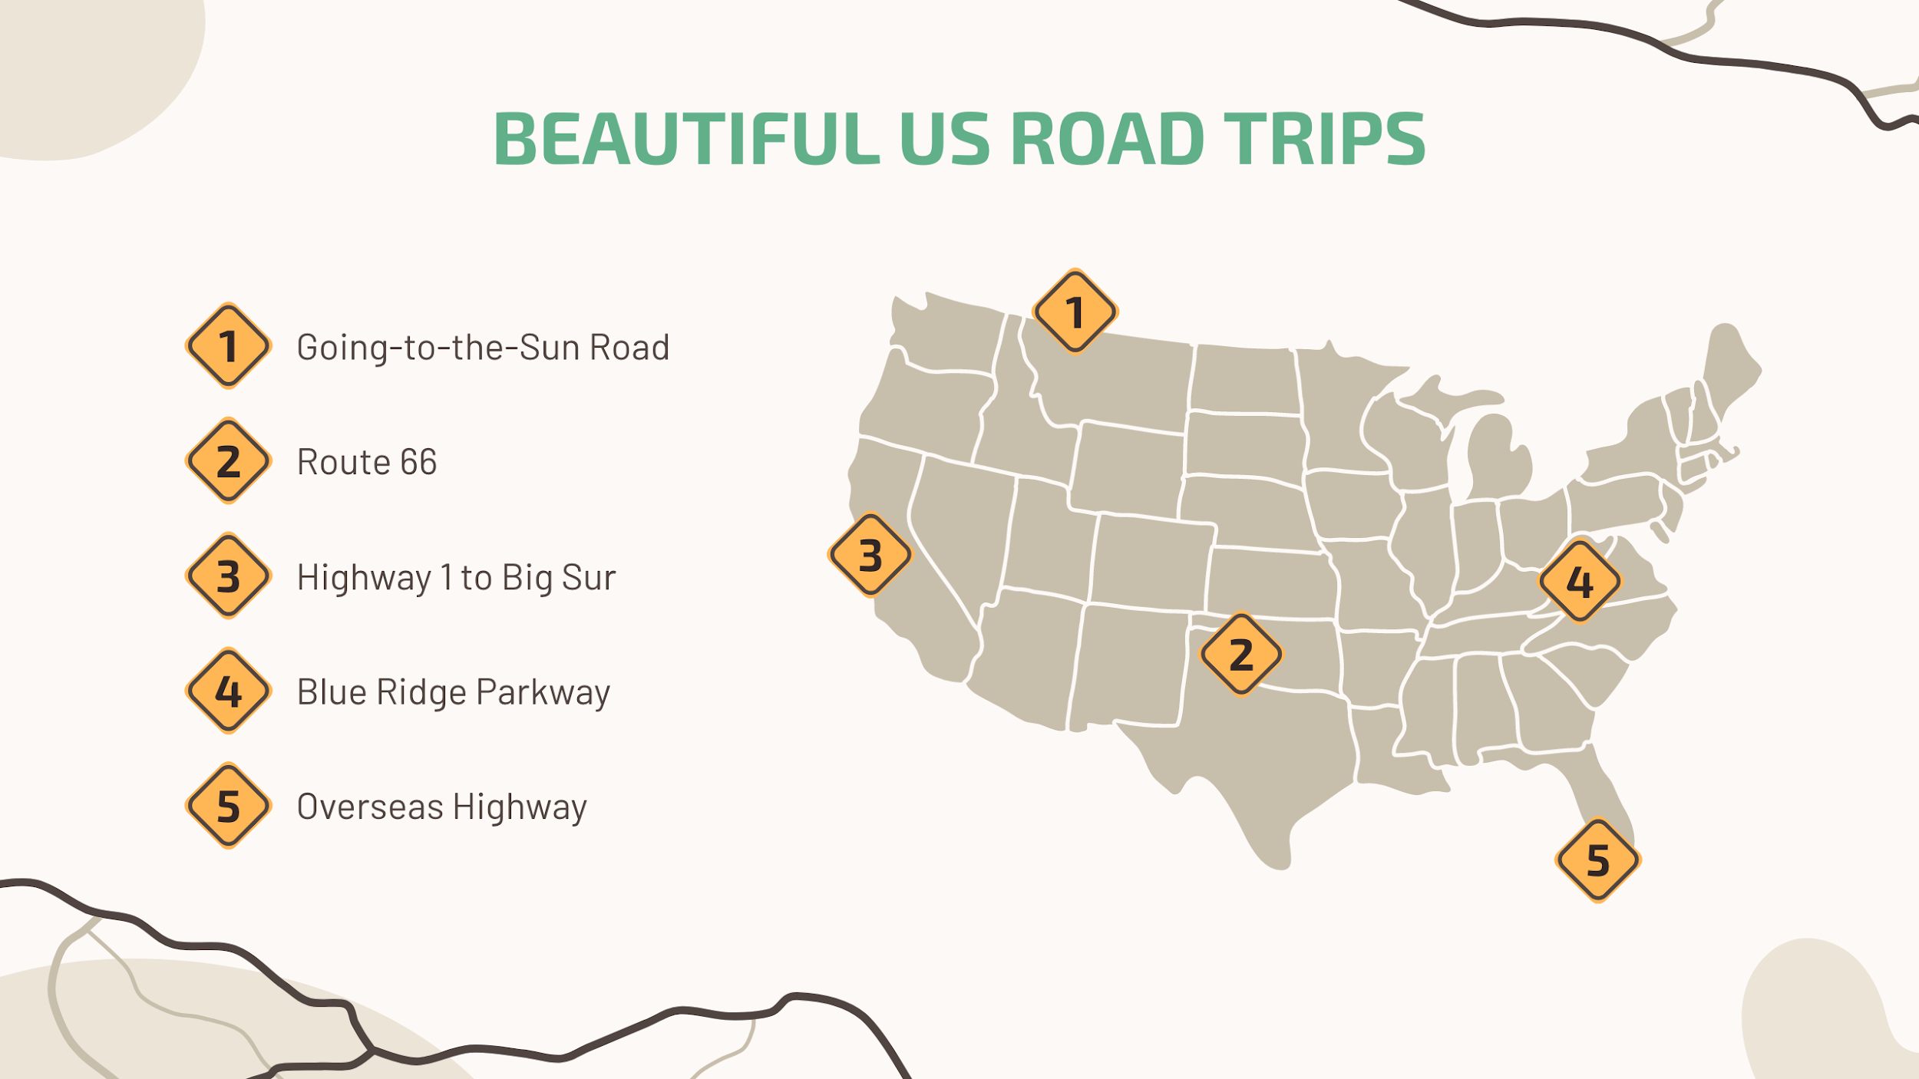
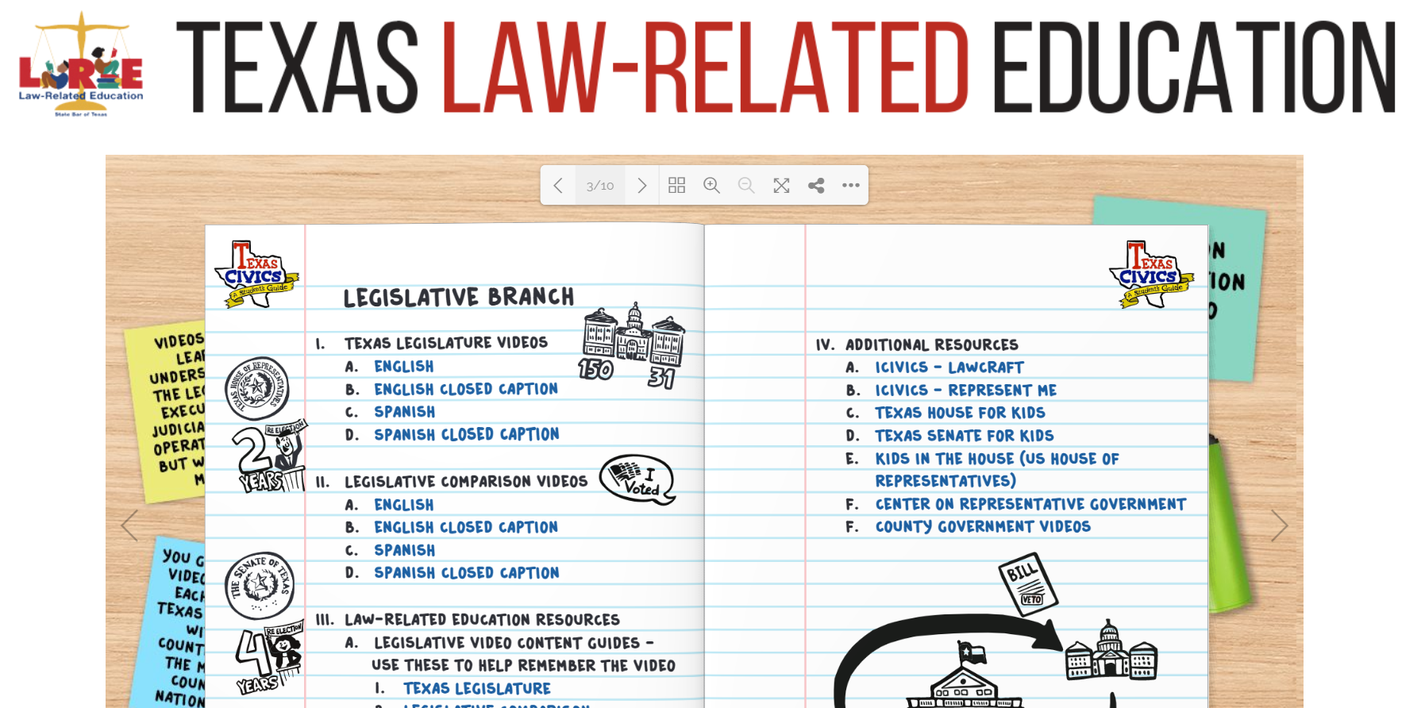
For a quick recap on the state, federal, and local legislative branches, watch this quick review:

Slide 17
WHOA!
Have you ever noticed how these federal, state, and local laws often overlap?

Slide 18
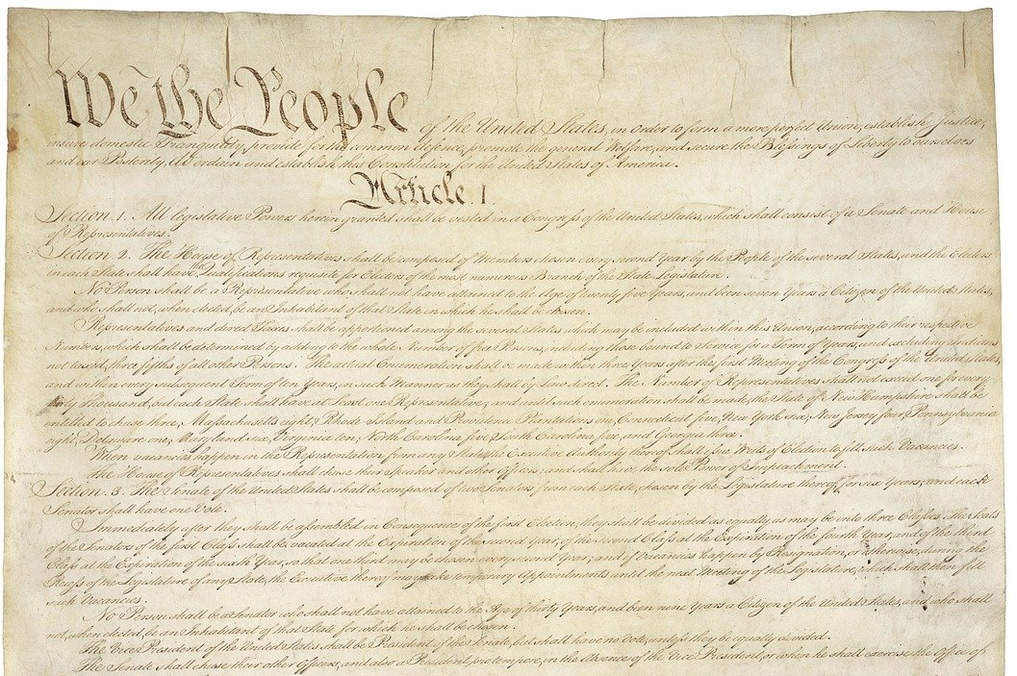
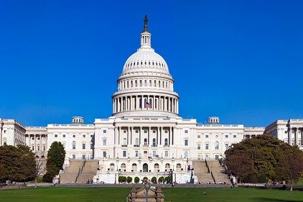
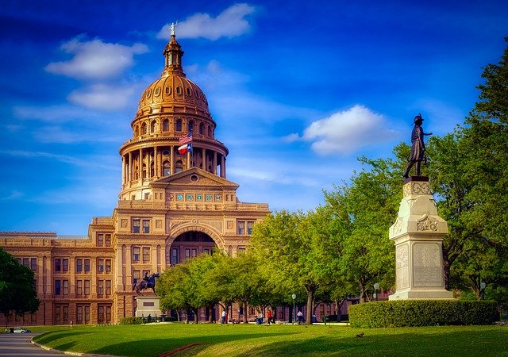
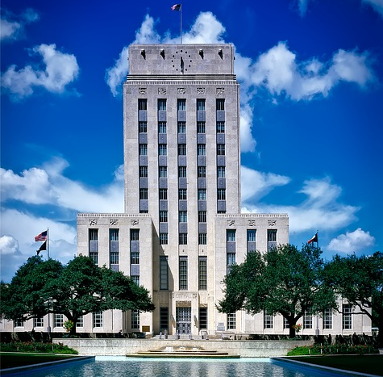
Supremacy of Statutory Laws: [The US Constitution is over everything!] - Then Federal Law, State Law, City Ordinances
Houston City Hall

Slide 19
What happens when the state and federal laws are in conflict?
Typically, the federal law will prevail, but sometimes it’s not so simple...

Slide 20
For Example:
Title 21 U.S.C. (United States Code) Ch. 13, The Controlled Substances Act,
states that Marijuana is a “Schedule I” illegal drug. This is an example of a FEDERAL STATUTE, and yet…States have been doing their own thing.
1
1
2
3
3
4
4
2
5
5
Legal
NOT Legal
Legal
NOT Legal but No Jail Time for Small Amounts
Medical Cannabis Laws

Slide 21
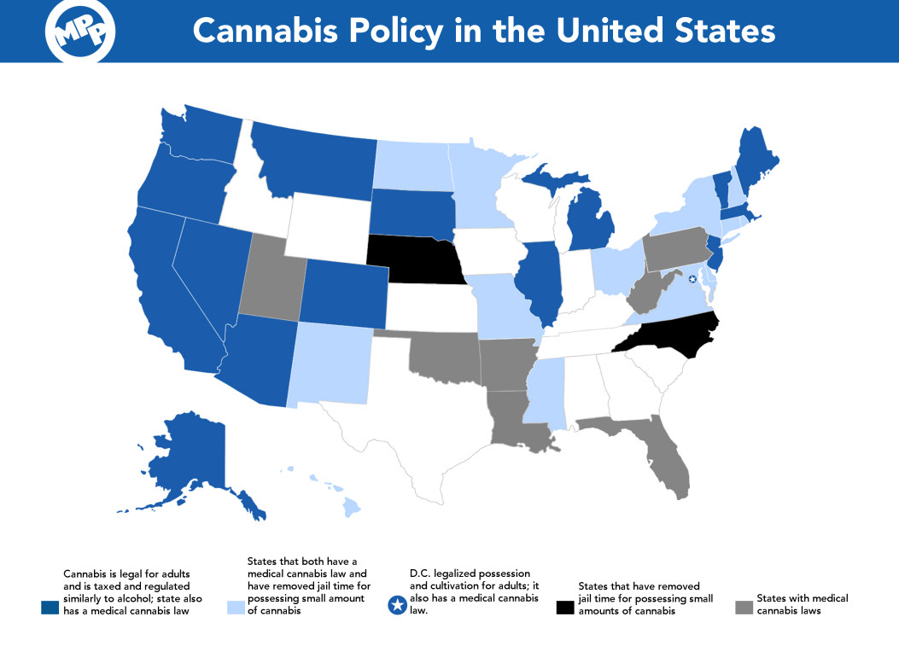
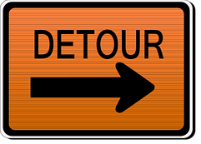
DISCUSS: Looking across the country, how do you think the varying laws affect federal and state law enforcement agencies?

Slide 22
91
A traffic stop with 91 pounds of marijuana?
An enforcement nightmare

Slide 23
Administrative Regulations
Administrative Agencies are typically created by legislation to direct and manage complex governmental tasks and implement legislative acts.
Article I, Section 8, Clause 18 of the U.S. Constitution gives the U.S. Congress the power “...to make all Laws which shall be necessary and proper for carrying into Execution the foregoing Powers…”

Slide 24
Administrative Regulations
Even though these agencies are created by Congress, they are part of the EXECUTIVE BRANCH.
These agencies may also be referred to as:
Departments
Regulatory Agencies
Administrations
Commissions
Bureaus
This collection of administrative agencies in the Executive Branch is sometimes called “The Federal Bureaucracy”

Slide 25
How Administrative Agencies Are Formed by Legislative Act or Statute
ENABLING STATUTE
AGENCY REGULATES
Congress passes a law that needs to be enforced
AGENCY IN EXECUTIVE BRANCH IS CREATED
Agency begins process of “rulemaking” to enforce enabling statute and carry out purpose
Statute details the creation of Executive Agency (or Independent Agency) & gives that agency authority
Director is appointed and staff is hired
LAW
REGULATION/LAW

Slide 26
WHOA!
Let’s play the NAME GAME & see how many Administrative Agencies we can name?

Slide 27
Brainstorm!
HINT: Many start with “Department of…”

Slide 28
U.S. Geological Survey (USGS)
Environmental Protection Agency (EPA)
Department of Education
Department of Defense (DOD)
Department of Justice
Centers for Medicare & Medicaid Services (CMS)
Central Intelligence Agency (CIA)
Internal Revenue Service (IRS)
Bureau of Engraving and Printing
National Archives & Records Administration (NARA)
Immigration and Customs Enforcement (ICE)
Equal Employment Opportunity Commission (EEOC)
National Highway Traffic Safety Administration
(NHTSA)
Office of Management and Budget
Drug Enforcement Administration (DEA)
Transportation Security Administration (TSA)

Slide 29
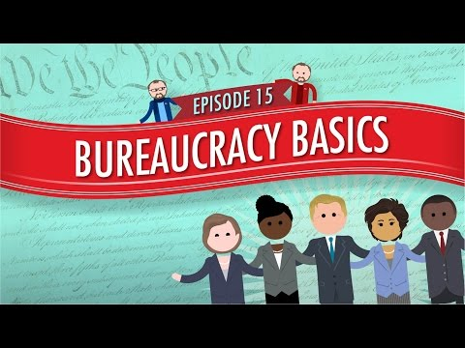

Slide 30
Executive Orders:
A.K.A. the other way the Executive Branch can make laws
EXECUTIVE
You’ve probably heard of them.
ORDERS

Slide 31

https://youtu.be/JUDSeb2zHQ0

Slide 32
Note:
EXECUTIVE
Like Regulations, Executive Orders are published in the Federal Register (published daily) and become part of the Code of Federal Regulations (published annually).
ORDERS

Slide 33

DON’T GIVE UP! WE’RE ALMOST DONE!
Just ONE MORE SOURCE OF LAW LEFT
to rule our sad, little lives.

Slide 34
JUST KIDDING!
About the “almost done” part.”

Slide 35
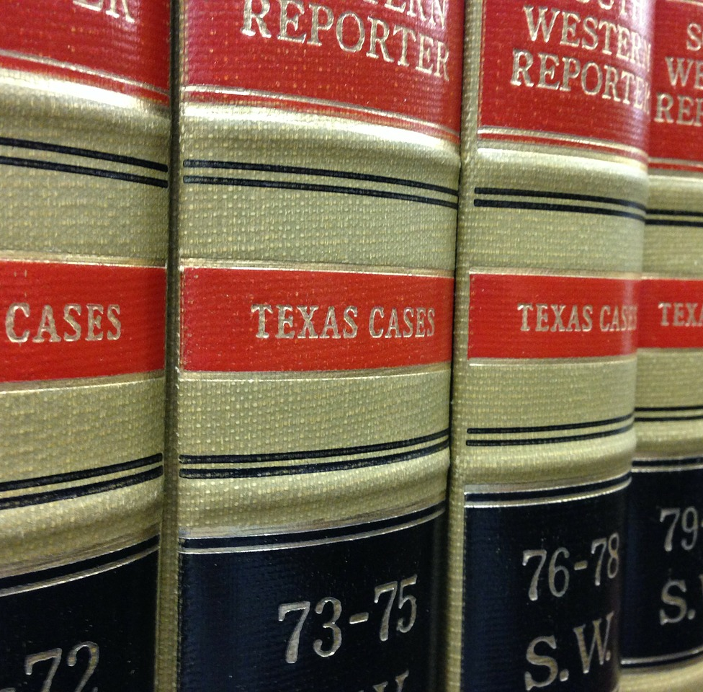
Case Law
Established through judicial decisions that create precedents
Stare Decisis: Latin for “to stand by things decided”
Provides predictability and consistency so that people may plan their lives accordingly

Slide 36
Case Law - Two Examples
Miranda v. Arizona established the “Miranda Warnings” in 1966
Obergefell v. Hodges protected same-sex marriage (nationwide) in 2015
Can you name any other landmark cases?

Slide 37
Remember our 4 MAIN SOURCES OF LAW? Let’s apply them to an everyday example!
1. THE CONSTITUTIONS
Federal and State
2. STATUTES & ORDINANCES
3. ADMINISTRATIVE REGULATIONS
Made by U.S. Congress & State Legislatures
Made by Federal & State Executive Agencies
4. CASE LAW (PRECEDENT)
Made by Federal and State Court Decisions

Slide 38
What is the Source of law for each example?
SOURCES OF LAW:
The U.S. Constitution
Federal Statute
Administrative Regulation
Case Law
The National Highway Traffic Safety Administration establishes safety standards for motor vehicles.
Article I, Section 8 gives Congress the power to make all laws that are “necessary and proper...”
States are allowed to require seat-belt usage after court decisions establish that states have a reasonable “public health” interest.
Congress passes a law in 1966 to create a Department of Transportation to research, develop, and administer national transportation policy.

Slide 39
What is the Source of law for each example?
SOURCES OF LAW:
The U.S. Constitution
Federal Statute
Administrative Regulation
Case Law
3. The National Highway Traffic Safety Administration establishes safety standards for motor vehicles.
1. Article I, Section 8 gives Congress the power to make all laws that are “necessary and proper...”
4. States are allowed to require seat-belt usage after court decisions establish that states have a reasonable “public health” interest.
2. Congress passes a law in 1966 to create a Department of Transportation to research, develop, and administer national transportation policy.

Slide 40
Complete the closure questions on your student notes handout about how laws affect each of the following:
DRUG ENFORCEMENT
ARE
How will federalism respond to marijuana?
TRAFFIC SAFETY
YOU
Fewer people are on the roads, so why are fatalities rising?
COVID-19 ISSUES
SERIOUS?
Who is in charge here and what’s next?

Slide 41
LAWS in the time of COVID
Rapidly-Change
Executive Orders
County Emergency Orders
Can get confusing if we don’t understand how things work
Misinformation on social media
Not the best place for information!
See example
Foundation of Understanding
Government must be able to expand and contract in response to needs
Citizens need to know more about how that process works
NOTE: These last 4 slides might only be used for the presentation with teachers (for discussion...not for students).

Slide 42
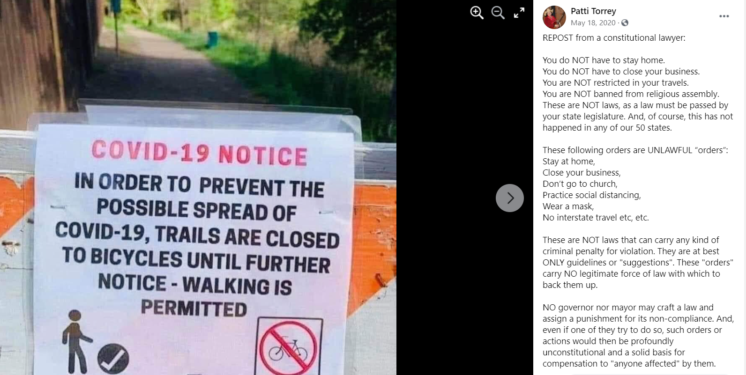
NOTE: These last 4 slides might only be used for the presentation with teachers (for discussion...not for students).

Slide 43
NOTE: These last 4 slides might only be used for the presentation with teachers (for discussion...not for students).
FALSE

Slide 44
That doesn’t mean our local, state, and federal governments always agree.
NOTE: These last 4 slides might only be used for the presentation with teachers (for discussion...not for students).
AUSTIN MAYOR
FEDERAL
Wants people to keep the masks on in public
CDC recommends masks, no federal mandate in place
COVID DECISIONS MAP
GOVERNOR ABBOTT
TRAVIS COUNTY JUDGE
Executive Order GA-34: “no person may be required by any jurisdiction to wear or to mandate the wearing of a face covering.”
Said the Mayor can keep the mask requirement while this case is under review...outcome pending

Slide 45

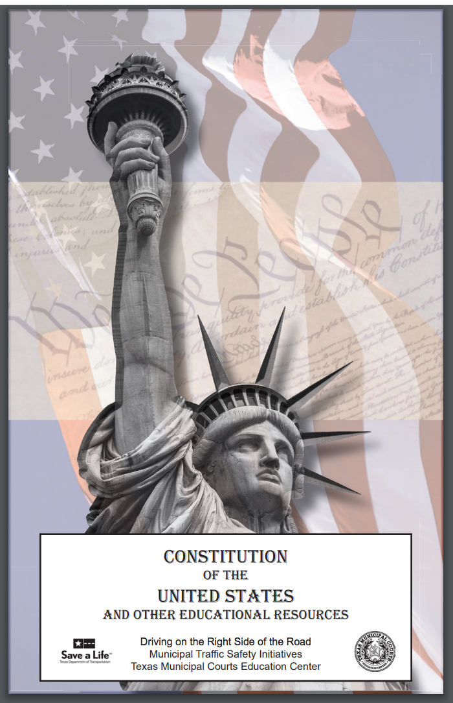
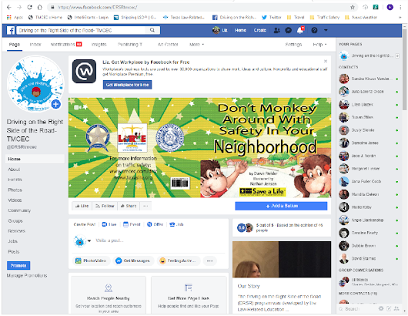
Additional DRSR Materials
01
02
03
Pocket Constitutions
Twitter
Facebook
Boxes come in increments of 300. Use the QR code below to order VIA Google form or go to http://www.tmcec.com/drsr/educators/ to download an order form.
https://twitter.com/DRSRtmcec
@DRSRtmcec
https://www.facebook.com/DRSRtmcec/

Slide 46
THANKS!
Do you have any questions?
Please, keep this slide for attribution

