Slide 1
Did you know…
Drivers cannot send or receive electronic messages in Texas
Drivers with learner’s permits are prohibited from using handheld cell phones in the first six months of driving
Drivers under the age of 18 are prohibited from using wireless communications devices
All riders under the age of 21 are required to wear a helmet when operating a motorcycle
School bus operators are prohibited from using cell phones while driving if children are present
In school zones, all drivers are prohibited from texting and using handheld devices while driving
How did these laws come to be?

Slide 2

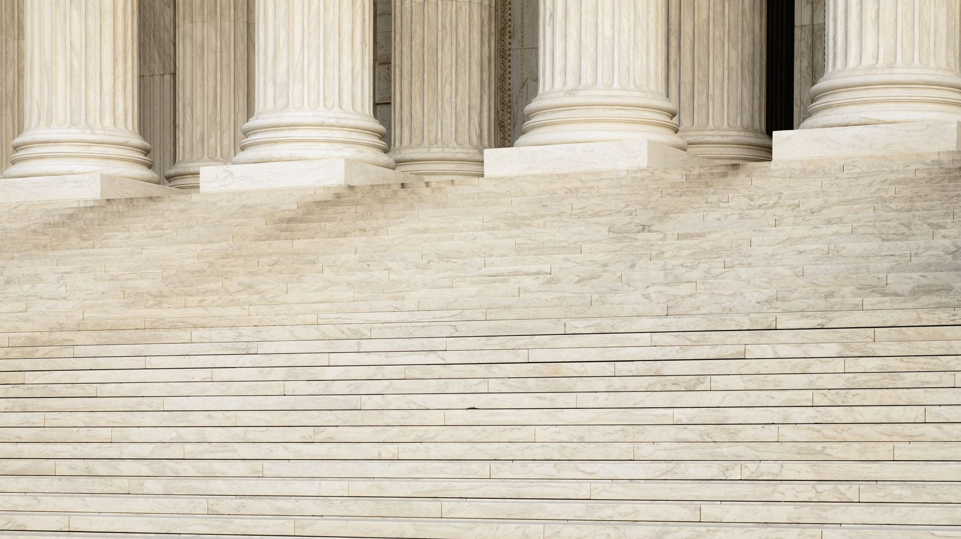
Learning Objective: Students will discover the complexities of how a bill becomes a law.

Slide 3
Majority Vote in both Houses and a signature from the Executive
_____
⅔ Majority vote from both Houses to override an Executive Veto
Right??
How does a bill becomes a Law?

Slide 4
Yes, but there are a few steps in between. Let’s take a look…
Us
Use the Infographic to follow the path of a bill...

Slide 5
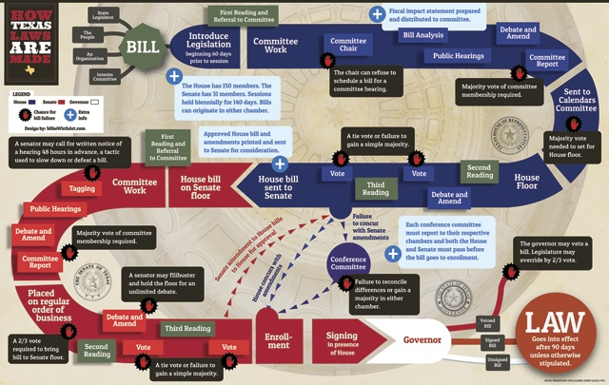

Slide 6
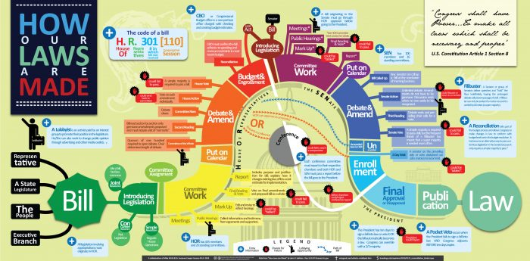

Slide 7

What does it look like in action?
Use your “what does it look like in action…” to find out

Slide 8
Questions to Consider...
Why is this system so complex?
What are the benefits? What are the drawbacks?
Why do you think the framers designed it this way?
If you could change anything about the process, would you? Is so, what?

