Slide 1
INQUIRY
Based Learning
Cars, Constitutions, & Courts

Slide 2
Btw, this case is based on actual events…*
You and your partner sit on The Court of Appeals.
With your partner, you will need to decide:
Questions of LAW
Questions of MORALITY and FAIRNESS (which are different from questions of law!)
Be prepared to defend your conclusions to the class!
*Some details have been altered, such as names and locations.

Slide 3
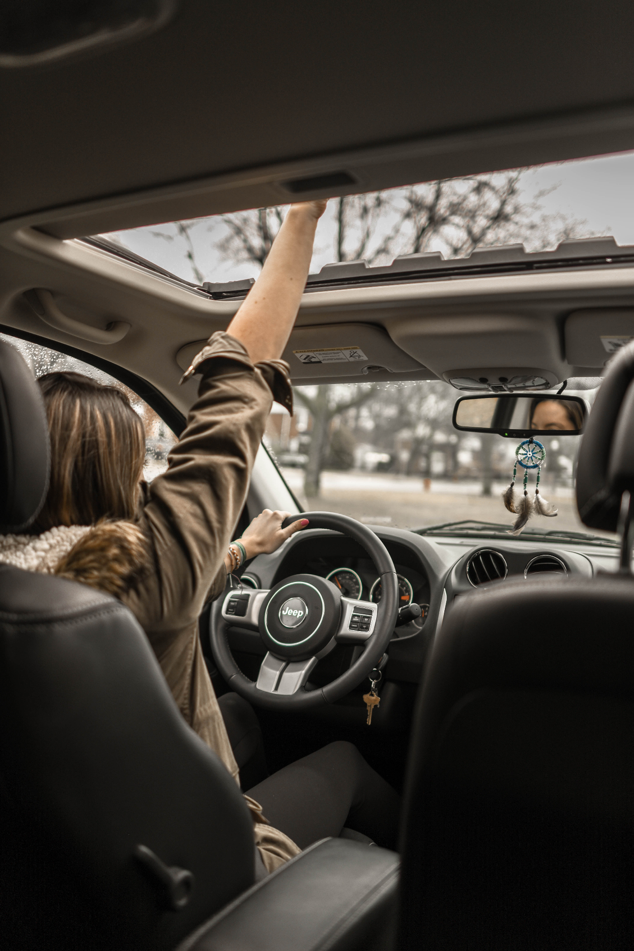
02
Meet Amber Jones.
TARGET
Amber
is on Summer Break!
Here you can describe the topic of the section
LUCKY!

Slide 4
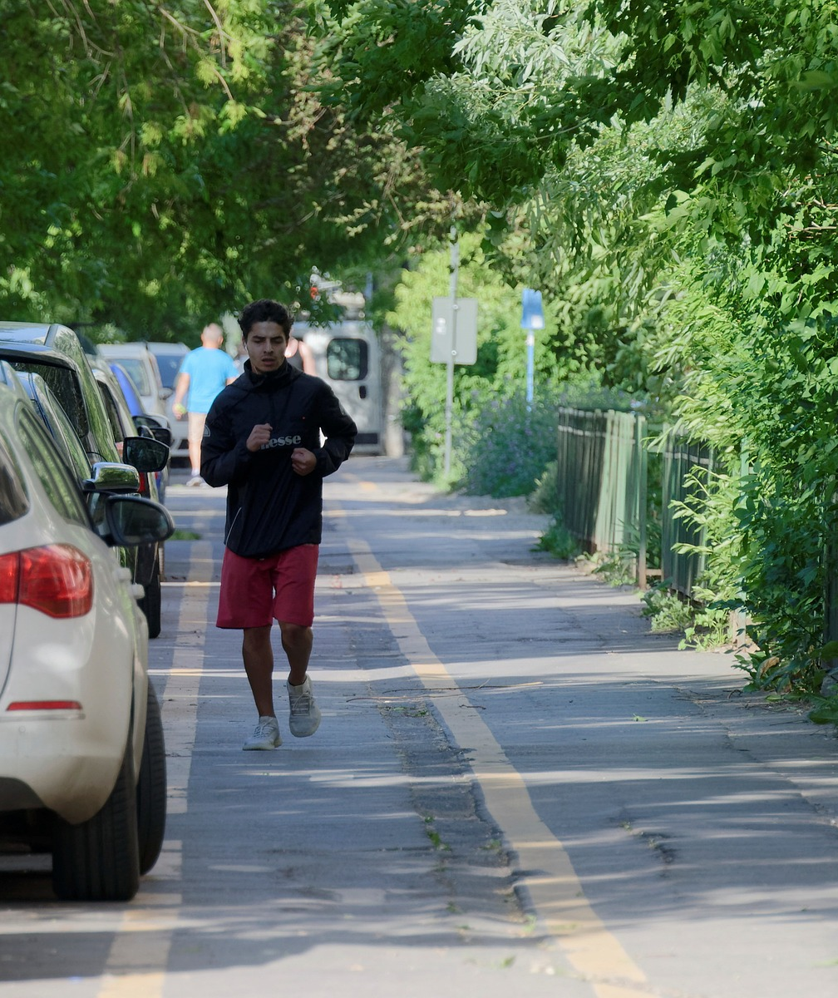
This is Daniel.
Amber and Daniel are friends.

Slide 5
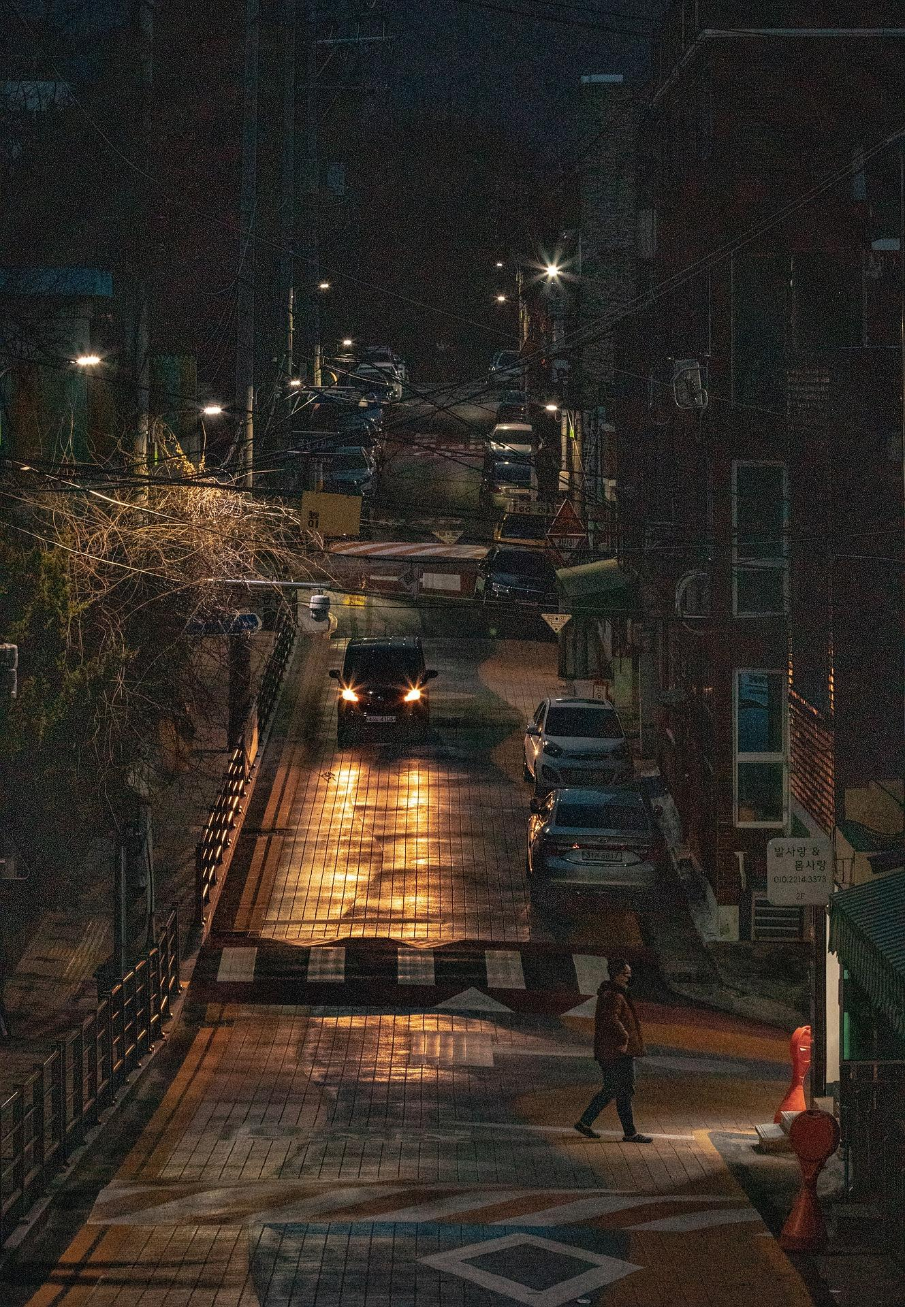
Amber and Daniel are out on the night of July 6, 2018.

Slide 6
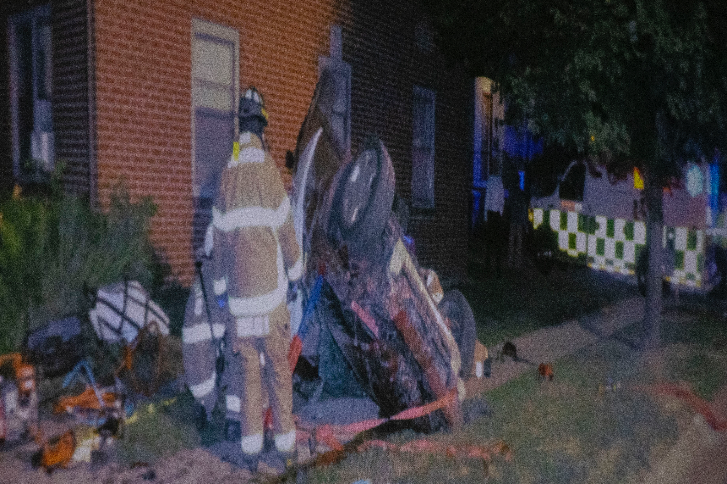
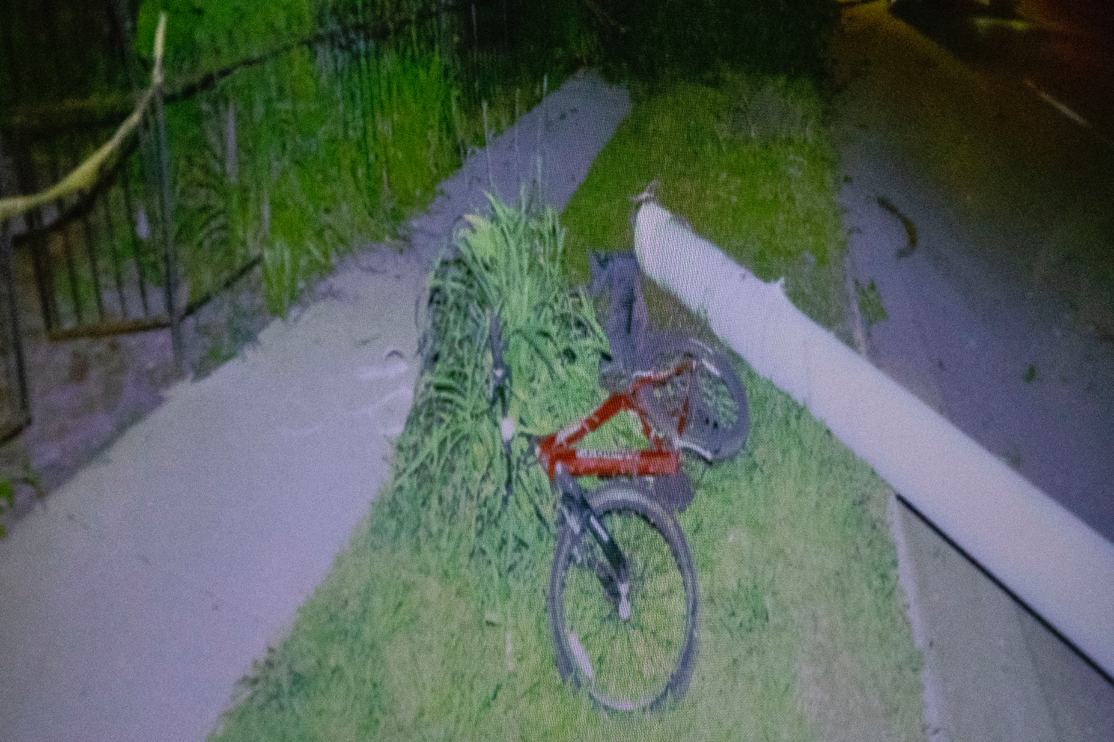
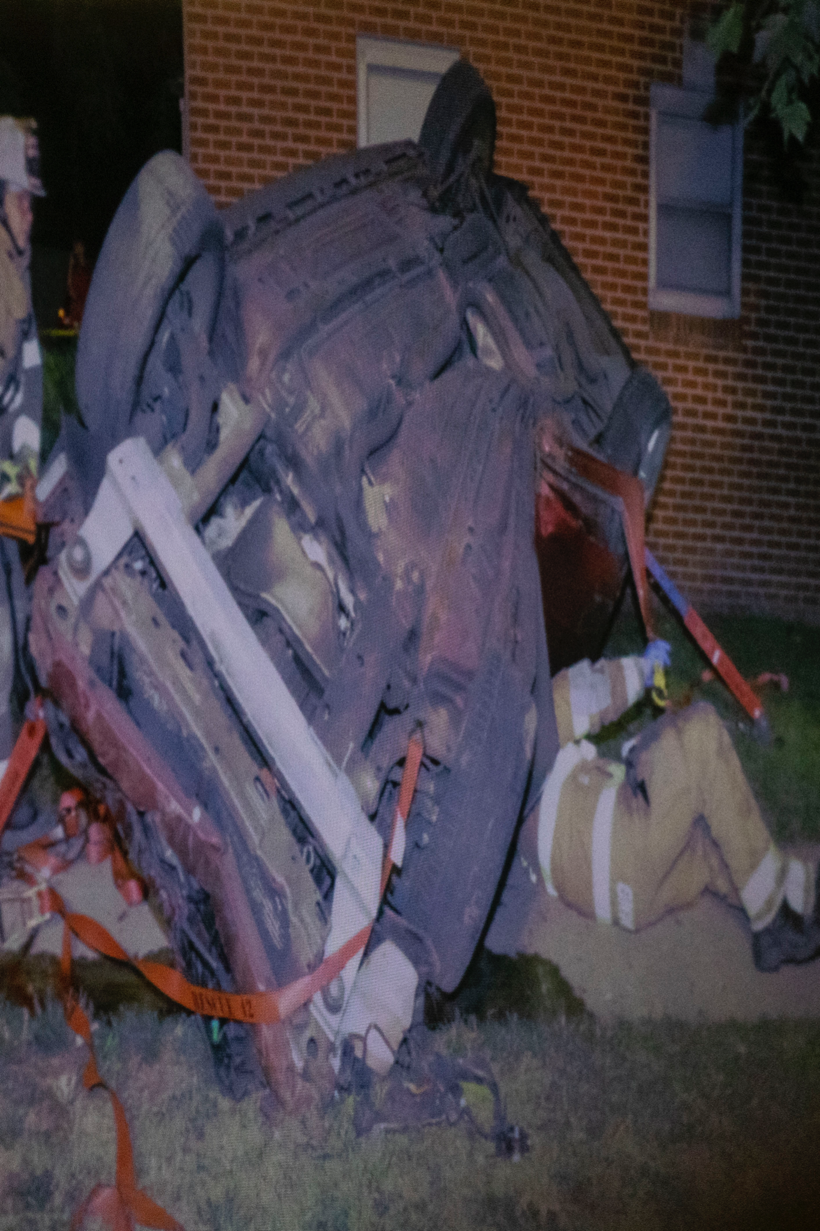
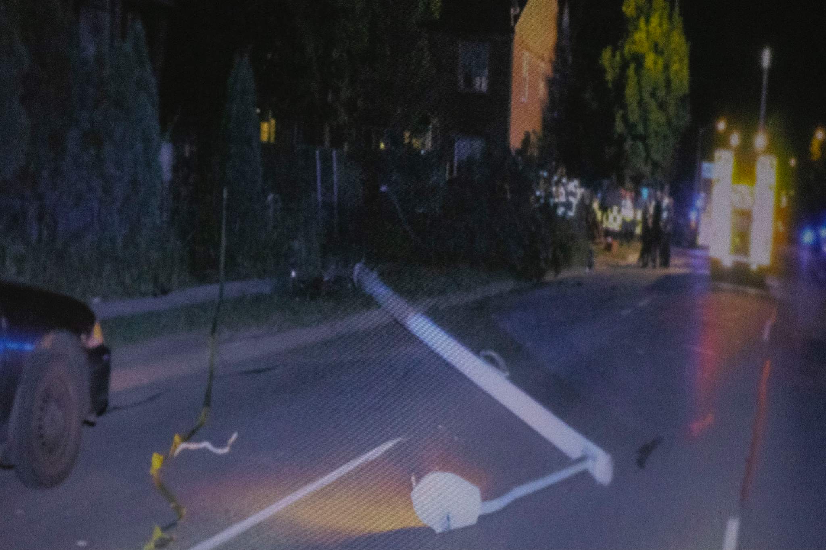
What questions are you asking at this point?

Slide 7
Read the Facts of the Case and discuss with your partner. You should both be able to describe the crash and how the evidence supported a conviction.
— Think Like the Jury

Slide 8

Before you analyze the appeal (and the potential errors of law), discuss your personal opinions on this case.
Opinions
— Think Like Yourself (go ahead and get it out of the way so you can be unbiased when you need to be!)

Slide 9

In order to appeal her conviction, Amber must claim that there has been an Error of Law
JUPITER
VENUS
It is different from factual errors (such as believing the evidence was inaccurate).
The jury is the trier of fact and decides what they believe to be the truth.
Disagreeing with the jury’s verdict is not a valid reason for appeal.
An error of law is a mistake in which the law was not applied properly.
Example: An error of law could be something the judge did incorrectly at trial.
It’s a gas giant and the biggest planet in the Solar System
Venus has a very poisonous atmosphere

Slide 10


With your partner, decide which of these are EXAMPLES of Errors of Law and which are NON-EXAMPLES.
— Think Like an Attorney!
5. Claiming the sentence is “cruel and unusual punishment” for a 1st time offender, because it is so long.
1. Claiming that the defendant is innocent and the jury made a major mistake.
2. Claiming the jury overheard the bailiff talking about the evidence with the judge in the hallway when the trial was in recess.
4. Claiming the expert witness for the defense had more experience and knowledge than the prosecution’s witness.
3. Claiming the judge should have excluded the blood test (toxicology) evidence because police did not have a search warrant.

Slide 11
Were you right?
EXAMPLES of Errors of Law and NON-EXAMPLES:
Claiming that the defendant is truly innocent and a major miscarriage of justice has taken place.
Claiming the jury overheard the bailiff talking about the evidence with the judge in the hallway when the trial was in recess.
Claiming the judge should have excluded the blood test (toxicology) evidence because police did not have a warrant.
Claiming the expert witness for the defense had more experience and knowledge than the prosecution’s witness.
Claiming the punishment amounts to “cruel and unusual punishment.”

Slide 12
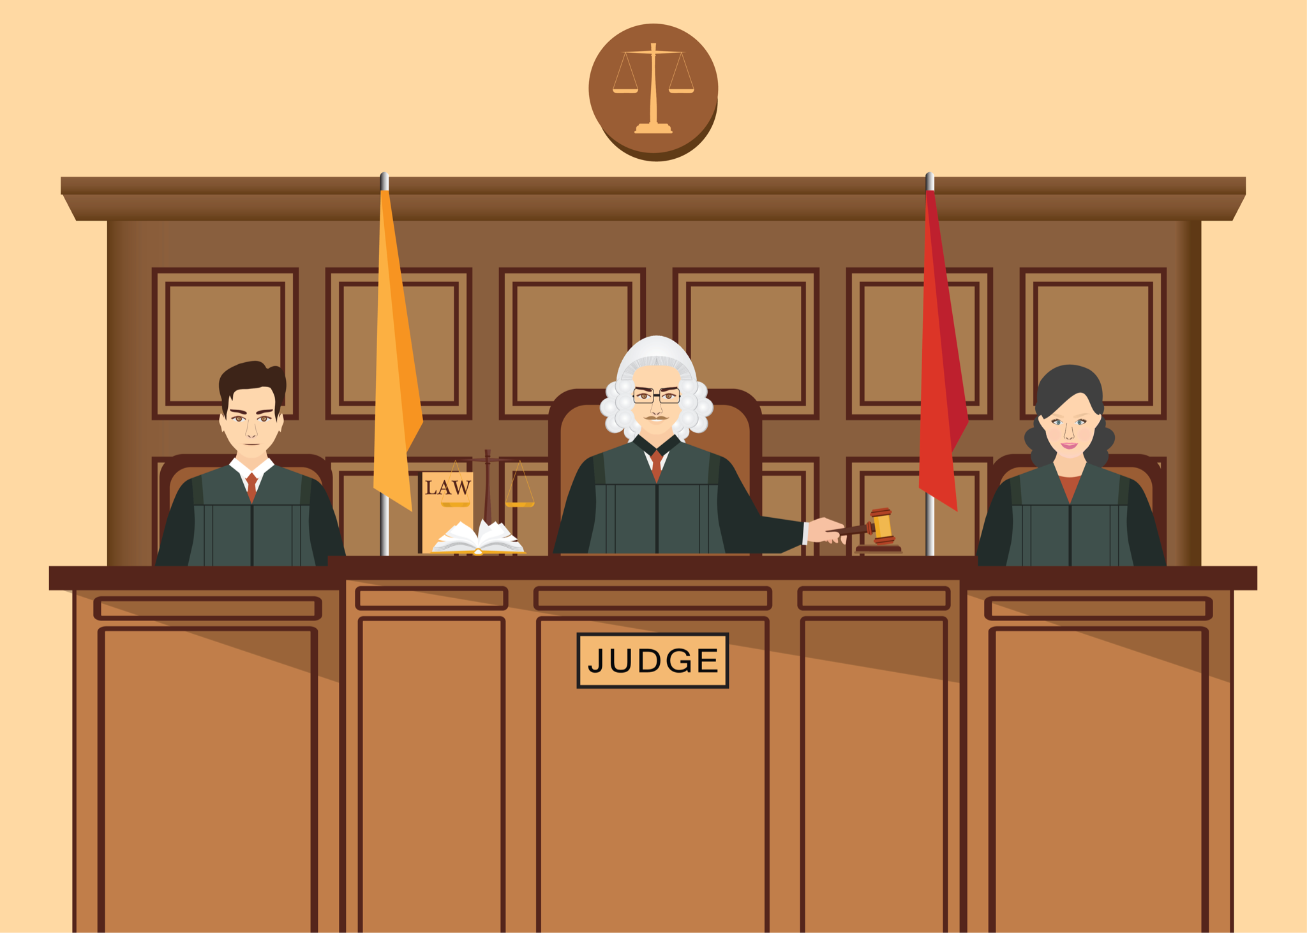
Now, you will evaluate Amber’s claims on Appeal. She is claiming 4 separate Errors of Law in her case.
Court of Appeals
— Think Like a Judge on the Court of Appeals

Slide 13

4th Amend.
Error
4th Amendment Unreasonable Search and Seizure violation because she did not consent to the blood draw for the blood alcohol (toxicology) test.

Slide 14

4th Amend.
Error
4th Amendment Unreasonable Search and Seizure violation because the data in the Event Data Recorder (a.k.a. “Black box”) in her car was her personal property and was obtained without a warrant.

Slide 15
6th Amend.
Error
6th Amendment Confrontation Clause violation, claiming that the data from the Event Data Recorder (a.k.a. “black box”) in her car equals inadmissible hearsay and that there is no way to cross-examine the computer-generated report used at trial.

Slide 16
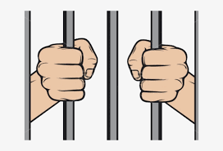
8th Amend.
Error
8th Amendment Cruel and Unusual Punishment for the sentence of 25 years.
(See also: Article I, Section 13 of the Texas Constitution)

Slide 17
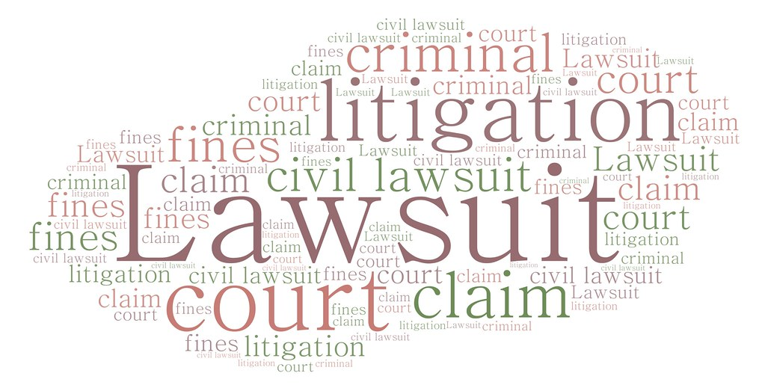
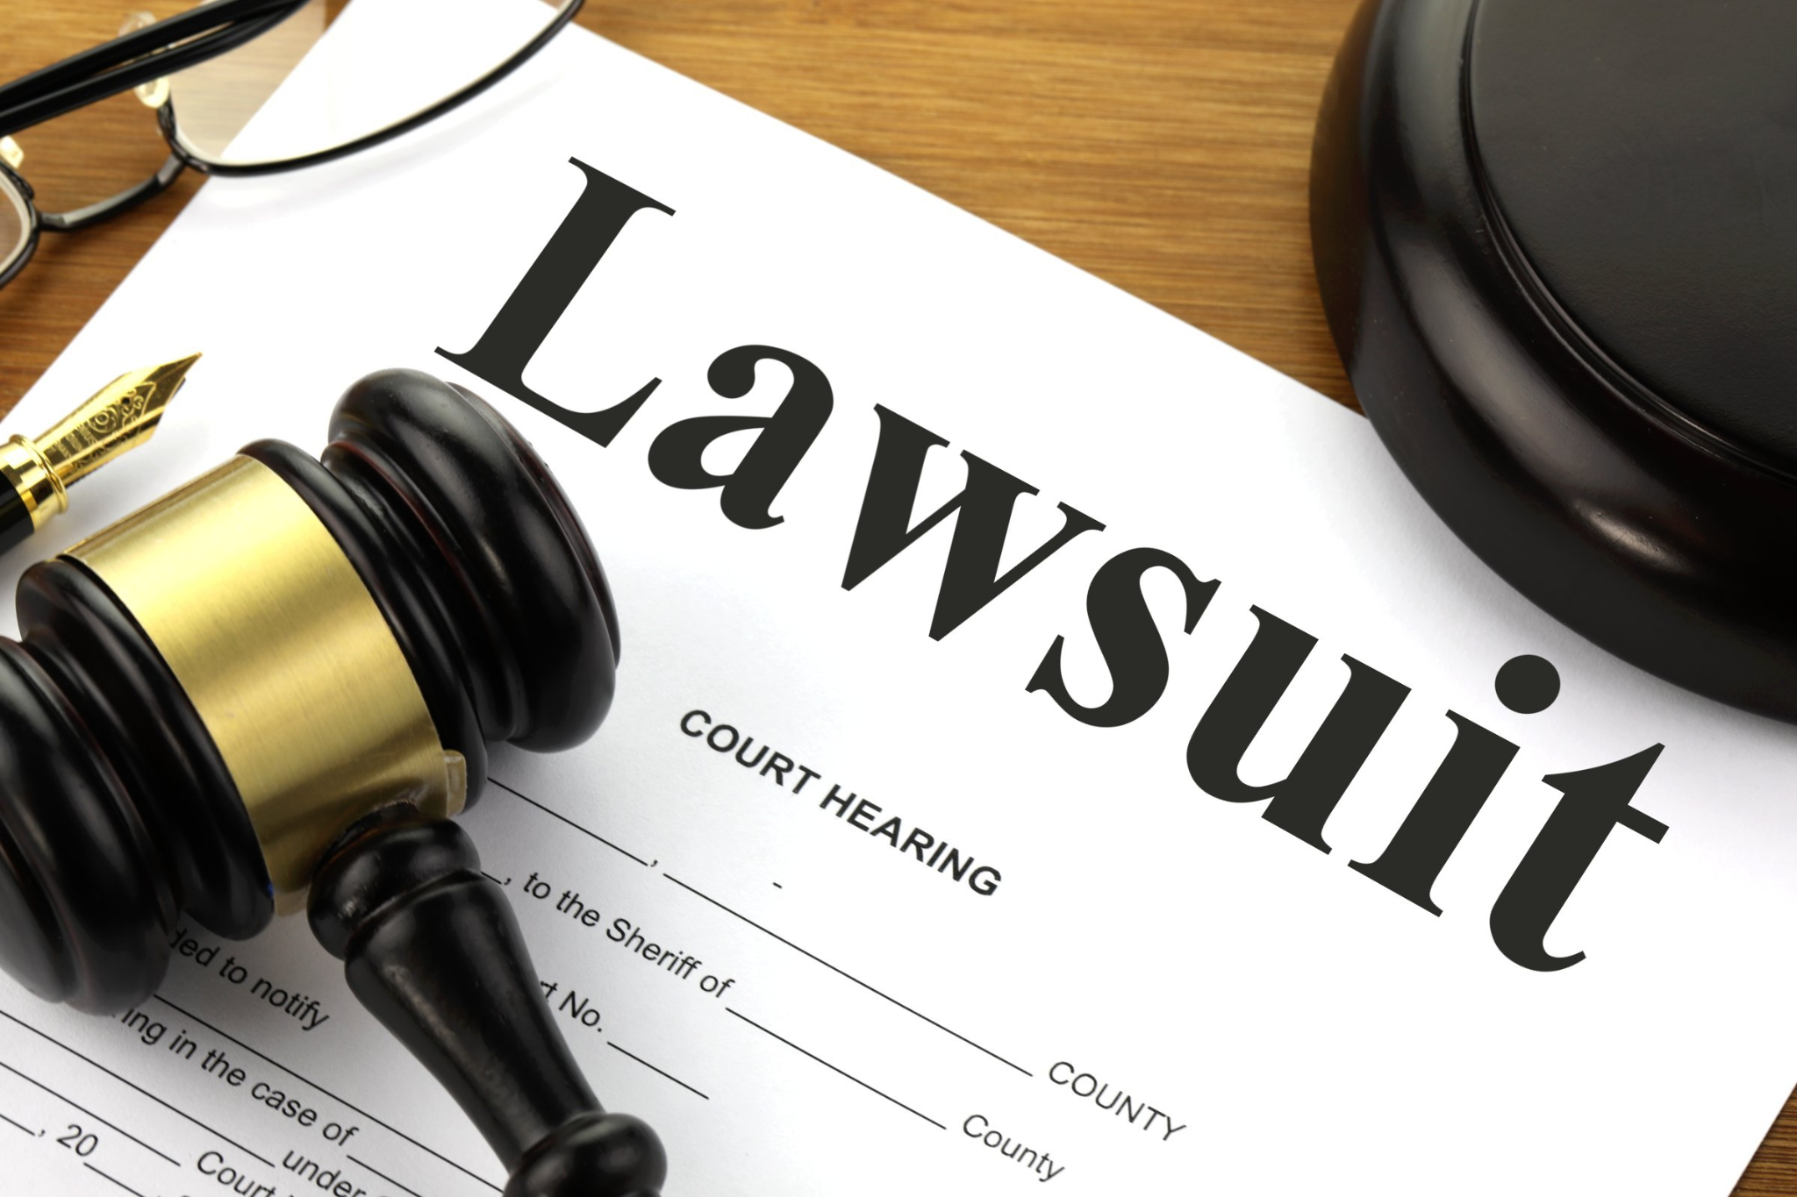
Side Note: Amber is also being sued for $1.2 million by Edgar Lewis (injured) and for $3 million by the parents of Daniel Smith (deceased). The constitutional protections above (and others like the “right to remain silent”) do not extend to civil cases where Amber is subject to depositions and discovery. The “burden of proof” in civil cases is also lower than in criminal cases.
Criminal Cases = Beyond a Reasonable Doubt [99.9%]
Civil Cases = Preponderance of the Evidence [>50%]

Slide 18
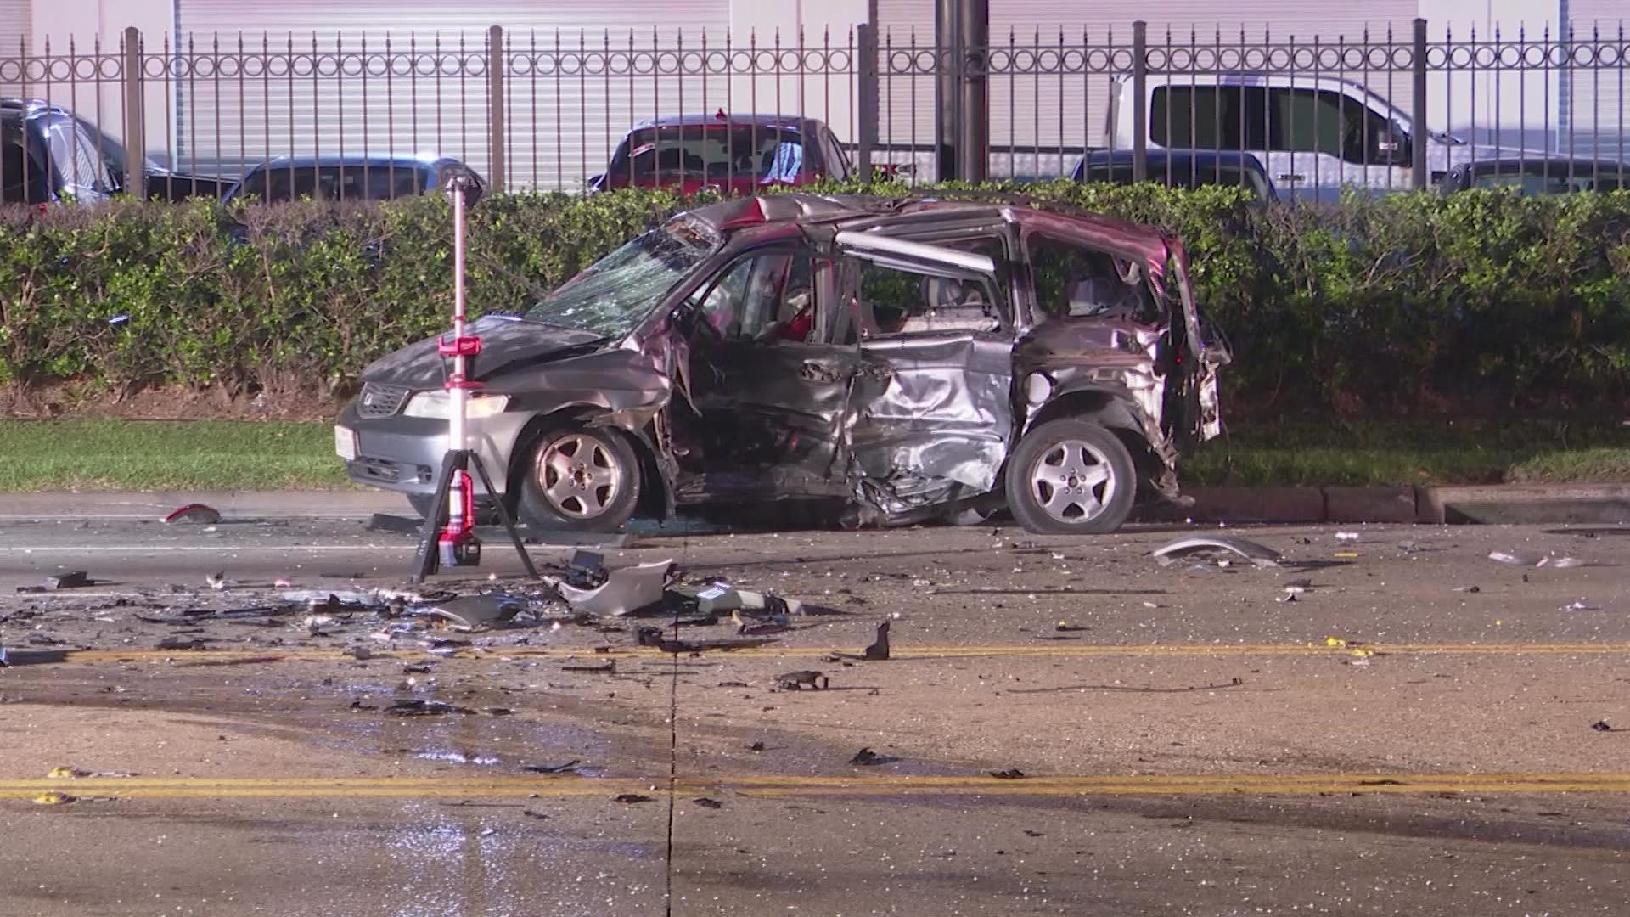
It could happen to you.
— Criminal charges, jail time, and lawsuits aren’t hypothetical outcomes.
May 2022, Harris County - Link

Slide 19
Summary: Amber is alleging the following Errors of LAW in her appeal:
4th Amendment Unreasonable Search and Seizure violation because she did not consent to the blood draw for the blood alcohol (toxicology) test.
4th Amendment Unreasonable Search and Seizure violation because the data in the Event Data Recorder (a.k.a. “Black box”) in her car was her personal property and was obtained without a warrant.
6th Amendment Confrontation Clause violation, claiming that the data from the Event Data Recorder (a.k.a. “black box”) in her car equals inadmissible hearsay and that there is no way to cross-examine the computer-generated report used at trial.
8th Amendment Cruel and Unusual Punishment for the sentence of 25 years. (See also: Article I, Section 13 of the Texas Constitution)

Slide 20
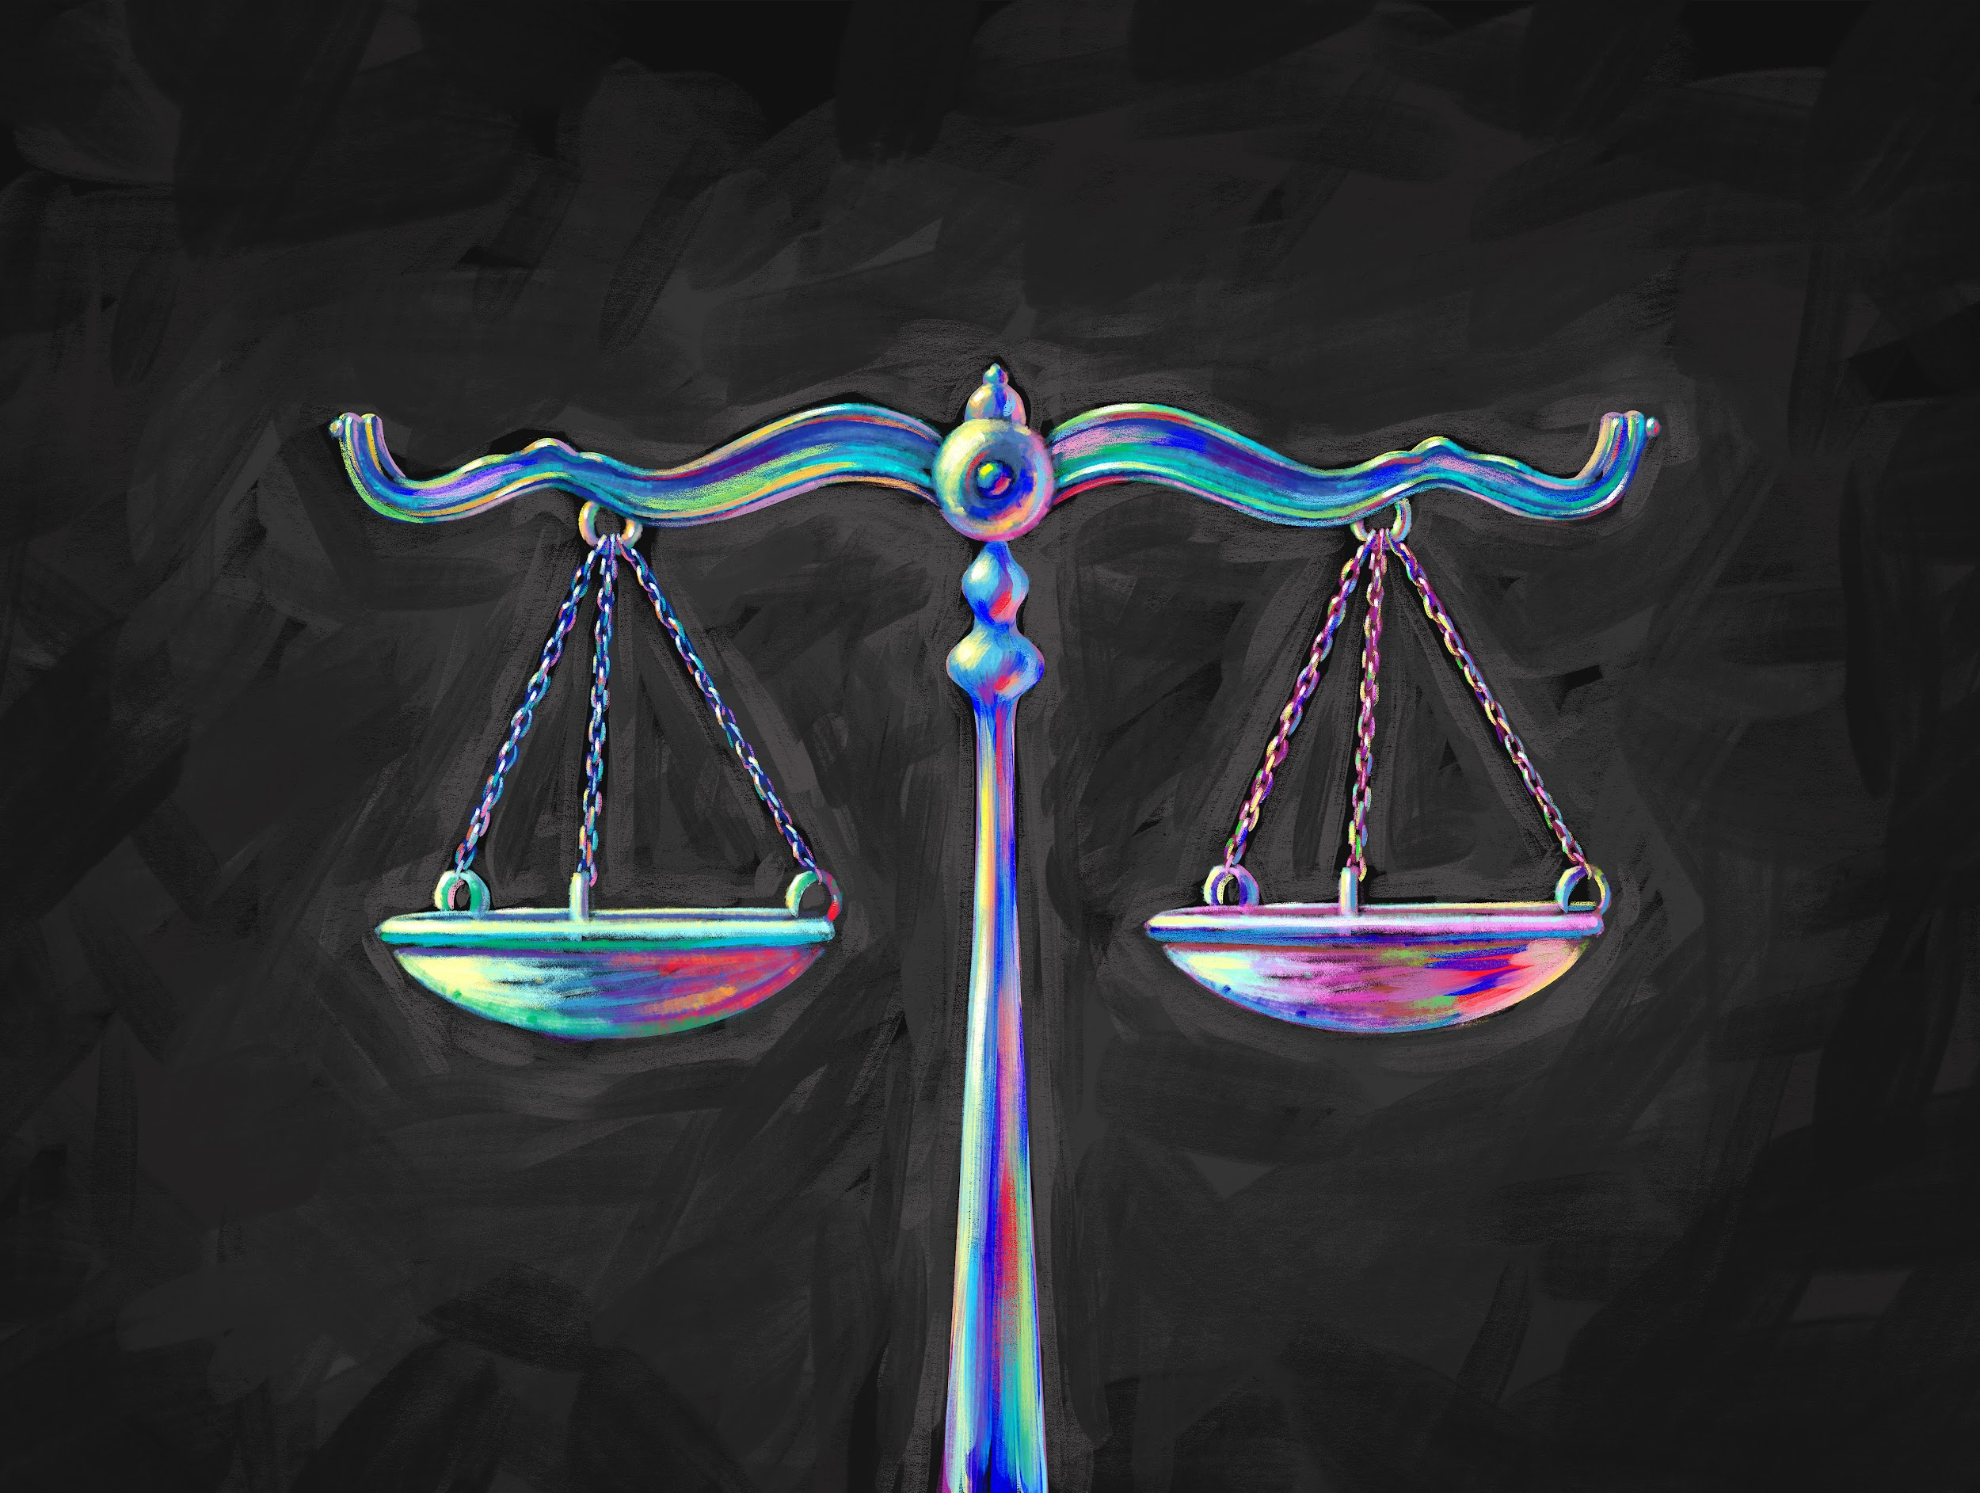
With your partner, discuss the 4 issues that form the basis for Amber’s appeal. Be prepared to use the information in the legal background to support your decisions regarding each ERROR/Question of Law!

