Slide 1
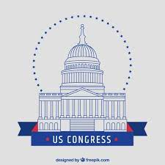

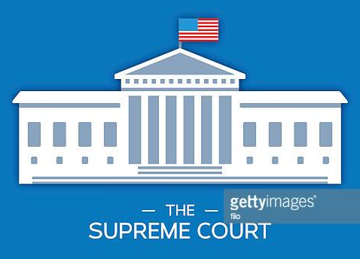
Administrative Office of the United States Courts
Legislative
Executive
Judicial
Architect of the Capitol
Consumer Product & Safety Commission
Territorial Courts
Equal Employment Opportunity Commission
Government Accountability Office
United States Court of Appeals for Armed Forces
5th Circuit Court of Appeals
Central Intelligence Agency
Federal Housing Finance Agency
Office of Management & Budget
Office of Special Counsel
Library of Congress
National Security Council
BREAKOUT ROOM #1
Department of Transportation
Appropriations Committee
Select Committee on Intelligence
Government Publishing Office
Department of Justice
Federal Election Committee

Slide 2
Administrative Office of the United States Courts
Legislative
Executive
Judicial
Architect of the Capitol
Consumer Product & Safety Commission
Territorial Courts
Equal Employment Opportunity Commission
Government Accountability Office
United States Court of Appeals for Armed Forces
5th Circuit Court of Appeals
Central Intelligence Agency
Federal Housing Finance Agency
Office of Management & Budget
Office of Special Counsel
Library of Congress
National Security Council
BREAKOUT ROOM #2
Department of Transportation
Appropriations Committee
Select Committee on Intelligence
Government Publishing Office
Department of Justice
Federal Election Committee

Slide 3
Administrative Office of the United States Courts
Legislative
Executive
Judicial
Architect of the Capitol
Consumer Product & Safety Commission
Territorial Courts
Equal Employment Opportunity Commission
Government Accountability Office
United States Court of Appeals for Armed Forces
5th Circuit Court of Appeals
Central Intelligence Agency
Federal Housing Finance Agency
Office of Management & Budget
Office of Special Counsel
Library of Congress
National Security Council
BREAKOUT ROOM #3
Department of Transportation
Appropriations Committee
Select Committee on Intelligence
Government Publishing Office
Department of Justice
Federal Election Committee

Slide 4
Administrative Office of the United States Courts
Legislative
Executive
Judicial
Architect of the Capitol
Consumer Product & Safety Commission
Territorial Courts
Equal Employment Opportunity Commission
Government Accountability Office
United States Court of Appeals for Armed Forces
5th Circuit Court of Appeals
Central Intelligence Agency
Federal Housing Finance Agency
Office of Management & Budget
Office of Special Counsel
Library of Congress
National Security Council
BREAKOUT ROOM #4
Department of Transportation
Appropriations Committee
Select Committee on Intelligence
Government Publishing Office
Department of Justice
Federal Election Committee

Slide 5
Administrative Office of the United States Courts
Legislative
Executive
Judicial
Architect of the Capitol
Consumer Product & Safety Commission
Territorial Courts
Equal Employment Opportunity Commission
Government Accountability Office
United States Court of Appeals for Armed Forces
5th Circuit Court of Appeals
Central Intelligence Agency
Federal Housing Finance Agency
Office of Management & Budget
Office of Special Counsel
Library of Congress
National Security Council
BREAKOUT ROOM #5
Department of Transportation
Appropriations Committee
Select Committee on Intelligence
Government Publishing Office
Department of Justice
Federal Election Committee

Slide 6
Administrative Office of the United States Courts
Legislative
Executive
Judicial
Architect of the Capitol
Consumer Product & Safety Commission
Territorial Courts
Equal Employment Opportunity Commission
Government Accountability Office
United States Court of Appeals for Armed Forces
5th Circuit Court of Appeals
Central Intelligence Agency
Federal Housing Finance Agency
Office of Management & Budget
Office of Special Counsel
Library of Congress
National Security Council
BREAKOUT ROOM #6
Department of Transportation
Appropriations Committee
Select Committee on Intelligence
Government Publishing Office
Department of Justice
Federal Election Committee

Slide 7
Administrative Office of the United States Courts
Legislative
Executive
Judicial
Architect of the Capitol
Consumer Product & Safety Commission
Territorial Courts
Equal Employment Opportunity Commission
Government Accountability Office
United States Court of Appeals for Armed Forces
5th Circuit Court of Appeals
Central Intelligence Agency
Federal Housing Finance Agency
Office of Management & Budget
Office of Special Counsel
Library of Congress
National Security Council
BREAKOUT ROOM #7
Department of Transportation
Appropriations Committee
Select Committee on Intelligence
Government Publishing Office
Department of Justice
Federal Election Committee

Slide 8
Administrative Office of the United States Courts
Legislative
Executive
Judicial
Architect of the Capitol
Consumer Product & Safety Commission
Territorial Courts
Equal Employment Opportunity Commission
Government Accountability Office
United States Court of Appeals for Armed Forces
5th Circuit Court of Appeals
Central Intelligence Agency
Federal Housing Finance Agency
Office of Management & Budget
Office of Special Counsel
Library of Congress
National Security Council
BREAKOUT ROOM #8
Department of Transportation
Appropriations Committee
Select Committee on Intelligence
Government Publishing Office
Department of Justice
Federal Election Committee

Slide 9
Administrative Office of the United States Courts
Legislative
Executive
Judicial
Architect of the Capitol
Consumer Product & Safety Commission
Territorial Courts
Equal Employment Opportunity Commission
Government Accountability Office
United States Court of Appeals for Armed Forces
5th Circuit Court of Appeals
Central Intelligence Agency
Federal Housing Finance Agency
Office of Management & Budget
Office of Special Counsel
Library of Congress
National Security Council
BREAKOUT ROOM #9
Department of Transportation
Appropriations Committee
Select Committee on Intelligence
Government Publishing Office
Department of Justice
Federal Election Committee

Slide 10
Administrative Office of the United States Courts
Legislative
Executive
Judicial
Architect of the Capitol
Consumer Product & Safety Commission
Territorial Courts
Equal Employment Opportunity Commission
Government Accountability Office
United States Court of Appeals for Armed Forces
5th Circuit Court of Appeals
Central Intelligence Agency
Federal Housing Finance Agency
Office of Management & Budget
Office of Special Counsel
Library of Congress
National Security Council
BREAKOUT ROOM #10
Department of Transportation
Appropriations Committee
Select Committee on Intelligence
Government Publishing Office
Department of Justice
Federal Election Committee

Slide 11
Legislative
Executive
Judicial
On the following slides, sort the various descriptores to the correct corresponding branch of government.
Government of the United States

