Slide 1

Opening Statements & Closing Arguments
Preparing for a Winning Mock Trial

Slide 2

First & Last Impressions
Opening Statements and Closing Arguments are one of the most important elements of a successful mock trial.
The first and last thing that the jury hears about your case will leave the biggest impression on them. This is likely what they will remember most as they begin their deliberations.

Slide 3
Rule #1:
Tell the Best Story
Telling the best story can help win your case! Remember, the jury should have no previous knowledge of the case.
Introduce the cast of characters
Lay the foundation of events
Be clear and easy to follow
Be confident in your theory
Don’t confuse the jury! Tell them the story.

Slide 4
Opening Statements
How to Set the Stage for a Winning Mock Trial

Slide 5
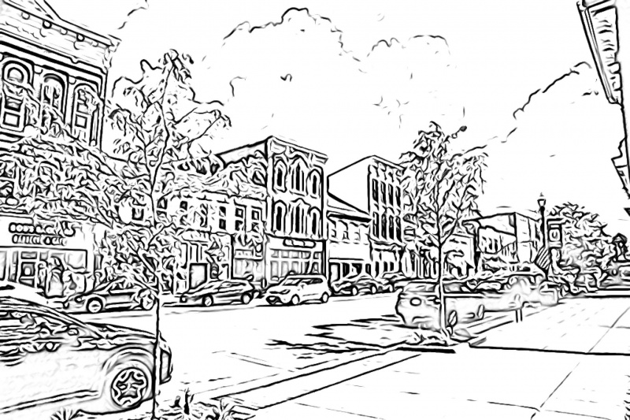
Prosecution
This is the opportunity to give the jury the FULL PICTURE.
Defense
Paints the picture to provide evidence of guilt, the context for motive, and details about the elements of the crime
Paints the picture to provide exculpatory evidence, alternative theories, raise doubt, or discuss mitigating factors

Slide 6
Prosecution
This is the opportunity to give the jury the FULL PICTURE.
Defense
“Gruesome”
“Premeditated”
“Negligent”
“Reckless”
“Shocking”
“Desperate”
“Unfortunate”
“Accidental”
“Unlucky”
“Stressful”
“Regrettable”
“Troubled”

Slide 7
Building a Narrative
Damage Control
Witnesses
What you expect the other side to present & how the jury should interpret it
Testimony that will support your theory
1
2
3
4
5
Events: What Happened?
Evidence
Verdict Desired
Evidence that will be introduced to prove your theory
Your theory of the events
How should the jury rule in this case?

Slide 8
Tip:
Choose a theme or catch phrase and repeat it often for dramatic effect. Examples:
  “It could’ve happened to anyone.”
  “He was at the wrong place at the wrong time.”
  “If it doesn’t fit, you must acquit.”
  “Until death do us part.”
  “One beer never hurt anyone, he said…”

Slide 9
The Case
Each witness and key piece of evidence are important pieces of a larger puzzle:
Step 1 in your narrative is to give the jury a preview of the big picture, your theory of the events…
Then explain how the pieces fit together with the witnesses and evidence

Slide 10
The Case
Each witness and key piece of evidence are important pieces of a larger puzzle:
Steps 2 & 3 are kind of like “paint-by-number”
Fill in the details with the witnesses and evidence that you will be presenting as part of your case
Remember: You only have the mock trial materials to work with. Don’t embellish something that would alter a material fact of the case!

Slide 11
The Case
Each witness and key piece of evidence are important pieces of a larger puzzle:
Step 4 is to discuss witnesses and evidence that the opposing side will bring up.
You don’t need to address everything; consider what information you’d rather tell the jury yourself (so you can “get ahead of it”)
By addressing detrimental facts first, you can potentially sway how the jury interprets that information

Slide 12
The Case
Each witness and key piece of evidence are important pieces of a larger puzzle:
Step 5: Be clear and confident in telling the jury what verdict you want/expect and which verdict is the “right choice” for them to make at the end of the trial.

Slide 13
Other Tips
Refer back to the theme or catch phrase to tie your case together.
  “One beer never hurt anyone, he said…”

Slide 14
Other Tips
Starting in your Opening Statement (and throughout the trial), remember to use simple language to avoid confusing the jury.
For example, Prosecutors will refer to “the Defendant,” whereas the Defense Attorney will call him/her “Casey” or Ms. Bryant.
By painting a portrait of each opposing witness with your own brush strokes, you may affect how the jury views that witness’s testimony when they take the stand.

Slide 15
And Don’t Forget
Rule #1: :
Tell the Best Story

Slide 16
Opening Statements & Closing Arguments are two of your best opportunities to address the jury!
Don’t treat them as formalities that sit at the start and end of your mock trial.

Slide 17
Closing Arguments
A winning Closing Argument is not just a mirror image of your Opening Statement.
Its purpose is persuasive; it should be convincing and emotionally charged.

Slide 18
Closing Arguments
Closing arguments must:
Summarize the facts that support your case
Summarize favorable testimony
Make the legal argument & show how the facts & testimony meets the law’s requirement
Move the jury (the trier of fact) to a favorable verdict

Slide 19
Closing Arguments
Remember your theme or catch phrase & refer back to it often for dramatic effect. Examples:
“It could’ve happened to anyone.”
“He was at the wrong place at the wrong time.”
“If it doesn’t fit, you must acquit.”
“Until death do us part.”
“One beer never hurt anyone, he said…”

Slide 20
Closing Arguments
And Don’t Forget
Rule #1: :
Tell the Best Story

Slide 21
The Jury is the Trier of Fact
Lastly, at the end of the day, the jury is the trier of fact. This means that they will determine the facts in a case and what is relevant to deciding the outcome (or verdict). This is one reason why connecting with the jury during your Opening and Closing is so important.
NOTE: In a “bench trial,” the judge would be the trier of fact and no jury would be present.

