Slide 1
How to Qualify an Expert
*Disclaimer: the information found in this material is intended for mock trial use in the classroom only.
DRSR - TTSA Lesson Plan Presentation
July 12-14, 2022
Cory Cummings & Debbie Keen

Slide 2
Expert Testimony for
a Mock Trial
What Is an Expert?
Why Do They Matter?
How Do You Qualify Them for Mock Trial?

Slide 3


What is an Expert Witness?
Notes:
What is an Expert: https://www.youtube.com/watch?v=Wl92bHtrOvA (2:25 min.)

Slide 4
Let’s take a look at your worksheet. Match the expert to the case best suited
for them.

Slide 5
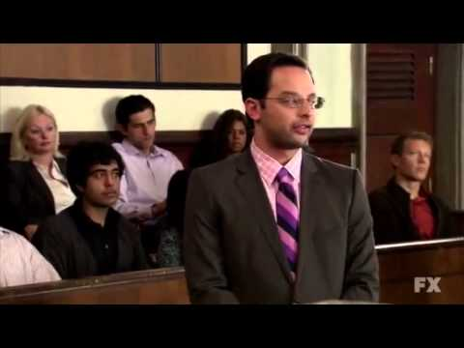
What it shouldn’t look like…
What was wrong with that?
Notes:
The League - FX https://www.youtube.com/watch?v=swu3NqyxACY

Slide 6

Why do expert witnesses Matter?
Qualifying a witness as an expert frees them from several hearsay, opinion, and/or speculation objections during a court proceeding.
Expert witnesses help the trier of fact understand the evidence or determine a fact in issue.

Slide 7
What Would YOU
Ask an Expert?
On your worksheet, consider what questions you might ask the individuals to prove to the court they are experts in their field…

Slide 8
Consider it in action…
Who Decides if a witness is an expert?
What are the steps to qualify a witness as an expert?
Why Does it Matter?

Slide 9
What it looks like in action
How to attempt to prove they are NOT an expert
Notes:
How to Qualify an Expert: https://www.youtube.com/watch?v=AZ1cyFy7hJQ (2:55 min)
How to DisQualify an Expert: https://www.youtube.com/watch?v=2ZikLQjkgDs (1:11 min.)

Slide 10
Congratulations, You’re Hired!
Using the link below, find an expert for your case and plan your questions to set them up as an expert witness for the court.
https://www.jurispro.com/category/traffic-highway-safety-s-45/TX

