Slide 1
Criminal vs. Civil Court
Learning Target: I will compare and contrast the elements of criminal and civil court.

Slide 2


What is the purpose of the courts?
Turn to your neighbor and discuss

Slide 3
Settle Disputes
Interpret Laws
Create expectations for future actions
Basic Functions of the Courts
1.
2.
3.

Slide 4
US Supreme Court
The court of last resort
The Federal Court Structure
US Circuit Courts of Appeal
Losing side in district court
decision can appeal
US District Courts
Considers criminal and civil cases under federal
(not state) jurisdiction

Slide 5
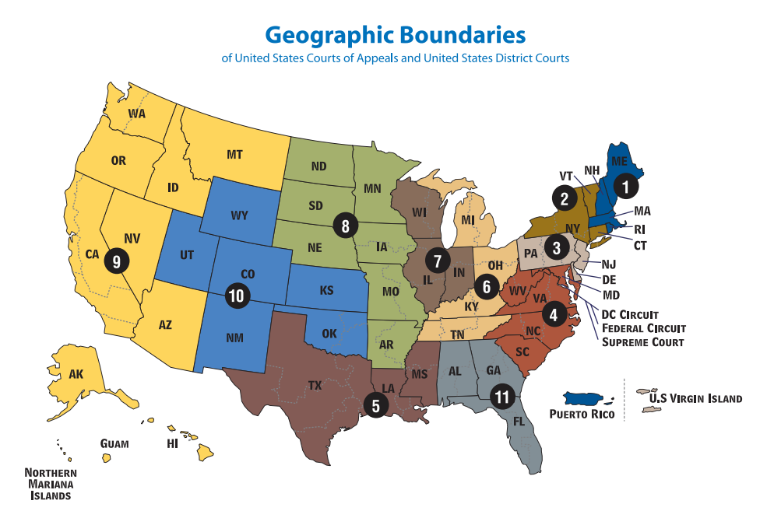

Slide 6
Trial Court vs. Appellate Court
Trial Courts hear witnesses, explore evidence, and use objections to limit what is introduced in court
Notes:
Trial courts are any courts that hear a case first, referred to as courts of original jurisdiction. A trial court makes both findings of fact and law through a full trial expounding the evidence of the case. The findings of law may be appealed to a higher court that has the power of review.

Slide 7
Trial Court vs. Appellate Court
Appellate Courts do not hear witnesses or “re-try” the case…
Instead, lawyers argue an error of law before a judge or panel of judges, who rule on the specific appeal made in a case.

Slide 8
What degree do I need to practice law if this interests me?

Slide 9
Jurisprudence is the study of law and legal philosophy
A post-graduate law school degree is called a Juris Doctorate (or a JD)

Slide 10
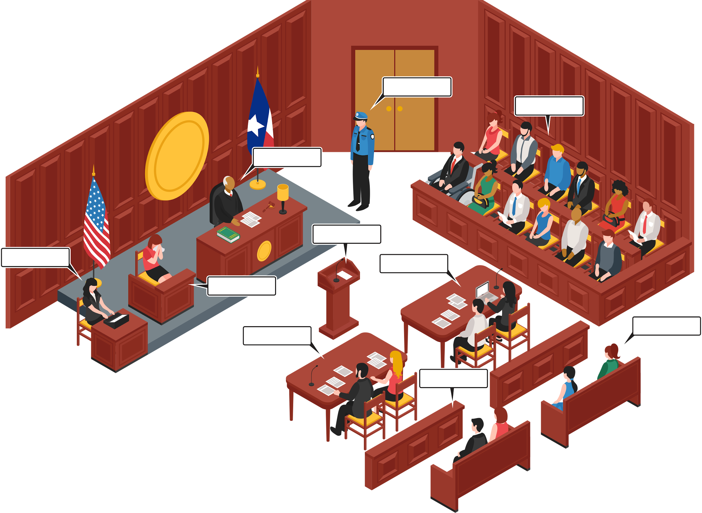
Important players in the courtroom.

Slide 11
But how do I know if I’m dealing with a CIVIL issue, or a CRIMINAL issue?
Civil Laws
Criminal Laws
regulate relations between people or groups of people (think LAWSUITS)
regulate conduct and duties owed to society. They are divided into felonies & misdemeanors; the government brings the case.

Slide 12
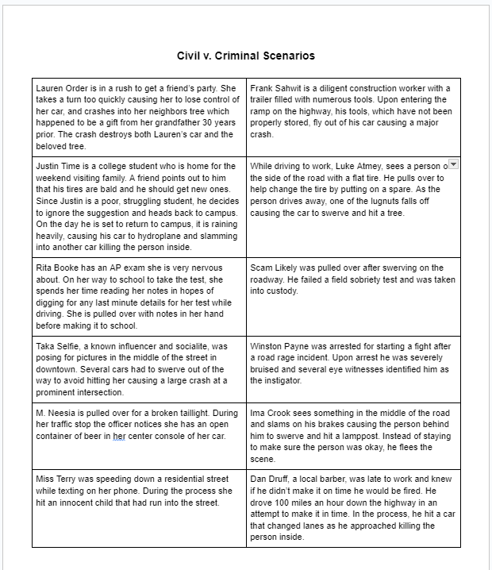
Let’s take a look…
Using the Traffic Safety Scenario Cards, sort them into Civil, Criminal, and I’m Not Sure
As you do so, note that incidents often fall into both categories. For now, pick the one you think is MOST likely.

Slide 13
Let’s take a look at your Criminal Pile…
Remember that Criminal Laws regulate conduct and duties owed to society. They are divided into felonies & misdemeanors.

Slide 14
What’s the difference between a felony and a misdemeanor
Felony
Misdemeanor
An offense punishable by a year or more in prison.
An offense punishable by up to a year in prison.

Slide 15
Looking at your CRIMINAL column,
sort them into your best guess of a felony or misdemeanor

Slide 16
Let’s Discuss
What Elements could be changed on the scenarios to place them in another column?

Slide 17

Bifurcated System
Dividing a case into two stages
Stage 1 - Liability / Guilt
Stage 2 - Damages / Punishment

Slide 18
Back to the idea of Criminal vs. Civil
What are some of the Similarities? What are some of the Differences?
Let’s take a look at some of the terminology…

Slide 19
Similarities & Differences
 | Criminal Law | Civil Law
Defined | Regulates conduct owed to so | Regulates relationships between people or groups
Burden of Proof | On the state (prosecutor), “guilty beyond a reasonable doubt” (98-99% certainty) | On the plaintiff, “preponderance of evidence” (>50% )
Punishment | Incarceration, fine, execution | Losses, damages, $$$
Protections for Defendant | Bill of Rights, no “ex post facto” law, presumption of innocence | Attorneys can demand documents, depositions, testimony of defendant, complaint may take years to reach trial
Examples | Murder, assault, theft | Consumer, employment, tax, negligence

Slide 20
Similarities & Differences
 | Criminal Law | Civil Law
Defined | Regulates conduct owed to society | Regulates relationships between people or groups
Burden of Proof | On the state (prosecutor), “guilty beyond a reasonable doubt” (98-99% certainty) | On the plaintiff, “preponderance of evidence” (>50%)
Punishment | Incarceration, fine, execution | Losses, damages, $$$
Protections for Defendant | Bill of Rights, no “ex post facto” law, presumption of innocence | Attorneys can demand documents, depositions, testimony of defendant, complaint may take years to reach trial
Examples | Murder, assault, theft | Consumer, employment, tax, negligence

Slide 21
Constitution
Case Law
Administrative Regulations
Statutes & Ordinances
What is the Source of these Laws?
The guiding principle for all laws that govern State & Federal Government
Laws created through court rulings (Written by the JUDICIAL Branch)
Made by Federal and State EXECUTIVE Agencies
Laws passed the LEGISLATIVE Branch)

Slide 22
Constitution
Case Law Example
Administrative Regulations Example
Statute Examples
Examples…
What examples of Constitutionally protected rights can you think of with traffic safety?
Whren v. US: if officers have a reasonable cause to believe a traffic violation occurred, they may stop a vehicle
Created by the Department of Transportation - example: guidelines for wearing seatbelts
Example: TX Senate Bill 1551 makes it a misdemeanor charge if you don’t identify yourself to an officer (2023)
Notes:
The unanimous Court held that as long as officers have a reasonable cause to believe that a traffic violation occurred, they may stop any vehicle.

Slide 23
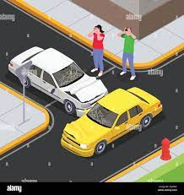
Traffic Safety Case Study…
Take a look at the Traffic Safety Case Study and decide how the incident is both a civil and criminal matter.

