Slide 1
TTSA 2023
Cory Cummings
cummingsc@friscoisd.org
Debbie Keen
keend@friscoisd.org
Ideas for Success on Your First Day of School

Slide 2
01
02
Welcome to Class!
03
04
Sign-In
Find your name plate and seat
Pick a Card
We will use these later this period
Getting to Know You
Answer the questions on your worksheet your the best of your ability
Prepare to Share
We will share answers with your peers shortly

Slide 3
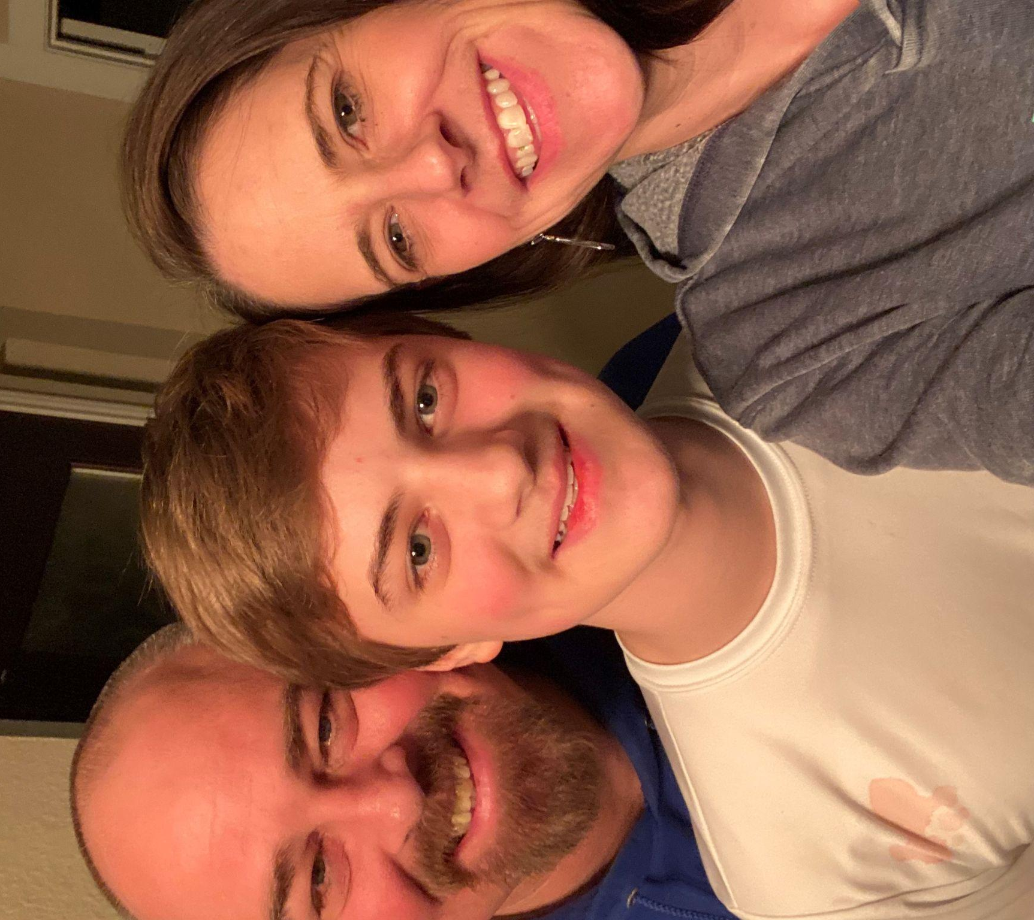
Cory Cummings
Survey of Government and Public Administration teacher at the Career & Technical Education Center in Frisco ISD
The Cummings Crew

Slide 4
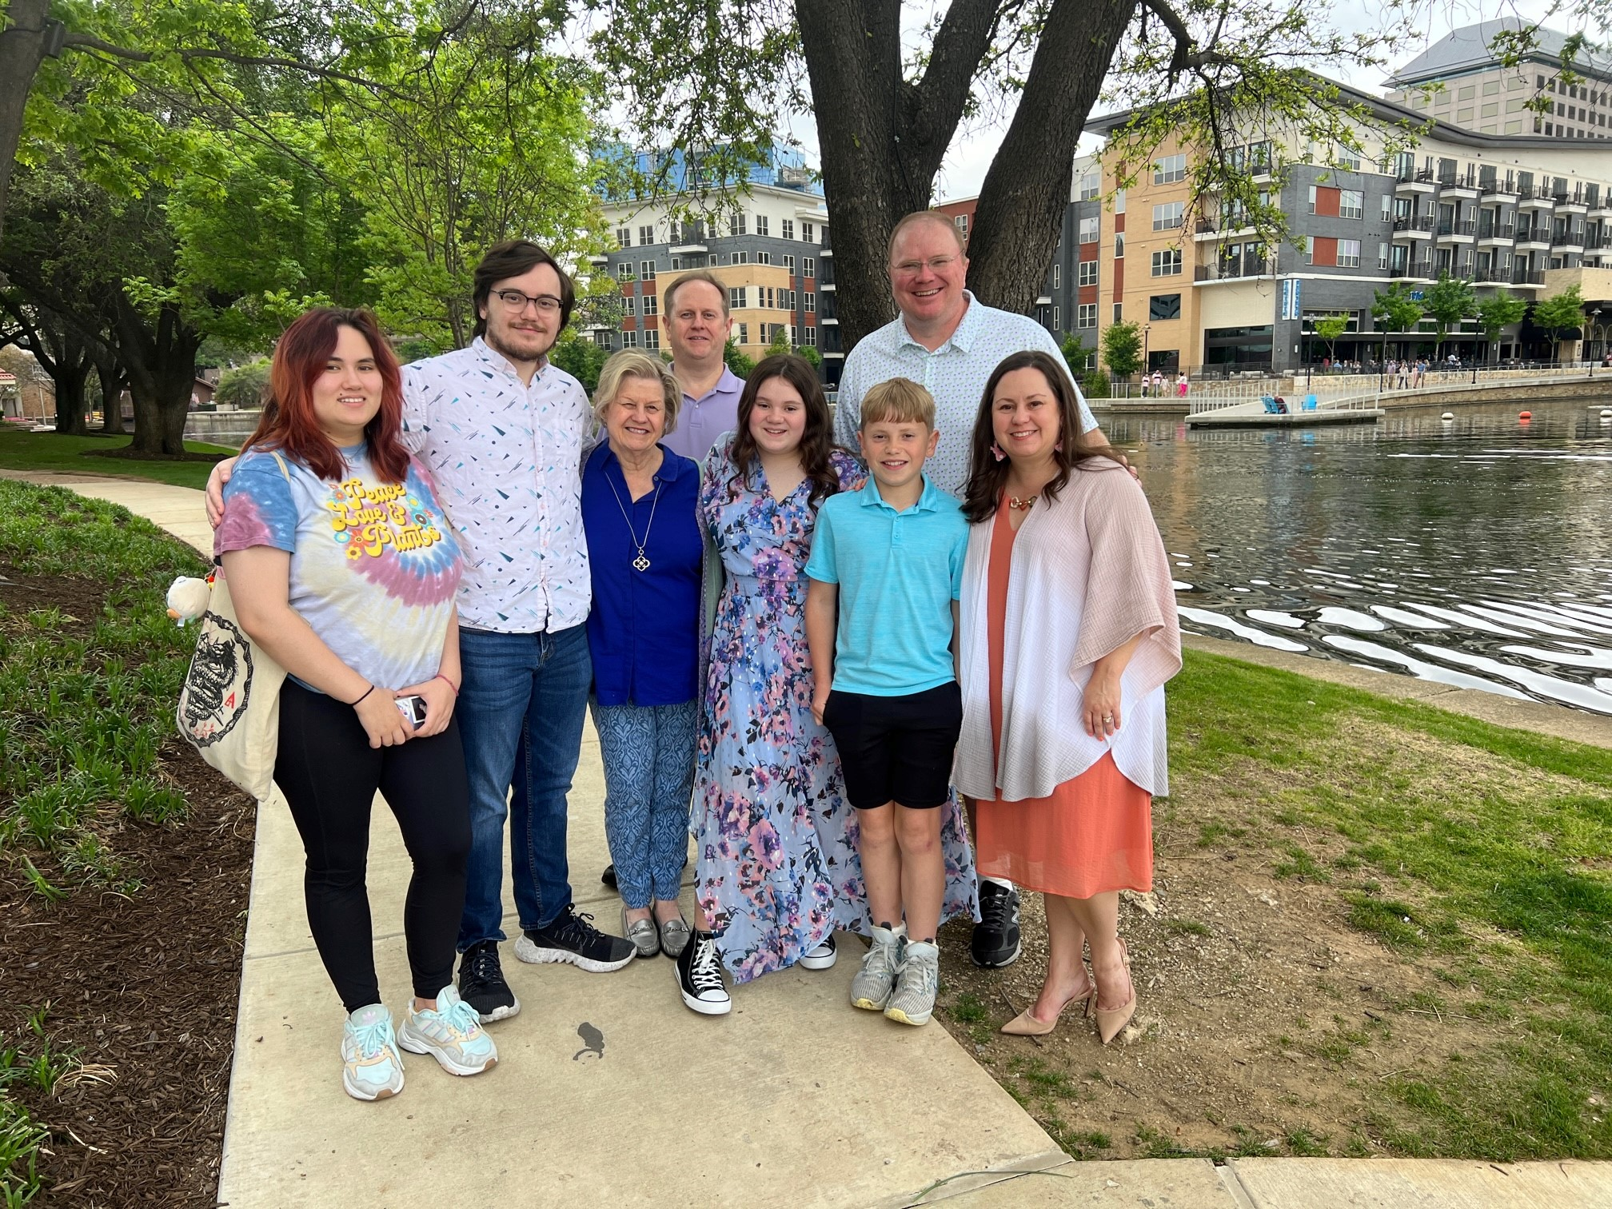
Debbie Keen
Coordinator of Federal Grant Instructional Programs

Slide 5
Which road sign depicts how you are feeling today?

Slide 6
When the music stops…
Introduce Self
Share your name, school you attended last year, and thoughts on this class so far
Make a group with the # called
Electric Cars
What was your answer to the electric car question? Share with your group
Keep talking until music plays again
Your Car
Share what type of car you would be and why

Slide 7
Meet Marvin
Read the scenario on the worksheet provided and try to save Marvin from his horrible crash.
Marvin is a terrible driver

Slide 8
Get the Life Preserver
No Hands
Save Marvin
It is found under the boat
The only object your hands can touch are the paperclips
Safely secure Marvin inside the life preserver

Slide 9
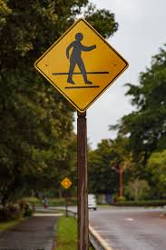
Pick a card… any card…
Find the card you were handed when you walked in. Note the font color on the text and use it to guide discussion within your group.

Slide 10
BLACK: Read the facts out loud on your card
Lead a discussion based on your color card…
RED
Which item surprises you the most
YELLOW
What questions come to mind when considering these facts
GREEN
Ideas with how to improve behaviors to keep people safe

Slide 11
Laws Teach us how to behave
What will guide us towards safe and successful behavior this year…

Slide 12
Here’s to a Great Year!
We wish you all the best!!

