Slide 1
jury trials and Traffic Safety
Name
Municipal Court (Judge/Administrator/Clerk)
City of Blank
Notes:
Good (morning/afternoon). Thank you so much for inviting me into your classroom today. My name is ____________________ and I work with our city’s municipal court.
Has anyone here ever been to our municipal court? You don’t have to tell everyone if you were in trouble! What type of issues do you think we deal with in municipal court? Okay, those are good thoughts and ideas, we’ll talk a little bit more about that in a minute.
Today we are going to spend some time talking about the trial process and how it helps increase traffic safety.

Slide 2
Introduction
Municipal Judge
  Appointed or Elected Public Officer
  Judicial Powers or Abilities
    To hear facts
    To decide
    To render judgment
    To execute the judgment
Notes:
I am the judge of the municipal court. All municipal judges are public officers, most of whom are appointed—although there are a few cities where municipal judges are elected. I was appointed by our city council. As a judge I have to do a lot of things, but some of the most important parts of my job is to preside over trials. As a judge I have the ability to hear facts as presented by the prosecution and the defense, to decide which facts and arguments are believable and whether I think the defendant committed a crime, and then I render judgment. Basically, that means that I say the defendant is guilty or whether he or she is not guilty. If the defendant is guilty, there is some penalty associated with that crime (in our case a fine) that the defendant must pay, and I need to make sure that it happens through execution of the judgment.

Slide 3
Jurisdiction
Criminal misdemeanors punishable by fine only
  No confinement
Criminal municipal ordinance cases
What types of offenses or crimes can you think of that would fall under these categories?
Notes:
I asked you earlier what type of issues you thought we dealt with. Well a shorter way to say that is: What is our Jurisdiction? It’s kind of a big word, and you all may not be terribly familiar with it, but a court’s jurisdiction basically means which problems or issues it is allowed to handle. So the municipal court has jurisdiction over criminal misdemeanors punishable by fine only. So we don’t see people accused of crimes where confinement is a part of the punishment. What does confinement mean? What does it mean if you are confined? Any thoughts? (short discussion) For our purposes we are talking about going to jail. So we don’t hear any cases that involve jail time. Now there is a possibility that you can still go to jail as a result of a fine-only misdemeanor if you don’t pay a fine, but generally we deal with crimes that are punished only by a fine. These cases can be found in state law or in an ordinance (which is a law that is passed by the city)
What types of offenses or crimes can you think of that would be fine only?
That’s good. Speeding, traffic offenses, those are state offenses. Can you think of any ordinances? Curfew?
Well, what I heard from you most (or from one person/fit to the situation) is traffic offenses. And you’re right that is the most common. Let’s talk for just a minute about traffic offenses.

Slide 4
Traffic Offenses
7.85 million new cases filed in municipal court each year
6.5 million of those cases were traffic cases
About 83% of municipal court cases are traffic cases
Why is it important to enforce our traffic laws?
Notes:
Overall, in Texas municipal courts, we see about 7.85 million new cases filed each year. But 6.5 million of those were traffic cases. So 83% percent of municipal court cases are traffic cases.
Do you think it is important to enforce these? Why?
Those are all good reasons… It keeps us safe on the roads, etc…

Slide 5

Vehicular
Homicide
Vehicular Assault
Reckless Driving
Speeding
Notes:
Let’s look at this picture. This pyramid represents traffic related crimes. At the bottom, we see speeding… This is most common of these offense as represented by the broad base of the pyramid on the screen. Now, many of you may be thinking that speeding is not a huge deal… you speed from time to time, or your parents speed, or everybody speeds. But if speeding is not enforced-- that can have a direct effect on a lot of things. Perhaps people that speed will notice that they never get stopped so they can speed a little faster… Maybe people that don’t usually speed don’t ever see enforcement so they decide it doesn’t matter and they speed a little bit, too. And so more people are speeding and speeding at higher rates of speed. This gives us a broader base of the pyramid above, and then we might see more reckless driving, vehicular assault, or heaven forbid, vehicular homicide and somebody dies because people just want to get somewhere a little bit quicker. Do you see how that might work?
Let’s have another example… Think about some of your teachers. Say you have one teacher that is a real stickler about getting to class on time. Say they keep very close track of tardiness, and report you to the office, or give you detention, etc. Do you have teachers like that? If not, imagine that you do. Now imagine that you have another teacher that isn’t really aware of people coming in late, and doesn’t keep close track of it. Which teacher probably has more people coming in late? That teacher that doesn’t enforce the tardiness might have more and more people show up late, and those late will be later and later. And then those taking their time in the hall may get into more trouble.
A reason to enforce traffic laws is not just individual deterrence, but also general deterrence: setting an example.

Slide 6
Defendant’s Options
Pay it
Driving Safety Course
Deferred Disposition
Plea Not Guilty—Go to Trial
  Bench Trial
  Jury Trial
Notes:
Let me ask all of you a question. If you received a speeding citation (or a ticket- as most people call it), do you know what all of your options are? What can you do if you get one of those?
Pay it (you can either enter a plea of guilty or no contest or just pay it, and the court will convict you and accept the money).
Driving Safety Course (do you all know what that is?) It is often referred to as defensive driving. Basically, you can take a class once a year and get your ticket dismissed (after you pay some costs and fees).
Deferred Disposition (the judge can at his discretion– if he chooses to– allow you to do something like take a DSC or do community service and stay out of trouble and then you can get your charge dismissed (after you pay some costs and fees).
Plea not guilty. If you want to fight the charge, you can plead not guilty and go to trial. This might be a bench trial or a jury trial.
A bench trial means that your case is tried before the judge alone. The judge decides guilt or innocence, issues the judgment, assesses the fine, etc. About 99% of trials in municipal court are bench trials.
So what does it mean to have a jury trial? I am sure you have seen these on TV.

Slide 7
The Right to a Jury Trial
Everyone has a right to a trial by an impartial jury
  U.S. Constitution
    6th Amendment
  Texas Constitution
    Article I, Section 10
  Code of Criminal Procedure
    Articles 1.05 and 1.12
Notes:
In Texas everyone has a right to a jury trial by an impartial jury. This is interesting and an important part of our laws. The U.S. Constitution guarantees the right to a jury trial, however that right is limited to defendants charged with offenses punishable by imprisonment for more than six months. Now, we talked about jurisdiction earlier and we know that in municipal court we don’t hear cases punishable by confinement (or imprisonment). However, in Texas, under our Texas Constitution, the right to a jury trial extends to all criminal matters, including fine-only offenses. So, we do see jury trials in municipal court.
I want you to look at that sentence up there “Everyone has a right to a trial by an impartial jury.” What does impartial mean?

Slide 8
Impartial
Favoring neither; disinterested; treating all alike; unbiased; equitable, fair, and just
Notes:
Here is a definition from the dictionary. If you are impartial you:
Favor neither (you don’t lean toward the prosecution or defense)
Disinterested doesn’t mean you don’t care, but that you don’t have an interest in the outcome. It won’t matter to you one way or the other whether they are guilty or not. That’s why you can’t sit on the jury for your Mom or husband or wife…
Treat all alike
Are unbiased
Are equitable, fair, and just
Okay. So let’s get into our activity for the day. Do you all think you can be impartial jurors? Okay you are going to form juries in groups of 6 (or as close as we can get to that)

Slide 9
Form Your Juries
Divide into groups of 6, as nearly as possible
Notes:
Juries in municipal court are made up of 6 people.
**For reinforcement after this exercise, tell the teacher of the web-based Pick six game to supplement this lesson.
You can divide them up however is easiest. Here are some suggestions:
If you have spoken to the teacher prior to your visit, you can have them grouped already. This could save some time.
You can have them count off 1-6 (or whatever number of groups is required), and then tell them to group by number
You can have them draw numbers 1-6 and then find their groups.
It is important for them to pull their chairs or desks together if possible and to separate from the other groups for deliberations.
I am giving each jury a packet. This is your packet, and not to be shared with other juries.
In the packet you will find: (1) The charge, (2) The facts, (3) The evidence in the form of testimony, and (4) A judgment form
Before you open your packets, let’s discuss a couple of things.

Slide 10
The Charge
The Defendant, stands charged by Complaint with the offense of "Speeding,” to which charge the Defendant has pleaded "Not Guilty."
A person commits an offense if that person operates a motor vehicle on a public street or highway at a speed in excess of the posted speed limit.
Notes:
What is the charge? What does this mean? This outlines the crime they are being accused of.
You will have more detailed information in the packet, but here are the basics. Read slide.

Slide 11
The Facts
The police officer pulled over the defendant for speeding saying that the speed detection device showed defendant to be traveling 51 mph in a 40 mph speed zone.
Defendant was issued a citation, and later entered a plea of not guilty.
More specific evidence and information is available in your jury packet.
Notes:
Again– What is a citation? Right. It’s a ticket.
Read slide.

Slide 12
The Punishment Range
A person guilty of this offense shall be punished by a fine of not less than one dollar ($1.00) nor more than two hundred dollars ($200.00).
Notes:
If you find this person guilty. You must assess a fine in this range.

Slide 13
Deliberations
Read your jury charges
You are the exclusive decision-makers
The burden of proof is on the State
Defendant is not required to prove innocence or produce any evidence at all
You are not to talk about this case with any person not of your jury
Take 10 minutes or so and come up with a conclusion
  Guilty or not guilty
  If guilty, what is the fine?
Notes:
It is now time to begin deliberations.
Read your jury charges.
Remember you are the decision-makers, and you make the decision.
The state needs to prove that the crime was committed (that’s is called the burden of proof).
The defendant is not required to prove innocence or produce evidence at all.
Talk about this only with your jury.
Take about 10 minutes and decide if they are guilty and assess a fine.

Slide 14
Judgment and Sentence
Was the defendant guilty?
If so, what fine did you assess?
Bring back your judgment form to me
Notes:
After you have received all of the judgments back, then you can reveal what the juries did. Write it up on the board. There are bound to be some differences. Discuss why there were differences. Were they surprised that there were differences. Then you can click forward and discuss the different pictures and facts that each group had.

Slide 15

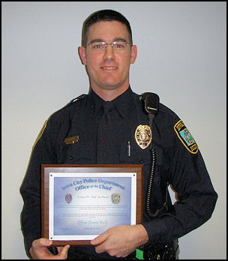
Group #1

Slide 16
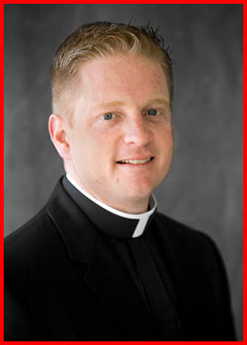
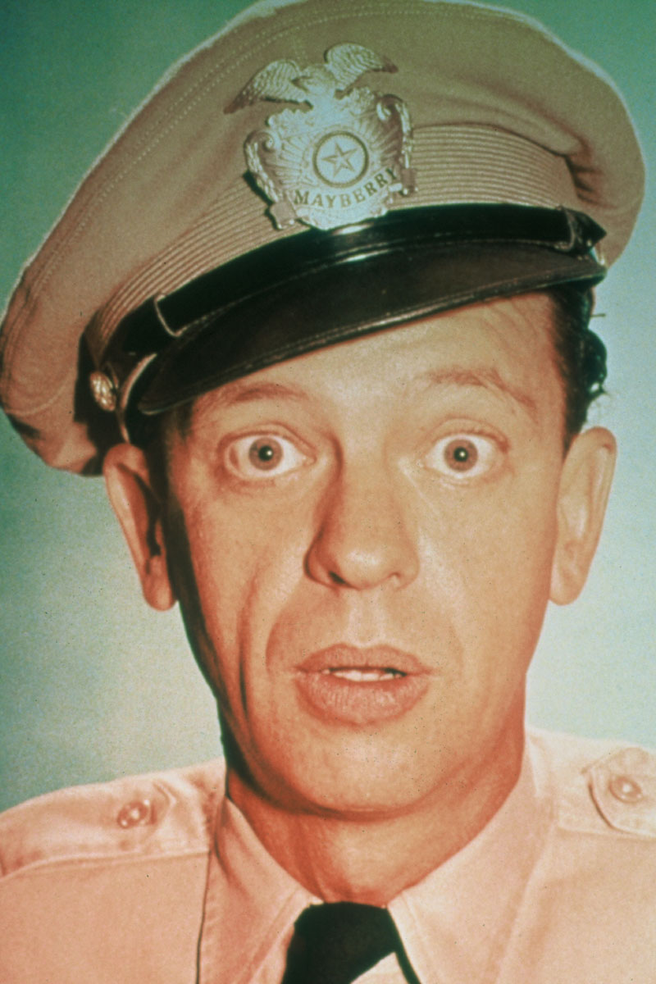
Group #2

Slide 17

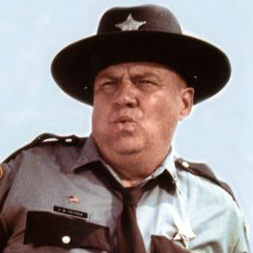
Group #3

Slide 18
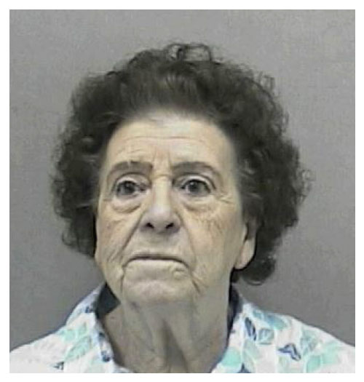
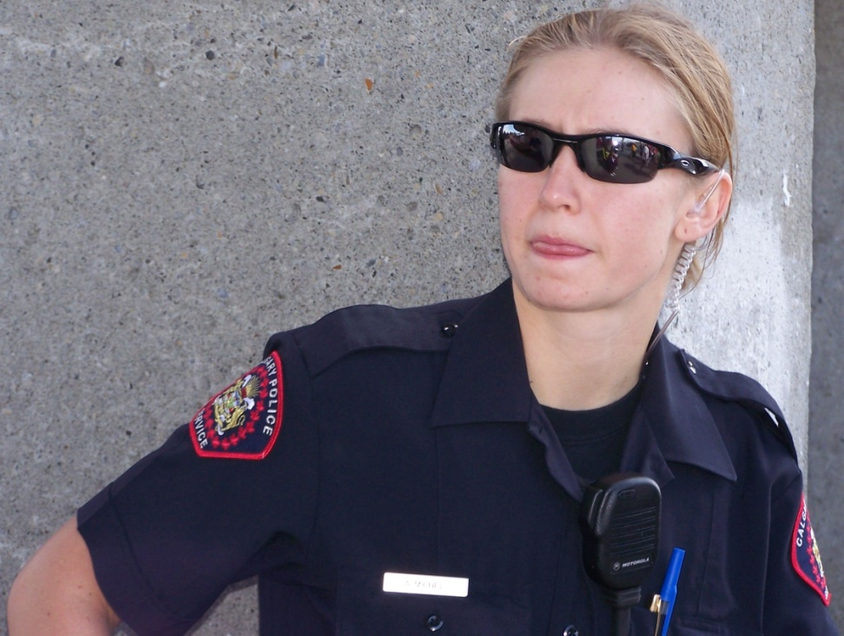
Group #4

Slide 19

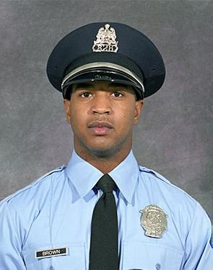
Group #5

Slide 20
Discussion
Why did you decide as you did?
Why do you think there were different results?
Would you have come to a different decision without a picture?
Do you see the importance of a judge and jury and the difficulty of their job?
Notes:
This decision could be as extensive or short as you want.
You could talk to them about how they were affected by the language that they used, the way that they looked, or their attitude.
This is where you can show that essentially the basic facts were the same, but some groups had more details than others. Two of the groups had exactly the same language used for testimony. Did they come to the conclusion? Did they come to different ones? Why?
What was the most important information that your group considered when making the decision?

Slide 21
Thank You for Your Time!
Contact information
  Name
  Court Address
  Email address
Notes:
Thank you for your time. Hopefully, you have a good understanding about what happens at municipal court and how juries work.
Here is my contact information if I can ever help you out with anything.

