Slide 1
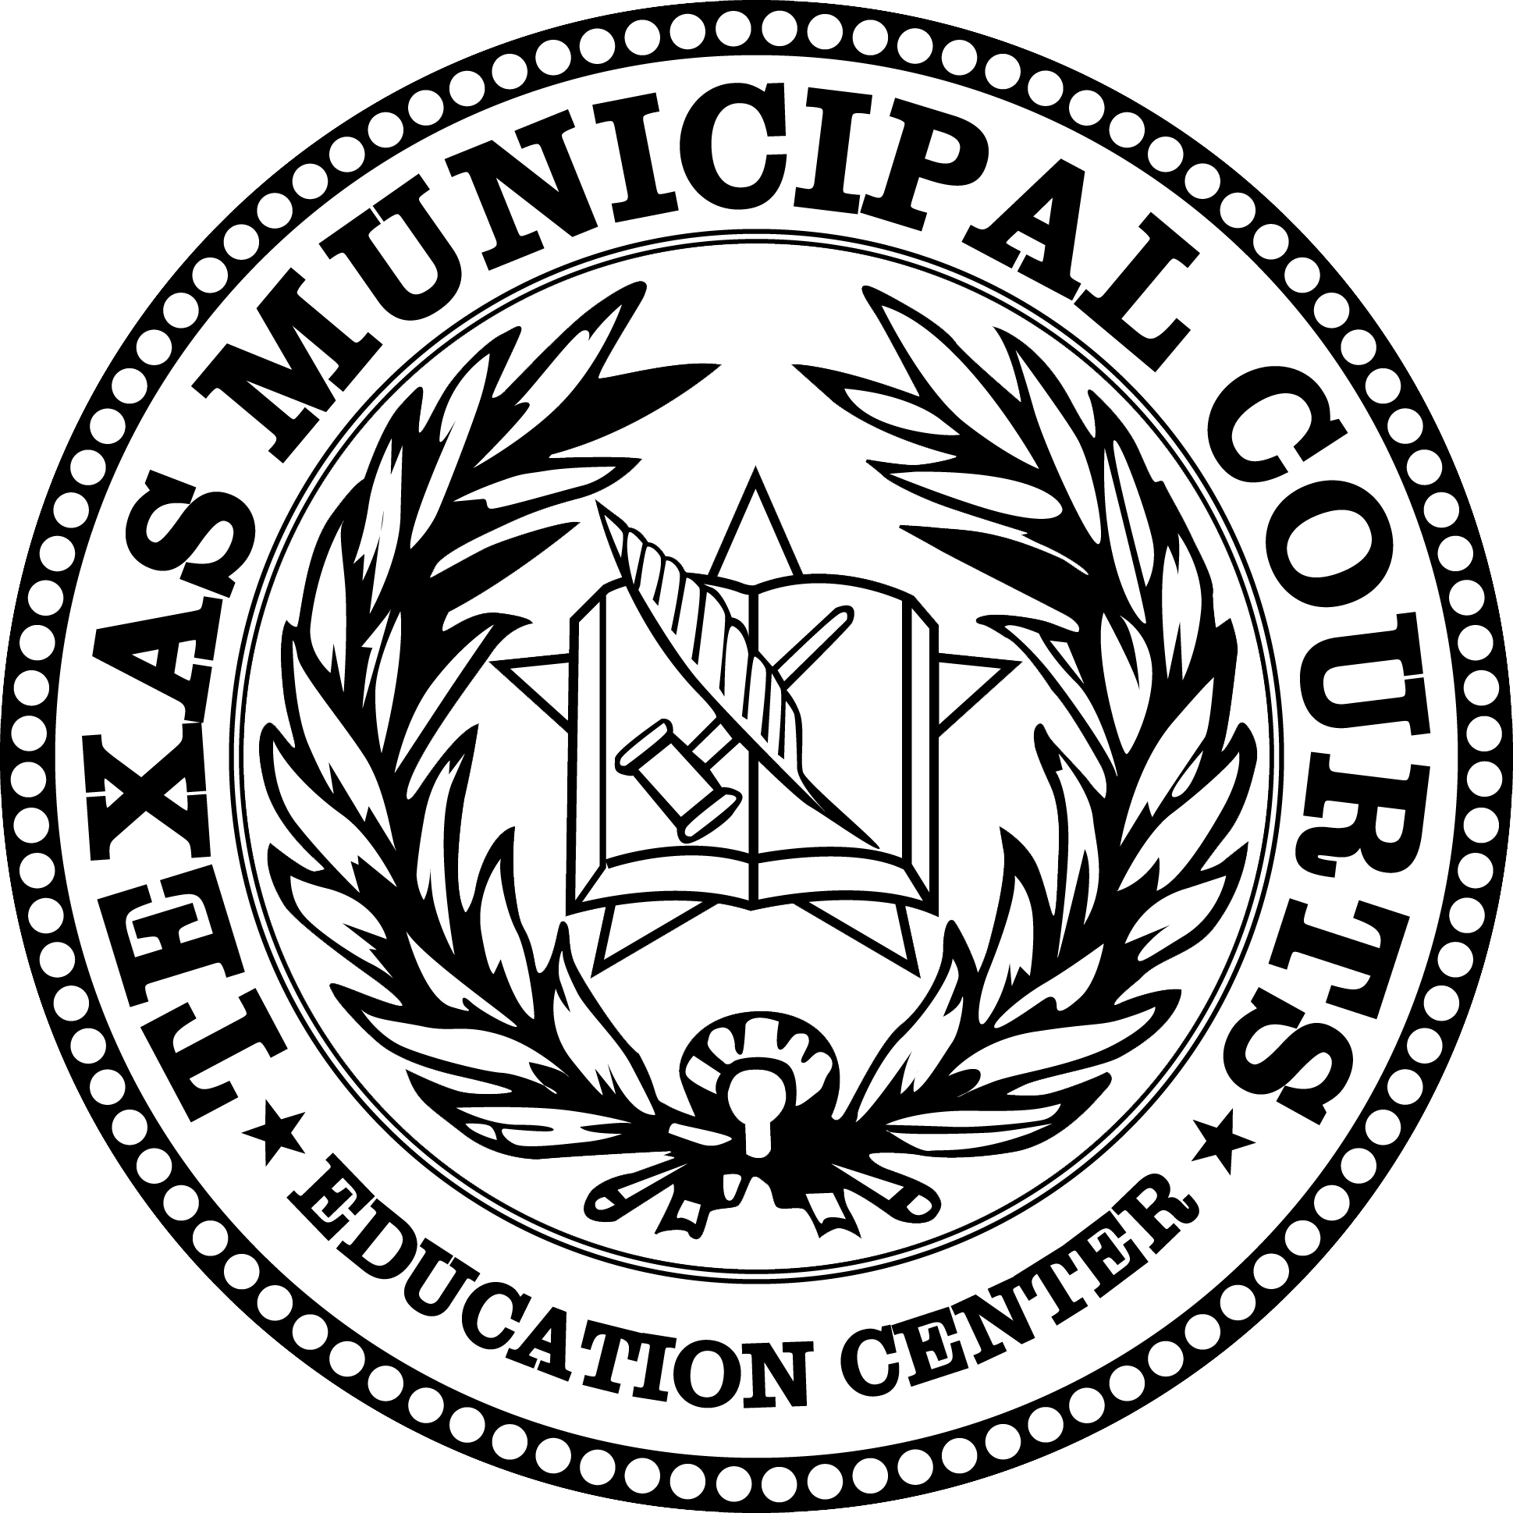
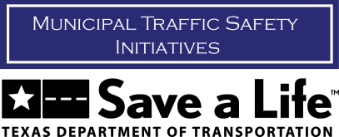
Misdemeanors Matter

Slide 2
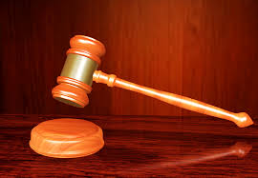
What is a Misdemeanor?
A misdemeanor is a crime punishable by a fine, jail time for a period of up to a year, or both
Felonies, on the other hand, carry fines and prison time of a year or more

Slide 3
What is a Misdemeanor?
While “less serious” than felonies, misdemeanors are NOT insignificant offenses!
While there has been a recent push by the media and certain advocacy groups to downplay the seriousness of misdemeanor offenses, these offenses have direct negative consequences to individuals and society

Slide 4
Texas Misdemeanors Examples
Class C Misdemeanors: DUI (under 21), theft, minors consuming or possessing alcohol, public intoxication, criminal trespass, speeding and many other traffic violations
Class B Misdemeanors: DWI (first offense), minors possessing drugs, vandalism, evading arrest on foot
Class A Misdemeanors: DWI (second offense), assault with bodily injury, possession of 2-4 ounces of marijuana, unlawfully carrying a weapon

Slide 5
Misdemeanor Consequences to Defendant
Class C Misdemeanors: Fine up to $500*
Class B Misdemeanors: Fine up to $2,000, jail up to 180 days, up to two years community supervision (probation)
Class A Misdemeanors: Fine up to $4,000, jail up to one year, up to two years community supervision (probation)

Slide 6
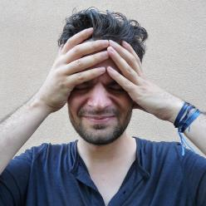
Further Misdemeanor Consequences to the Defendant
Non-court imposed consequences of misdemeanors might include:
Surcharges against defendant’s drivers license
Court costs and fees to be paid by the defendant
Increased car insurance premiums
Attorney fees to be paid by the defendant
Inclusion of the offense on the defendant’s criminal record, which makes it harder to obtain employment
Negative effect on credit score
Social stigma
Notes:
Talking Points:
What other consequences can you think of?
Do you have any personal experiences of people you know committing a misdemeanor? What were the negative consequences?

Slide 7
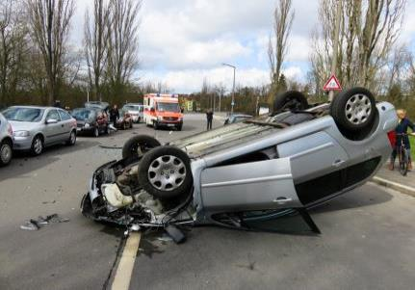
Misdemeanor Consequences to Society
The following traffic misdemeanors effectively illustrate the negative consequences misdemeanors have on society:
Impaired Driving
Speeding
Traffic Signal Violations
Not Wearing a Seat Belt

Slide 8
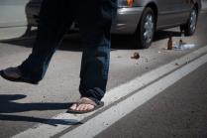
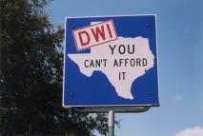
DUI and DWI (Alcohol)
In 2015, approximately 35,092 were killed and 4.4 million seriously injured in auto crashes in the U.S.
Of these deaths, 12,130 (35.35%) involved a driver who had been drinking alcohol (usually a misdemeanor offense!)
This means that in 2015, more than 33 people died every day from alcohol-related crashes
Sources: National Safety Council, National Highway Traffic Safety Administration
Notes:
Talking Points:
These statistics do not include deaths related to driving under the influence of drugs. Do you think the number would be greater if we include drugged driving?

Slide 9
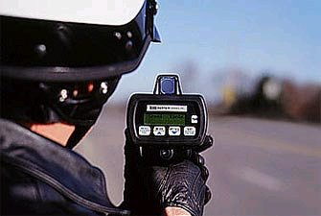
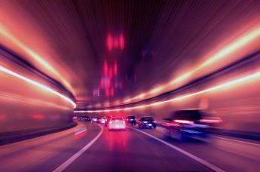
Speeding
Of the 2015 deaths, 9,557 (27%) involved a driver that was speeding (a misdemeanor!)
Source: National Highway Traffic Safety Administration

Slide 10
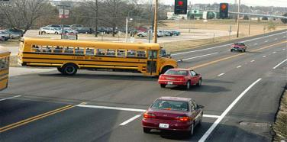
Traffic Signal Violations
From 2011 to 2015, an average of 719 people died each year from red light running (a misdemeanor!) crashes
In 2014, 709 were killed and approximately 126,000 were injured in stop sign running (a misdemeanor!) crashes
Source: American Traffic Solutions, Insurance Institute for Highway Safety

Slide 11
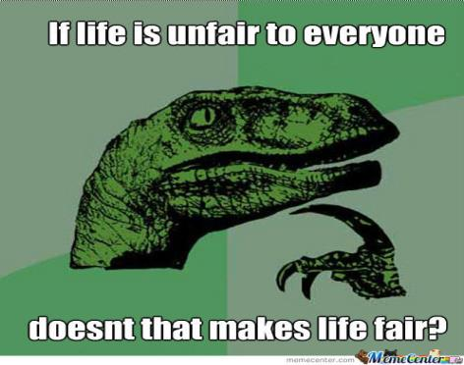
The loss of life is not only those who have committed misdemeanors, but also those following the law who are killed by those committing misdemeanors.
Notice anything about the previous video?

Slide 12
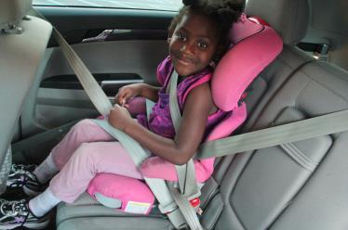
Seat Belts
In 2015, 7,221 drivers and 2,452 passengers died in car crashes that were not wearing a seatbelt (a misdemeanor!)
Seat belts saved an estimated 12,802 lives in 2014
Trivia: How might not wearing a seatbelt affect other vehicles?
Source: Insurance Institute for Highway Safety

Slide 13
Misdemeanor Consequences to Society
The loss of life illustrated by the statistics discussed is not only those who have committed misdemeanors, but also those following the law who are killed by those committing misdemeanors
Annually, traffic crashes have an estimated economic impact of $242 billion ($242,000,000,000.00!) on society
With that amount, you could buy almost 9 million Ford F-150 pickup trucks!
Question: Does anyone benefit here? What is lost?
Source: Insurance Institute for Highway Safety
Notes:
Talking Points:
Do you see how committing misdemeanors can affect others? Do you think this is unfair to those who follow the law?
What could you do with $242 billion dollars? What could society/government with this amount of money if it did not go toward traffic crashes?
What are some of the places this money goes? Answers: medical care, court costs, insurance, law enforcement.

Slide 14
The Vital Role of Municipal Courts in Texas
More people come into contact with municipal courts than all other levels of the Texas judiciary combined
Over 5 million misdemeanor cases are filed in Texas municipal courts per year
As we will see, misdemeanors have a significant negative effect on individuals and society at large, making the role of municipal courts VITAL
Source: Annual Statistical Reporting of the Texas Judiciary

