Slide 1

SPEED LIMITS
Joe Gorfida, Jr.
jgorfida@njdhs.com
Main Office: (214) 965-9900
Direct Dial: (214) 665-3323
TEXAS MUNICIPAL COURTS EDUCATION CENTER
2012 Municipal Traffic Safety Initiatives

Slide 2

AUTHORITY
Chapter 545 of the Texas Transportation Code

Slide 3
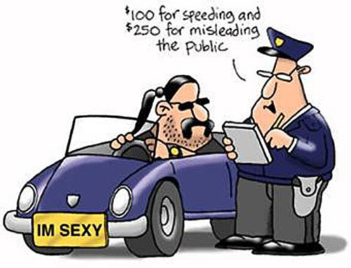
Who has the authority
Cities
County
Texas Transportation Commission
Regional Tollway Authority

Slide 4
AUTHORITY OF MUNICIPALITY TO ALTER SPEED LIMITS
              Section 545.356 of the Texas Transportation Code
    Highway or part of the highway within the municipality (including a highway of the state highway system)

Slide 5
REGIONAL TOLLWAY AUTHORITY
              Section 545.354 of the Texas Transportation Code
    Turnpike, or part of a turnpike, constructed and maintained by the Authority.

Slide 6
REGIONAL TOLLWAY AUTHORITY
    What if the turnpike is within the City limits of a home-rule municipality?

Slide 7
AUTHORITY OF TEXAS TRANSPORTATION COMMISSION
    Any part of a highway officially designated or marked by the Commission as part of the State highway system (including inside and outside the limits of a municipality).

Slide 8
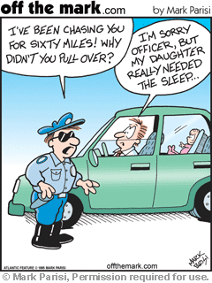
AUTHORITY OF TEXAS TRANSPORTATION COMMISSION
    What if the Commission sets a speed limit on a highway that conflicts with one set by the City?

Slide 9
AUTHORITY OF COUNTY COMMISSIONERS COURT
    Section 545.355 of the Texas Transportation Code.
    Same authority as the Texas Transportation Commission, for a county road or highway outside the limits of the right-of-way of an officially designated or marked highway or road of the State highway system and outside a municipality.

Slide 10
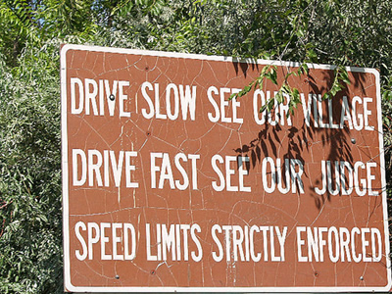
AUTHORITY OF COUNTY COMMISSIONERS COURT
    Does the County’s authority extend to any segment of the State highway system?

Slide 11
AUTHORITY OF COUNTY COMMISSIONERS COURT
    What if the Commission sets a speed limit on a highway that conflicts with one set by the City?
    An order of the Texas Transportation Commission establishing a speed limit on a part of the State highway system supersedes any conflicting speeds set by another authority.

Slide 12
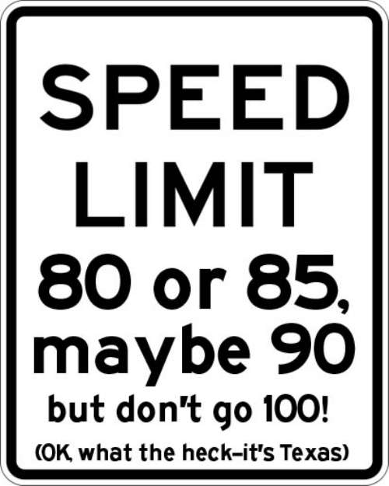
MAXIMUM SPEED REQUIREMENTS
Section 545.351 of the Transportation Code

Slide 13
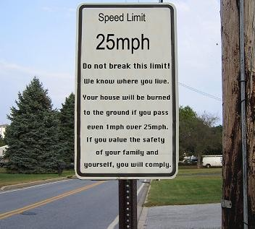
          Maximum speed requirements
An operator may not drive at a speed greater than is reasonable and prudent under the circumstances then existing.

Slide 14
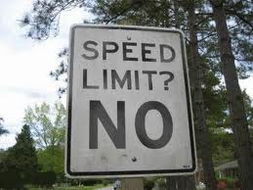
PRIMA FACIE SPEED LIMITS
Section 545.352 of the Transportation Code

Slide 15
PRIMA FACIE SPEED LIMITS
The following speeds are lawful under Section 545.352:
30 mph in an urban district on a street other than an alley;
15 mph in an alley;
70 mph on a highway numbered by the States or United States outside an urban district, including a farm-to-market or ranch-to-market road (Commission may go up to 75 mph);
60 mph on a highway that is outside an urban district and not a highway numbered by the State or United States; and
15 mph on a beach.

Slide 16
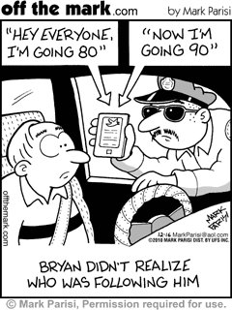
PRIMA FACIE SPEED LIMITS
A speed limit in excess of the limits established by section 545.352 or under the subchapter “Speed Restrictions” is prima facie evidence that the speed is not reasonable and prudent and that the speed is unlawful.

Slide 17
PRIMA FACIE SPEED LIMITS
What is the “Prima Facie” concept?
Prima facie limits are those limits which on the face of it are reasonable and prudent under normal conditions.

Slide 18
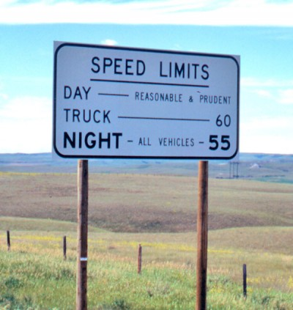
PRIMA FACIE SPEED LIMITS
How does a City set a speed limit?
  By Ordinance or Resolution.

Slide 19
PRIMA FACIE SPEED LIMITS
Engineering and traffic study (may not exceed 75 mph).

Slide 20
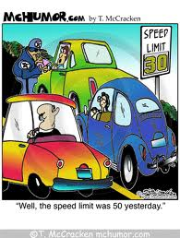
GUIDELINES FOR SELECTING SPEED LIMITS
Administrative Code Chapter 25

Slide 21
GUIDELINES FOR SELECTING SPEED LIMITS
Speed limits should be based on:
Spot speed studies;
85th percentile operating speed; and
Legal minimum and maximum speeds should establish the boundaries of speed limits.

Slide 22
GUIDELINES FOR SELECTING SPEED LIMITS
What if the inferred design speed for the roadway is less than the 85th percentile speed?
Arbitrarily setting lower speed limits at point locations due to a perceived shorter than desirable stopping distance is neither effective nor good engineering practice.

Slide 23
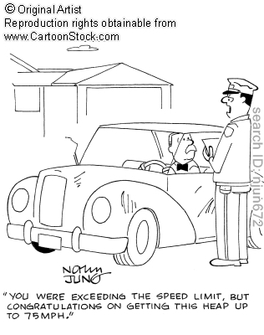
GUIDELINES FOR SELECTING SPEED LIMITS
Is speeding a violation under state law or a city ordinance violation?
Court costs?

Slide 24
GUIDELINES FOR SELECTING SPEED LIMITS
SPEED LIMIT SIGNS
  Located at points of change from one speed to another;
  Additional speed limit signs shall be installed beyond major intersections and at other locations where it is necessary to remind road users of the applicable speed limit; and
  Installed at entrances to the State and, where appropriate, at jurisdictional boundaries in urban areas.

Slide 25
GUIDELINES FOR SELECTING SPEED LIMITS
Accident Reconstruction Speed Limits
(Section 545.3561 of the Transportation Code)
  Temporarily lowers the prima facie speed limit;
  Site of a crash investigation;
  Must use transportation engineering official with experience establishing speed limits;
  Must include a highway within the state highway system;
  No study required;
  Signs must conform to the Texas Manual on Uniform Traffic Control Devices; and
  Conceal all other signs that permit a higher speed.

Slide 26
GUIDELINES FOR SELECTING SPEED LIMITS
May a municipality set minimum speed regulations on part of a highway within the municipality?
Must conduct an engineering and traffic investigation;
Results show that slow speeds consistently impede a minimum speed limit on the highway; and
Signs must be posted.

Slide 27
GUIDELINES FOR SELECTING SPEED LIMITS
Interim speed limits for new or reconstructed highways:
An interim speed limit for a new or reconstructed highway shall be determined and posted before the highway is opened to traffic;
To set an interim speed limit, a traffic and engineering investigation will be conducted;

Slide 28
GUIDELINES FOR SELECTING SPEED LIMITS
Interim speed limits for new or reconstructed highways:
The traffic and engineering investigation will include a review of:
(i) the statutory prima facie speed applicable to the highway;
(ii) the design speed applicable to the highway; and
(iii) a trial run speed study for the highway.

Slide 29
GUIDELINES FOR SELECTING SPEED LIMITS
When traffic speeds have stabilized on the highway, an 85th percentile speed study shall be conducted. The interim speed limit will be used on the highway until the maximum speed for the highway is determined following the conclusion of that investigation.

Slide 30


GUIDELINES FOR SELECTING SPEED LIMITS
Speed limits exceptions:
Authorized emergency vehicle responding to a call;
A police patrol;
A physician or ambulance responding to an emergency call.

Slide 31

THE STATE’S CASE

Slide 32
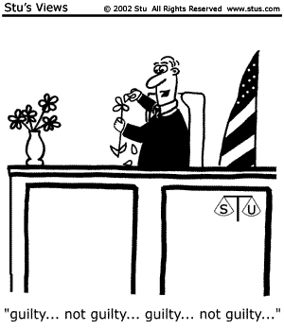
THE STATE’S CASE
Burden of proof –
beyond a reasonable doubt (criminal);
Presumption that the posted speed limit is reasonable and prudent; and
No culpable mental state required.

Slide 33
THE STATE’S CASE
Does the State have to introduce evidence that the speed was not reasonable and prudent?
Evidence that the person exceeded the posted speed limit is prima facie evidence that the speed was unreasonable.

Slide 34
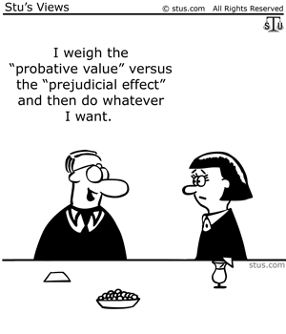
NEW LAWS

Slide 35
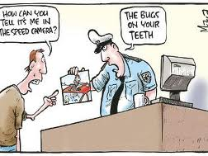
NEW LAWS
Radar Interference Devices Unlawful
(HB 1116)

Slide 36
NEW LAWS
Authority of the Commission (HB 1201)
The Commission may establish a speed limit not to exceed 85 mph on a part of the State highway system if:
that part of the highway system is designated to accommodate travel at that established speed or a higher speed; and
the Commission determines, after an engineering and traffic investigation, that the established speed limit is reasonable and safe for that part of the highway system.

Slide 37
NEW LAWS
Altering of Speed Limits, Removal of Night Time Limit of 65 MPH (HB 1353)
An entity that establishes or alters a speed limit shall establish the same speed limit for daytime and nighttime.

Slide 38
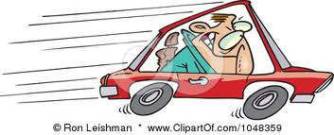
QUESTIONS????????

