Slide 1

HAVE YOU EVER WONDERED...
why the government can tell you how fast to drive or that you have to wear a helmet?
P

Slide 2
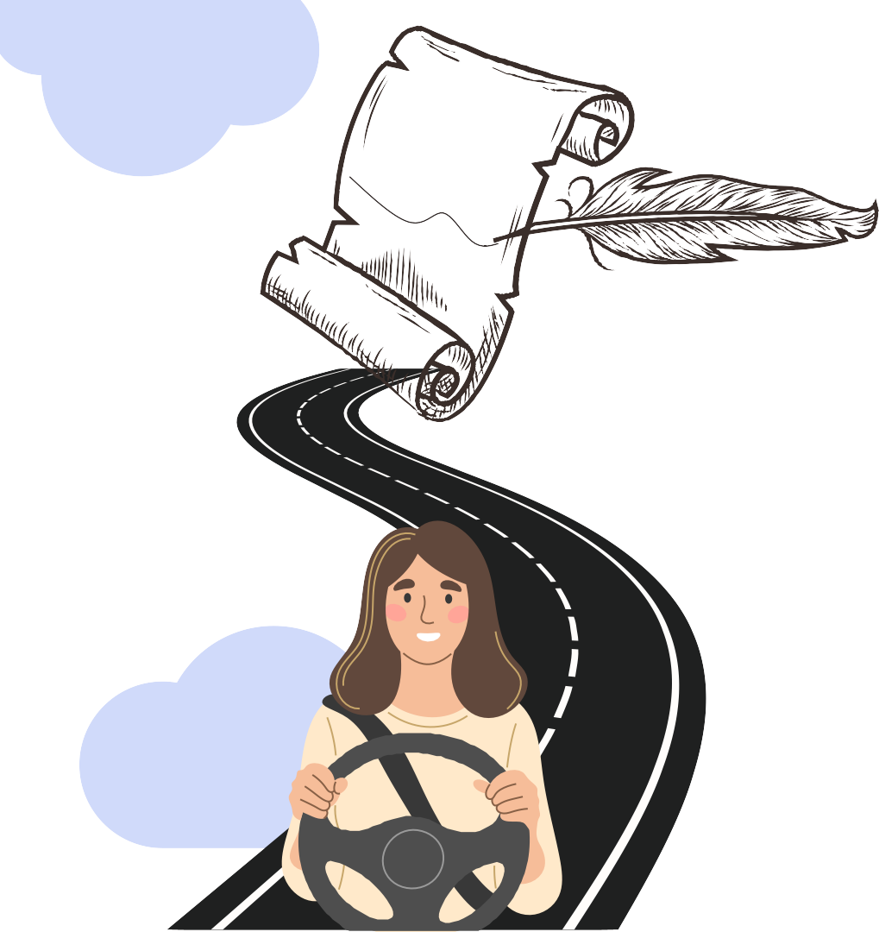
...IT ALL STARTS WITH THE
U.S. CONSTITUTION
THE SUPREME LAW OF THE LAND
THE FRAMEWORK OF THE U.S.
GOVERNMENT
Believe it or not, we can trace a path from every law or regulation from our neighborhood streets all the way back to the very document that outlined the structure and function of our
government system!

Slide 3

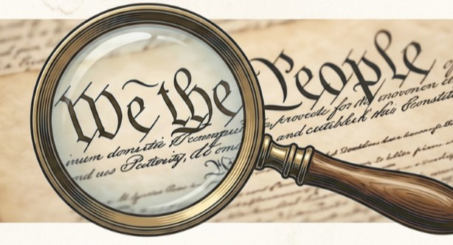

USE THE SCAVENGER HUNT & CHOICE BOARD TO EXPLORE
constitution scavenger hunt
citizen creator choice board
Dive into the U.S. Constitution and learn more about how our government works!
Choose your own adventure and create something to share your learning!

Slide 4






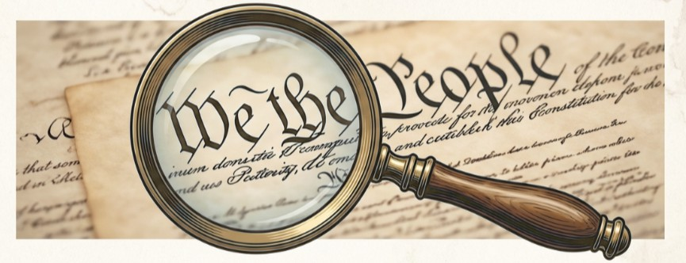


U.S. CONSTITUTION
g
n
e
e
r
h
v
u
a
n
c
t
s
The Constitution is a complex map of power, rights and responsibilities. Today, you are the detecive!

Slide 5





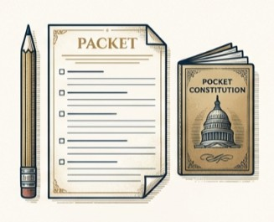

Your assignment: Constitutional detective
The Goals
Explore the text to understand how the government is structured, and how it functions to provide laws that affect our daily lives.
The Tools
You will need your Scavenger Hunt Student Document, a copy of the Constitution, and something to write with.
The TASK
Locate specific Articles, Sections, and Clauses to answer the questions in your Scavenger Hunt!

Slide 6
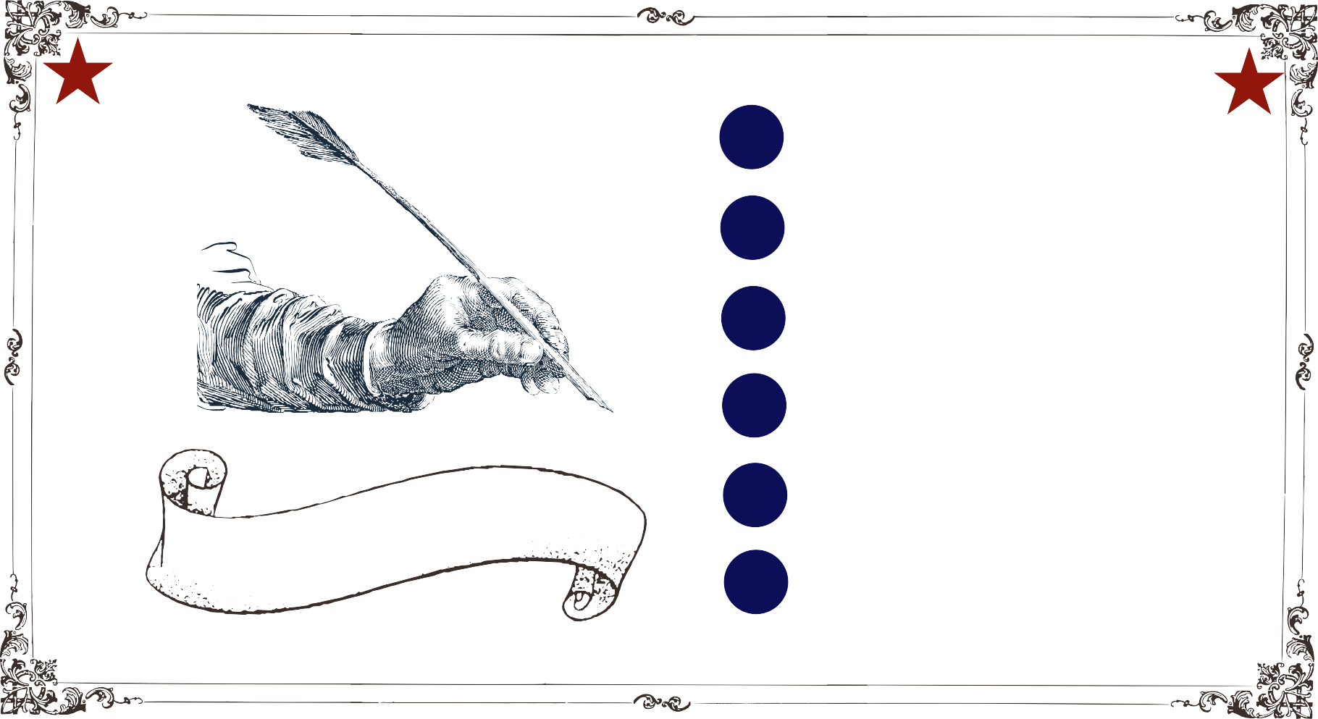
Tracing Traffic Safety Laws
01
02
Navigating the Document
03
The Preamble
04
Introduction to the Articles
agenda
05
Introduction to the Amendments
06
The Main Principles

Slide 7
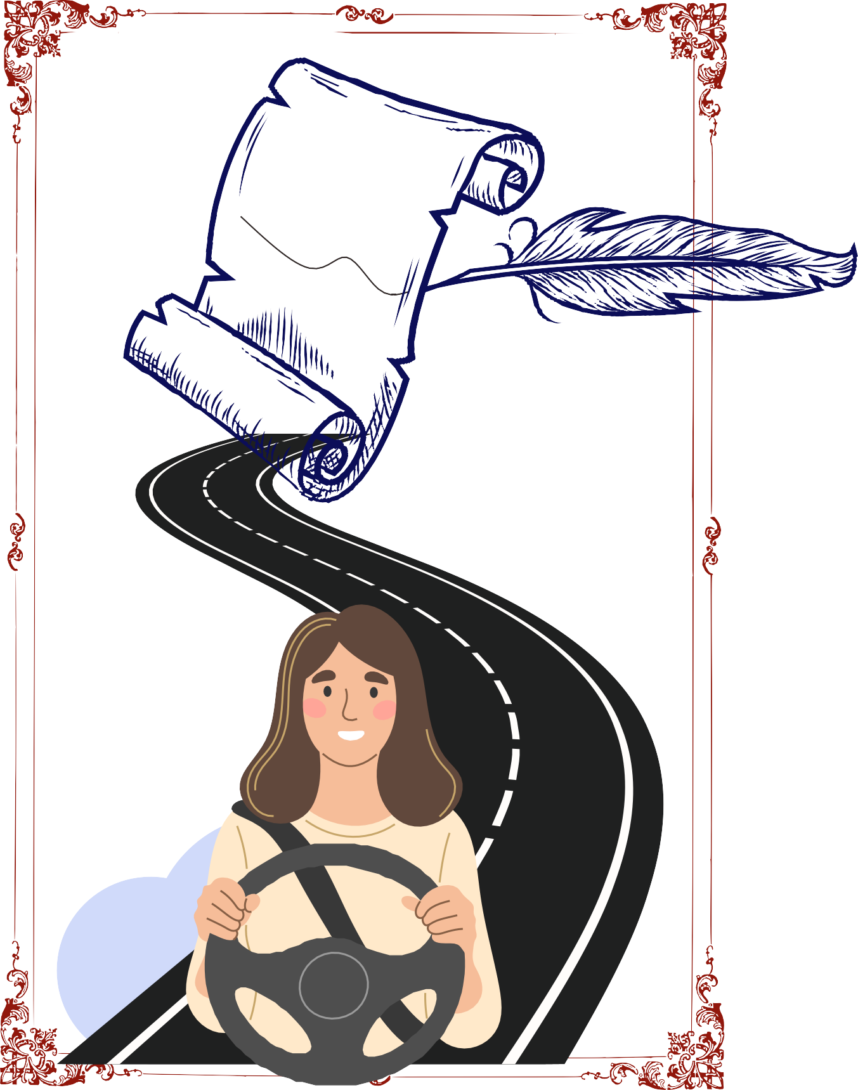
Real Life Example
As we search through the Constitution, we will continue to trace how traffic safety laws (and others) have come to exist and where government bodies and agencies get the power to create laws!

Slide 8




Preamble
01
Before we find the detailed road map of legal and legislative authority for traffic laws, we can point to TWO obvious places in the Constitution supporting these laws. The first is the Preamble which lists one reason the Framers “ordained and established” the Constitution in the first place - to “promote the general welfare.” Making sure that citizens are safe is a big part of promoting the general welfare!
02
10th Amendment
The second place that allows states and local governments to make traffic safety laws in their area is the 10th Amendment. The 10th Amendment states that powers not delegated to the U.S. (federal) government by the Constitution are “reserved to the States respectively, or to the people.”

Slide 9
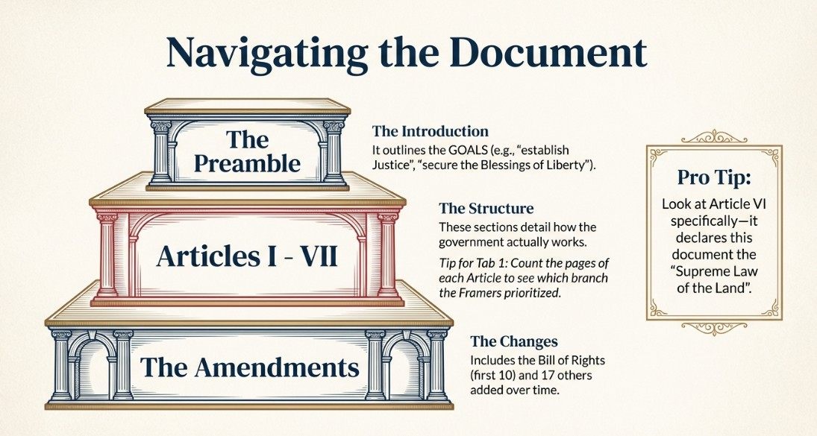


Slide 10

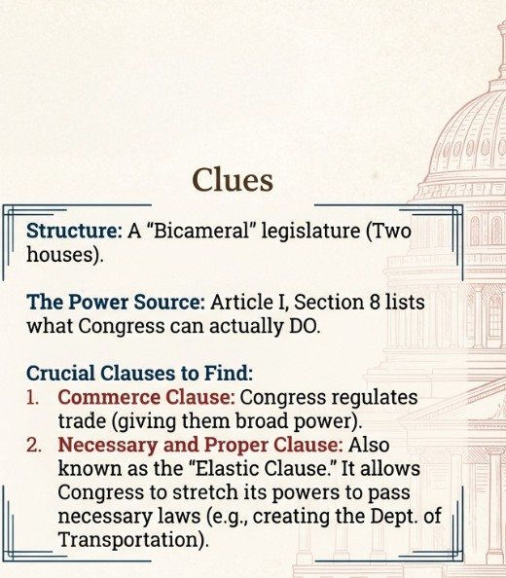


Article I
The Legislative Branch
2

Slide 11

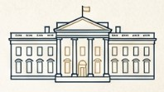


Article II
The Executive Branch
President Vice President
Cabinet Administrative Agencies

Slide 12

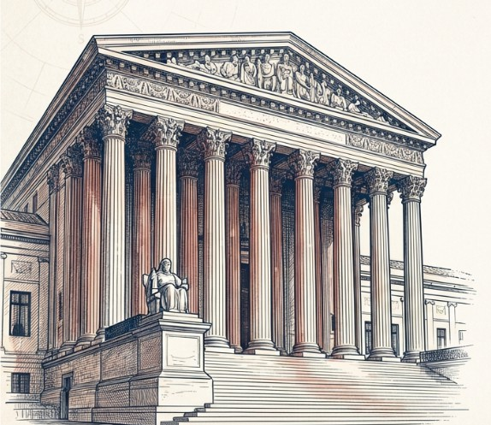

Article III
The Judicial Branch
The Supreme Court of the United States and all Federal Courts
The primary role of the courts is to:
interpret the Constitution, laws, and treaties of the United States (providing guidance as well as checks and balances)
and to resolve conflicts among lower courts, (providing uniformity & consistency across the nation).

Slide 13
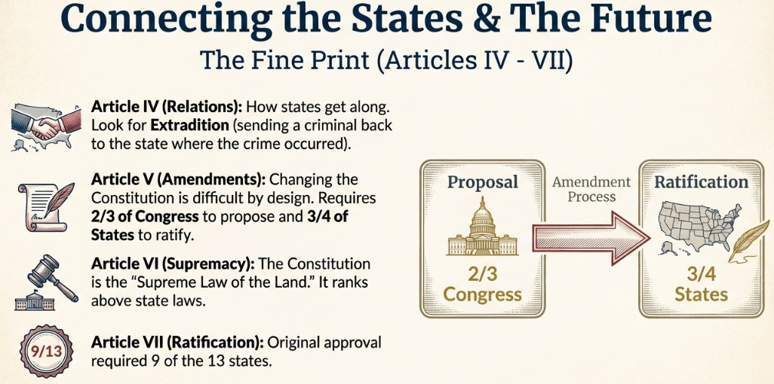

Slide 14





Amendments 1-10
The first 10 Amendments are called the Bill of Rights and were added to the Constitution in 1789 to safeguard individual liberties.
Amendments 11-27
Amendments 11-28 have each been passed over the years to change the Constitution in some way to meet the needs of the American government at the time.

Slide 15
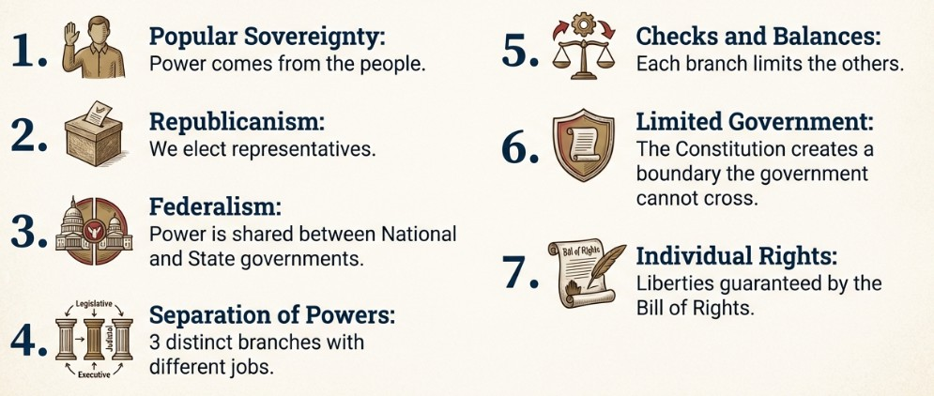

Slide 16








NOW CHECK OUT THE CHOICE BOARD AND CHOOSE YOUR ADVENTURE!

