Slide 1
Conroe Municipal Court
Court of the Future
Rhonda Scarborough, Court Clerk

Slide 2
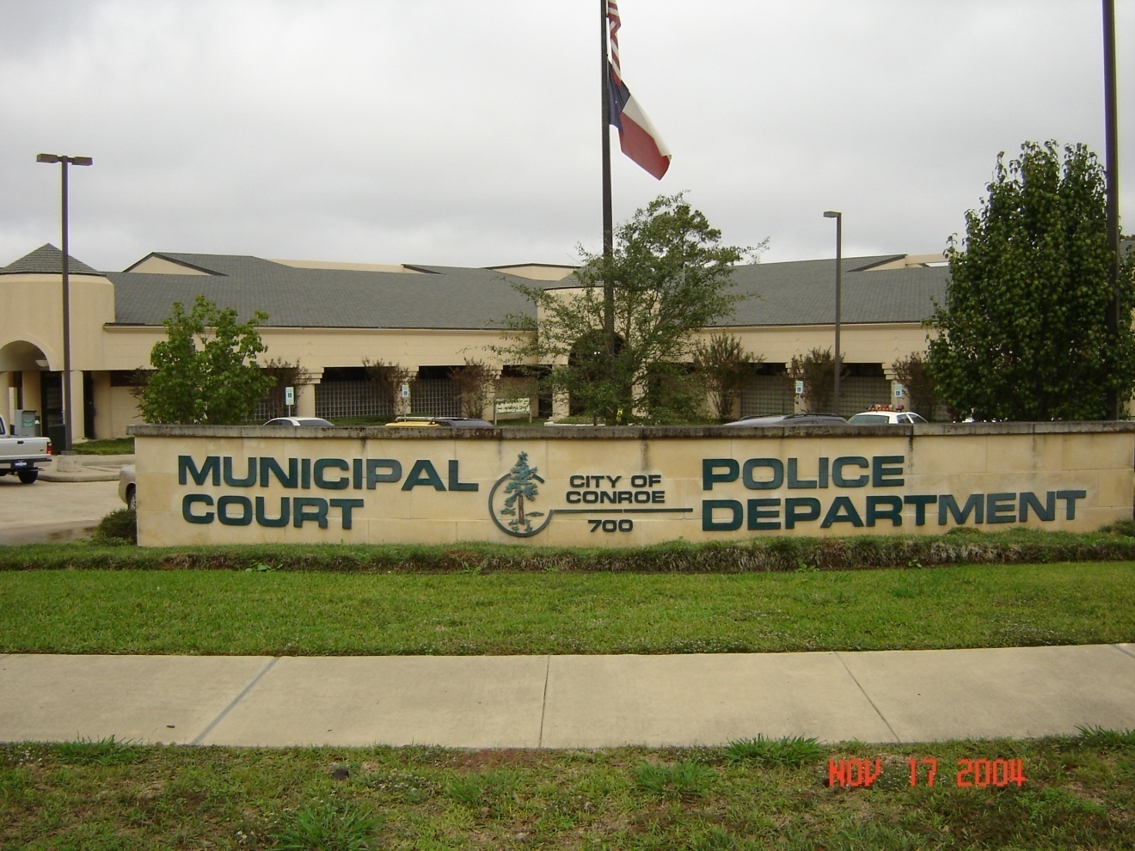
Conroe Municipal Court / Police Department Annex
Conroe Municipal Court is responsible for the filing of cases issued by the Conroe Police Department, Conroe School Police, Texas Department of Public Safety, Citizens of Conroe and the Montgomery County Sheriff Department. The court moved into these facilities on November 9th, 1999.

Slide 3
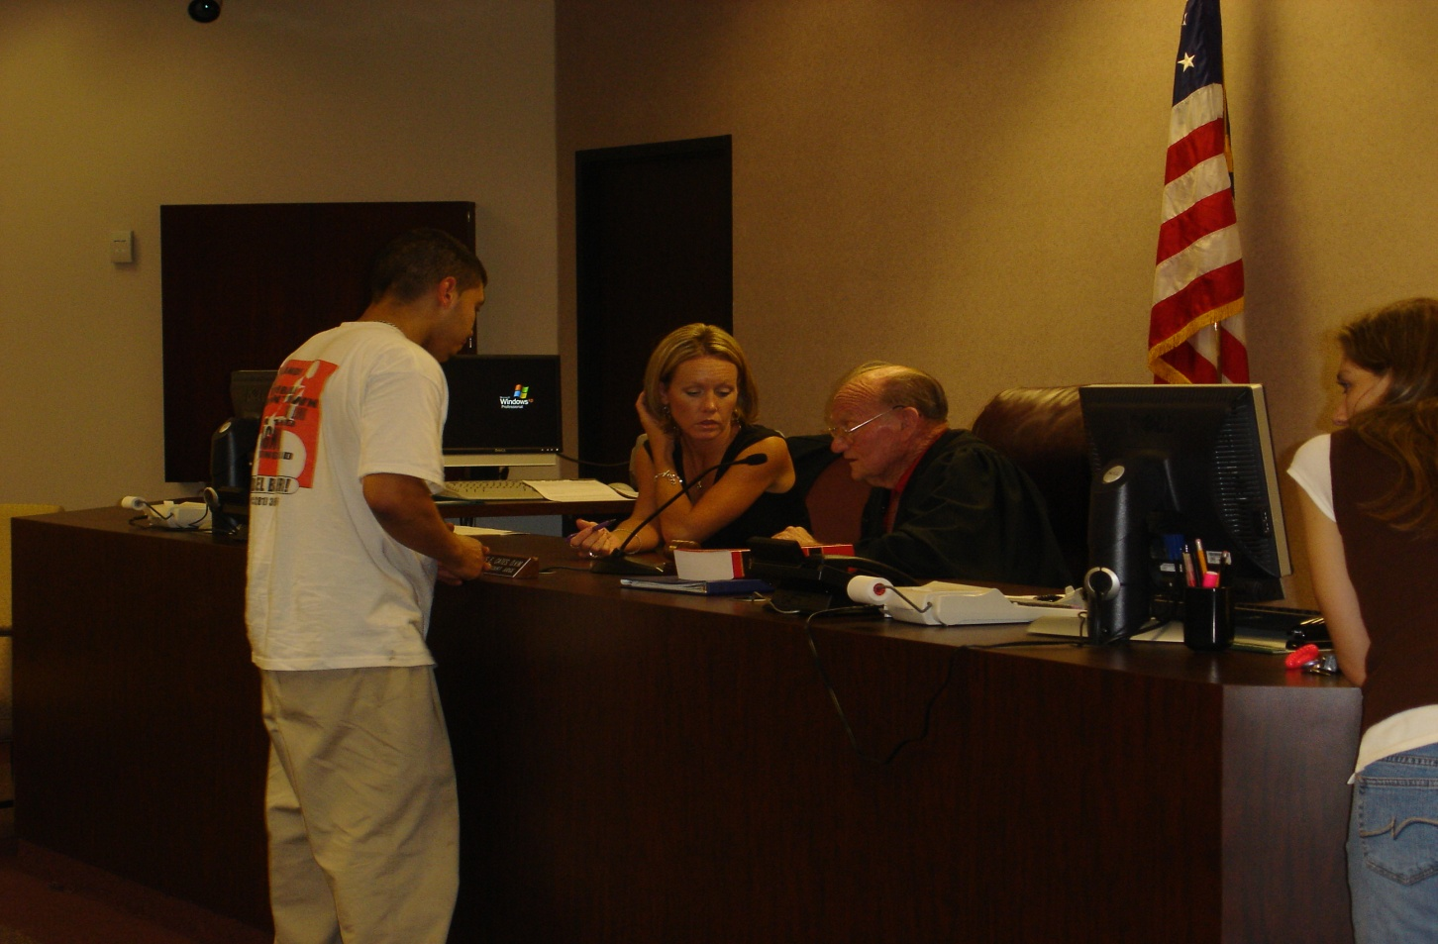
Court Staff
The court has a staff of one Court Administrator, one Warrant Administrator, one Warrant Clerk, one Juvenile Case Manager, two Deputy Clerk II, four Deputy Clerk I, one Warrant/Bailiff Officer and the Judge. This staff is there to help the public with the process of handling their citations in the Judicial System.
Notes:
The court has a staff of one Court Administrator, one Warrant Administrator, one Warrant Clerk, one Juvenile Case Manager, two Deputy Clerk II, four Deputy Clerk I, one Warrant/Bailiff Officer and the Judge.

Slide 4
Year | Citations Issued | Disposed Cases | Warrants Issued | Amount Collected
2003/2004 | 18,131 | 10,701 | 8,665 | 1,268,621
2004/2005 | 21,858 | 11,693 | 8,628 | 1,706,286
2005/2006 | 25,605 | 15,129 | 15,143 | 1,983,502

Slide 5

Fines and State Cost Comparison
Fines and State Cost 1972
Fines and State Cost 2008
The fines and state cost in 1972 were an average of a $25.00 fine and .25 cents state cost.
The fines and state cost in 2008 is an average of a $100.00 fine and $ 101.00 state cost.

Slide 6
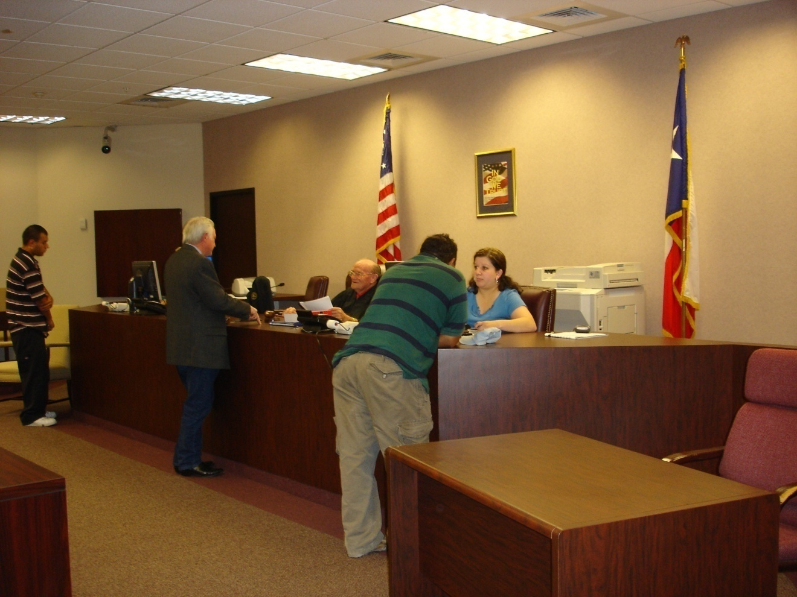
OMNI BASE COLLECTION – DEPARTMENT OF PUBLIC SAFETY
Department of Public Safety Omni Base has increased the Municipal Court collection of past due fines by denying the renewal of a defendants’ drivers’ license until he/she pays their fine and fees with the court.

Slide 7
MOVING INTO THE 21ST CENTURY
The court has requested a Case Management Imaging System to be purchased by the Court Technology Fund. This system will reduce the amount of paperwork issued, copied and filed in the court document processing of cases.

Slide 8
Municipal Courts’
Goals and Objectives
Municipal Court
Accomplishments for FY 2006-2007
Implemented the Juvenile Case Processor to expedite the
JNA (Juvenile Now Adult) collections.
Implemented the Collection Agency to collect fines that cannot be imported to the DPS Omni system because of the defendants not having a driver’s license.
Streamlined the case load to a setting of no more than thirty days with the
addition of a fifth jury trial date on the months with five Wednesdays.
Constructed an additional front counter collection window to expedite defendants paying their fines.
Implemented the court security system for defendants, witnesses, attorneys, and employees entering the court room through the metal detector with security personnel operating the detector.
Implemented a more efficient process on the Court’s records retention schedule.
Goals & Objectives for FY 2007-2008
Re-organize clerks for a more efficient case management system and process.
Implement a case management system (imaging system) to reduce the amount of files that the court must pull and re-file.
Implement a more efficient process to verify the non cash credit provided to defendants by time served, driving safety, community service and miscellaneous credit. This will assist the internal auditor with audits.
Schedule more frequent warrant runs with the State wide warrant round-up program that utilizes other courts in the process of collecting warrants issued by the Conroe Municipal Court.

Slide 10
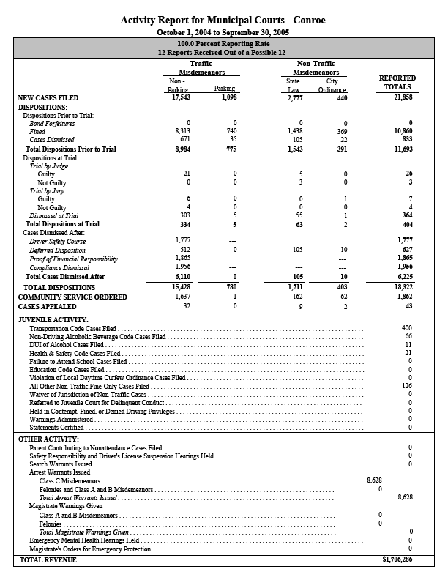

Slide 11
