Slide 1

Please start your “Do-Now.”

Slide 2



Agenda
Introductions
Using the Do-Nows
Subplans
Centers
Wrap Up

Slide 3
Using the Do Nows
Alignment
Beginning of class
Transitions
Tutoring
Homework

Slide 4

Using the Sub Plans
Substantive material.
On file in the office.
Template for future lesson plans.

Slide 5

Using the Centers
GT Extensions
Independent
Small Group
Whole Group

Slide 6
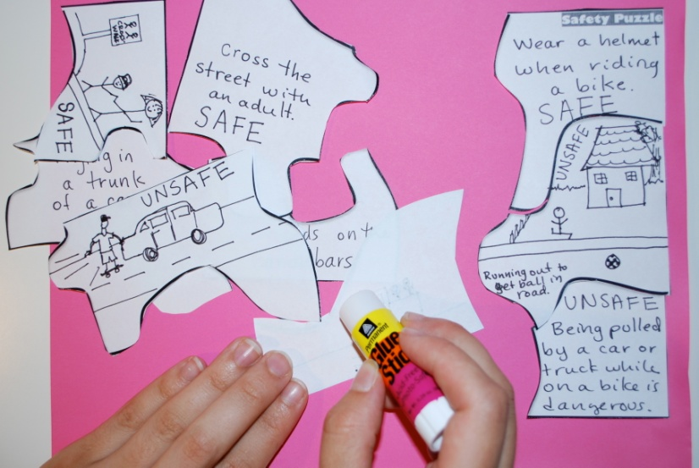
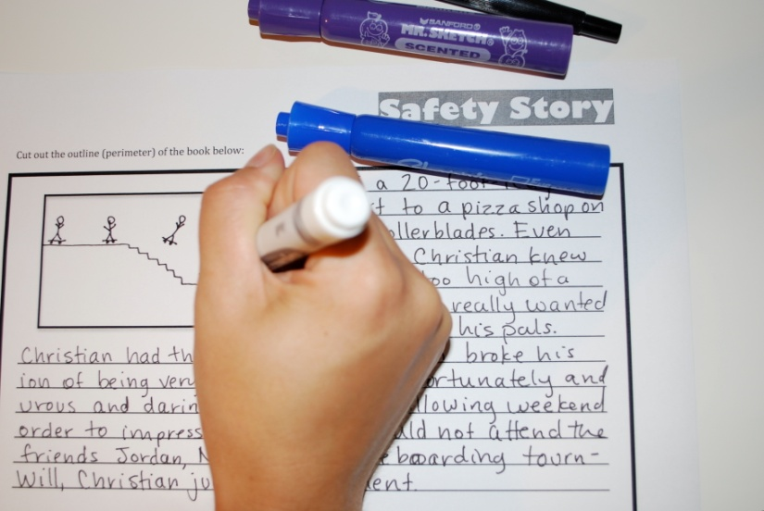
Now It’s Your Turn!
Work on your activity with a partner or group.
In 5 minutes, we’ll share our final products.
Prize to the best!

Slide 7
Wrap Up
Questions?
Comments?
Denise Baxindine
denisebaxindine@yahoo.com
Molly Powers
PowersML@gmail.com
Joanna Waggoner Norquest
Joanna.Waggoner@gmail.com

