Slide 1


Anatomy of No Refusal
Warren Diepraam
Assistant District Attorney
Montgomery County, Texas

Slide 2

Blood is the Future

Slide 3
No Refusal Guarantee
Save your agency money in the long run
Provide solid evidence of alcohol impairment
  AND DRUG IMPAIRMENT
  AND INNOCENCE
Cut down drastically on the number of DWIs
Put your officers back on the street faster
Cut down on officer’s court time
Receive significant publicity
It will save lives

Slide 4



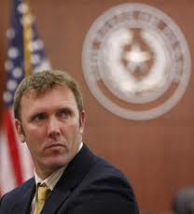
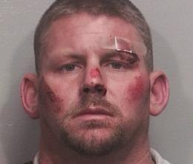

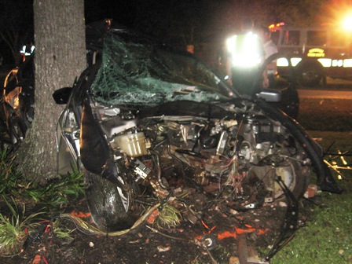
Why do we need No Refusal?
Traffic deaths are not declining like they should
Refusal rates are the same with defense lawyers advising people to refuse
Cases get reduced or dismissed
Trial conviction rate is low
We don’t know what other drugs are on board
People have difficulties with breath testing
Some people may actually be innocent
The CSI Effect

Slide 5
What is a No Refusal?
In most states, a suspect may not have the right to refuse due to implied consent laws
However, in almost as many states, the suspect has the ability to refuse a breath or blood test
Some states criminalize refusals; but most do not, leaving the prosecutor to handle a case with no scientific evidence

Slide 6
What is a No Refusal?
A No Refusal program will take away the suspect’s ability to refuse to provide evidence
During No Refusal, police, prosecutors, nurses, and judges work to review refusal DWI cases for probable cause to obtain a warrant
All aspects of the criminal justice field coordinate to ensure scientific evidence is obtained in all DWI cases

Slide 7
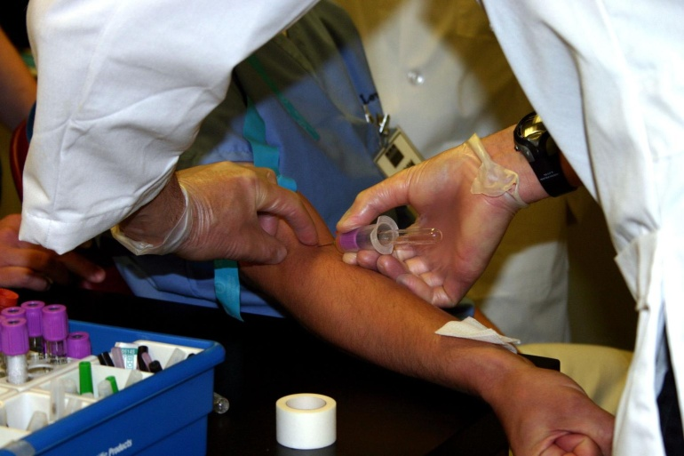
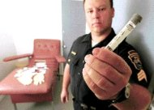
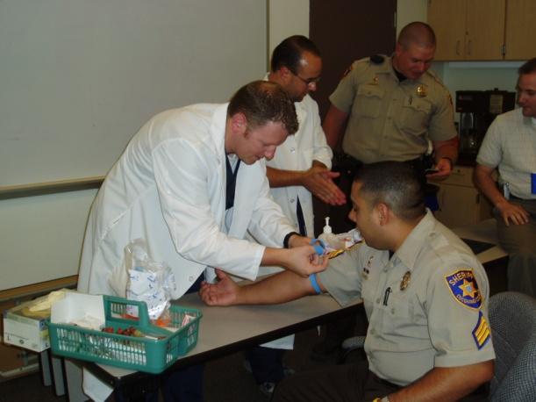

How is it different from Arizona’s Phlebotocop Program?
It does not require significant amounts of training
Officers do not have to go through a phlebotomy program or worry about lawsuits
It involves many more aspects of the criminal justice system and medical communities
Only 1 state has 100s of phlebotocops

Slide 8
What is a Phlebotocop?
A police officer or police personnel with specialized training to take blood from a person for investigative purposes
  DUI / DWI Related Investigations
  Homicide Investigations
  DNA Testing
  Communicable Disease Testing
  Internal Affairs
  Many other reasons

Slide 9
Questions to Consider
Does your law allow police officers to perform this procedure?
Could police officers be trained sufficiently to draw blood?
Will the program stand up to legal challenges that almost certainly will occur?
Will this program lower the chemical test refusal rates of DUI/DWI offenders?
What are the legal liability implications of this program?
What are the costs in time and funding?

Slide 10
Phlebotomy Training for Officers
Arizona, Utah, Idaho, and Texas laws state that blood may be drawn in DUI related cases by a physician, registered nurse, or other qualified person.
In 1994, DPS Officers asked if this pertained to police officers trained in phlebotomy.
  Paramedics?
  Officers with prior medical training?
  Personnel with no prior medical training?

Slide 11
Phlebotomy Training for Officers
In 2000, Cathee Tankersley, PC Phlebotomy Program Director, developed a new course
Designed specifically for law enforcement
One week intensive – basic venipuncture
  20 hours - lecture & lab
  20 hours - clinical experience

Slide 12
Phlebotomy Training for Officers
The new HCE 109 / 110 Course:
Designed to accommodate time demands
Content meets national standards
Course meets requirements for APOST proficiency
Problems encountered
  Premature media involvement
From 2000 to the Present:
  Schools expanded to Coconino and Pima Counties
  56 Arizona Police Agencies
  Utah Highway Patrol
Texas and Idaho

Slide 13
Officer Phlebotomists Trained

Slide 14
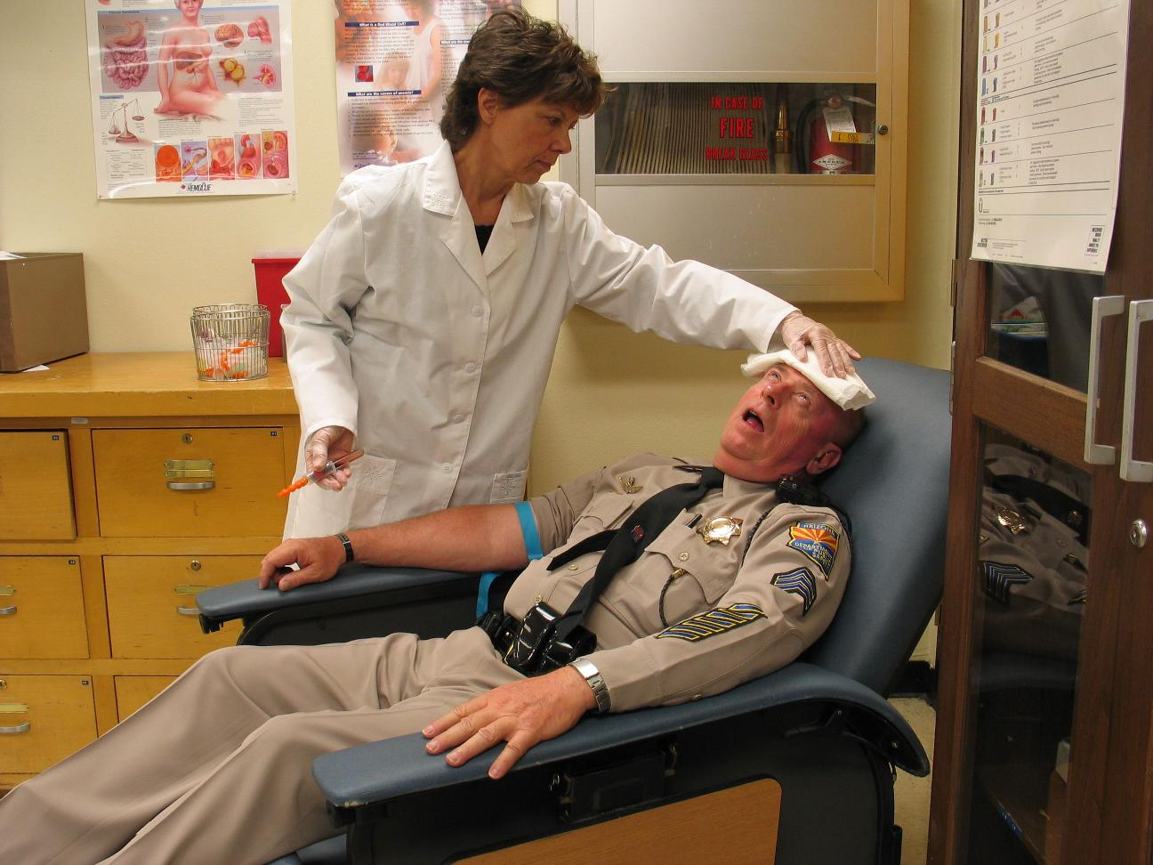
Phlebotomy Not For Everybody??

Slide 15
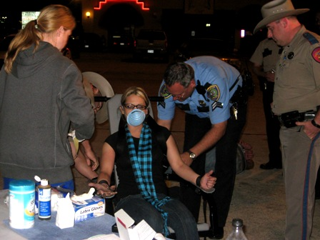
MCDA Vehicular Crimes

Slide 16

What are the Benefits of No Refusal?
Scientific evidence in 100% of DWI cases
Scientific evidence results in increased convictions and fewer reductions, dismissals, or adverse verdicts
Blood results often trigger mandatory interlock statutes
Blood evidence reveals additional drugs
Lower DWI rates and fatality rates
Cops get back on the street faster and spend less time in court

Slide 17
The History of No Refusal
In 1966, the US Supreme Court in Schmerber v. California decided that blood can reasonably be taken in DWI cases
In 1995, 2 Arizona DPS troopers got certified in phlebotomy
In 2002, a Texas police officer used a search warrant to obtain blood in a DWI case
In 2006, the No Refusal moniker and program were created
In 2007, No Refusal spreads to Louisiana, Missouri, Illinois, and other states
In 2009, first No Refusal grants are awarded (TXDOT)
In 2010, the US DOT and NHTSA endorse No Refusal

Slide 18
How to Conduct a No Refusal?
www.nhtsa.gov/no-refusal

Slide 19
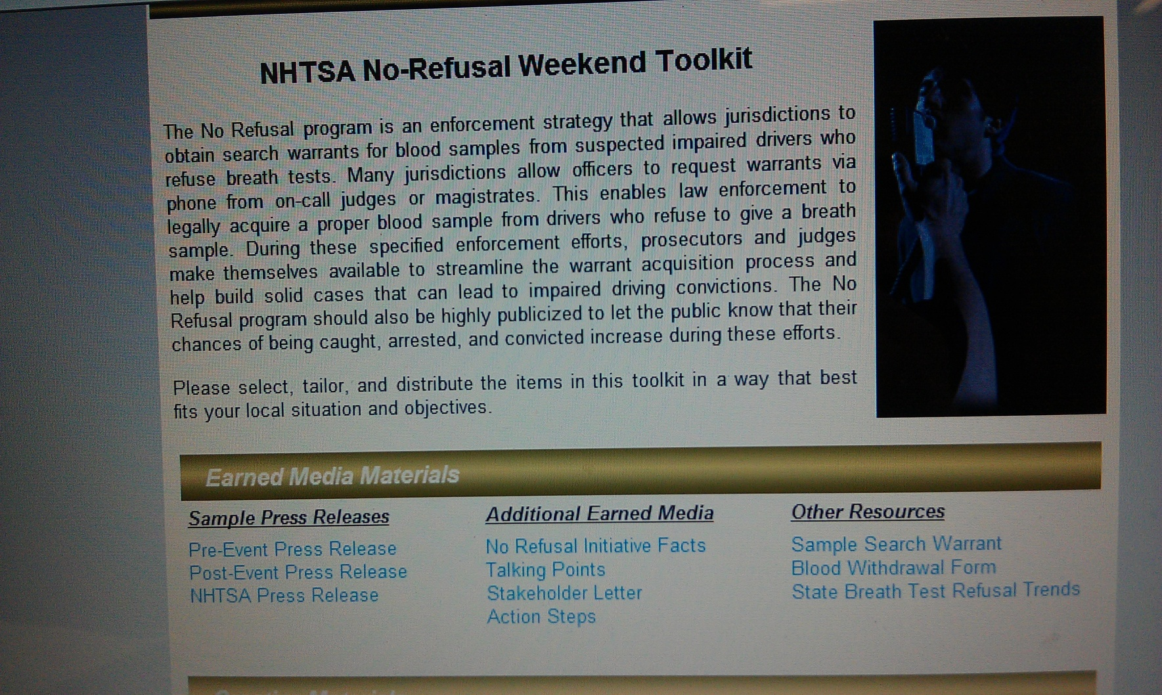
How to Conduct a No Refusal?
www.nhtsa.gov/no-refusal

Slide 20
Action Steps
Get interested parties together
Find volunteers: judges, prosecutors, nurses..
Find host facility and agency
Prepare equipment
Inspect facility and equipment
Ensure communication lines are working
Secure and sanitize facility
Documentation and warrants need to be maintained
Press releases (before, during, and after)

Slide 21
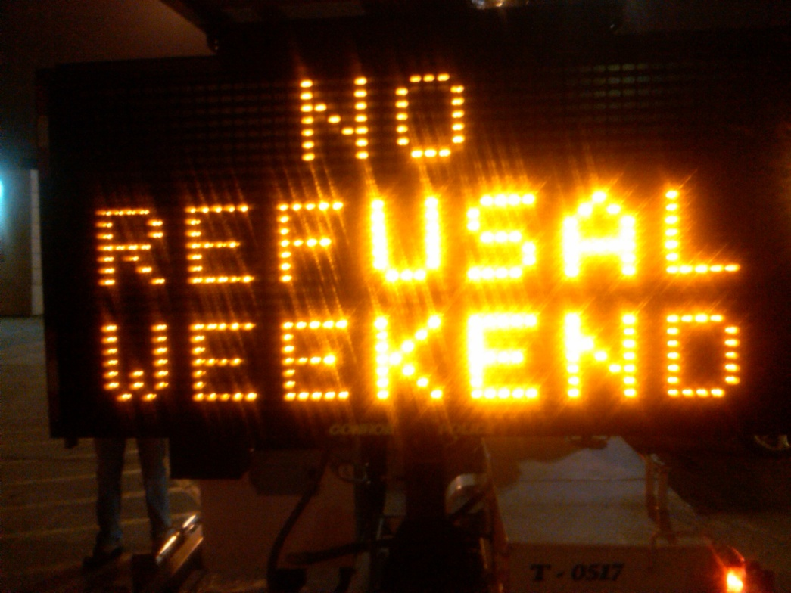
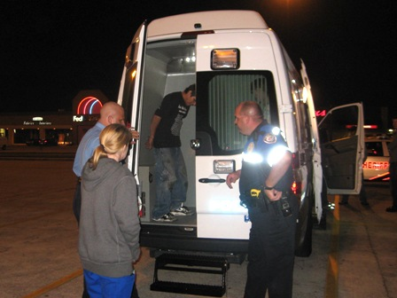
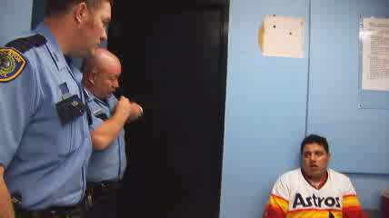
Staffing a No Refusal
Phlebotomist
Prosecutor
Judge
Police officer
  Ideally should be: SFST instructor, breath test operator, DRE instructor, and phlebotomist
No Refusal coordinator
Victim’s advocate

Slide 22
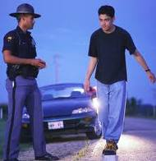

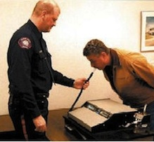

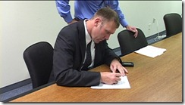

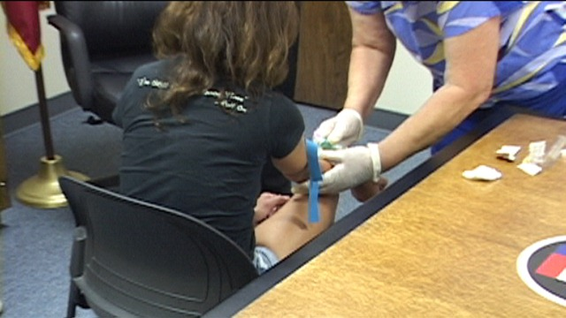
No Refusal Timeline

Slide 23

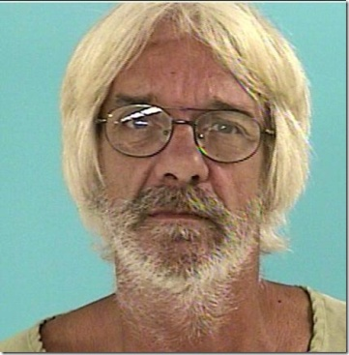
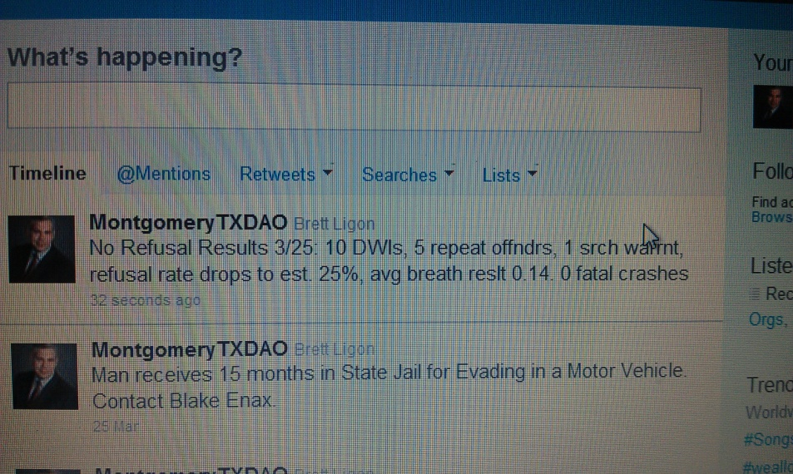

Post Event Planning
Compile all warrants
Compile all statistics
Send out a press release
Follow cases through court system
  Attention needs to be given to these cases

Slide 24
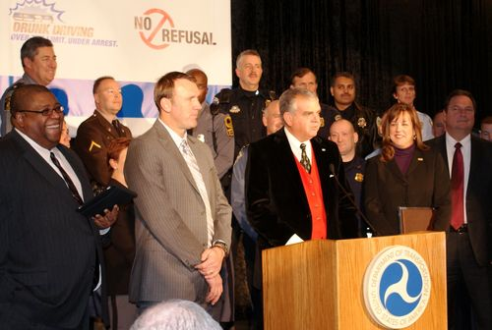
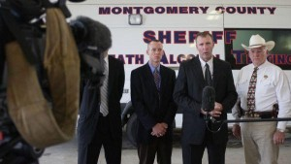
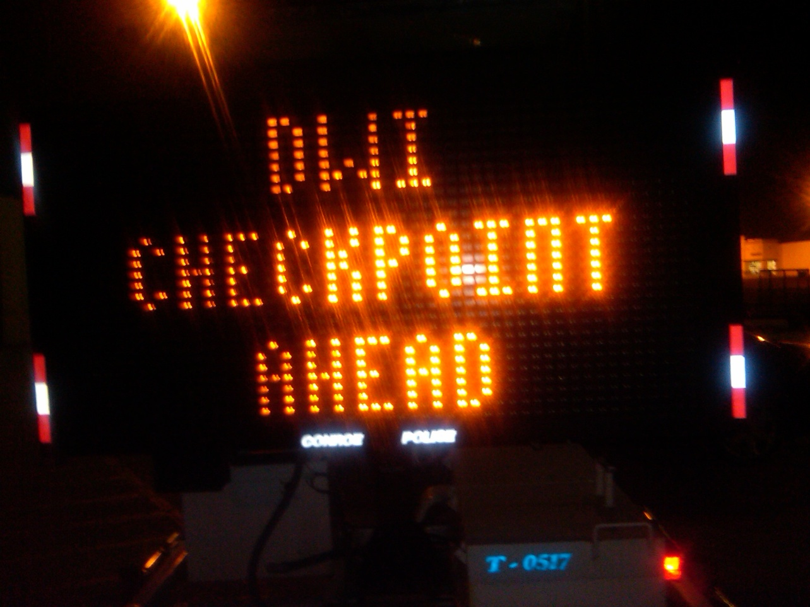

No Refusal IS High Visibility

Slide 25
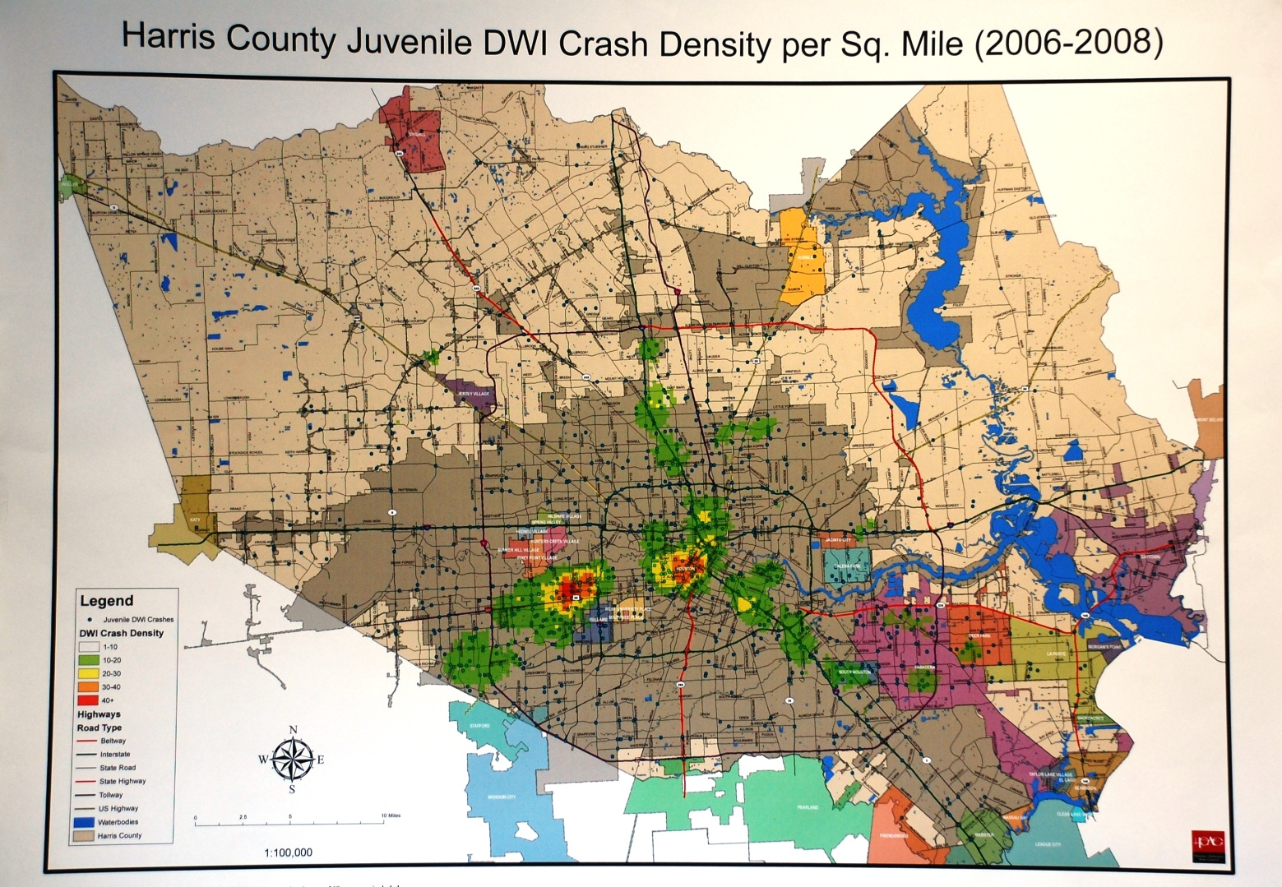
Juvenile Crashes, DWI Hotspots, and No Refusals

Slide 26
Juvenile Crashes, DWI Hotspots, and No Refusals
Crashes are not within 5 miles of suspect’s home
Crashes are within 5 miles of “party spots”
Suspect’s blood results are generally higher than adults
Suspect’s blood results typically have additional drugs on board
Problem: officers tend to file the less serious juvenile cases versus DWI

Slide 27
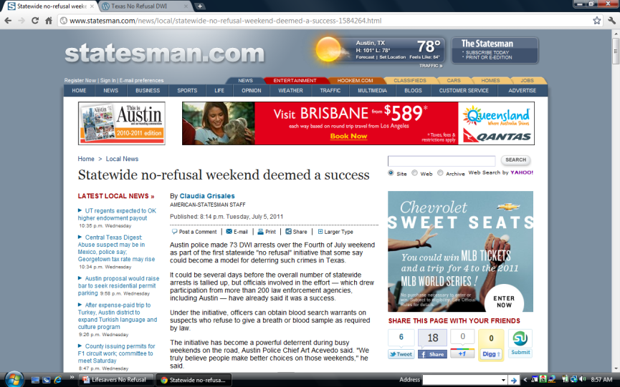
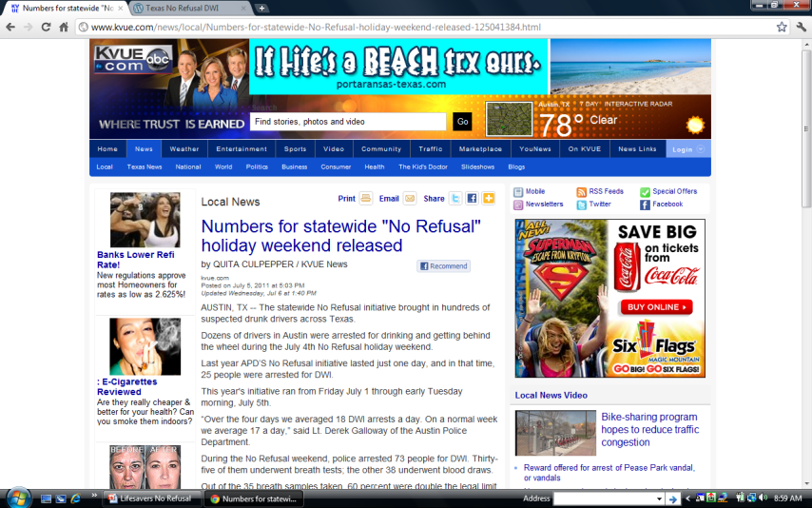
Nation’s First Statewide No Refusal
Coordinated by Chief Bill Waybourn,
Richard Alpert, Clay Abbott, and
Warren Diepraam
Involved almost 500 agencies around
the state including DPS and TPWD
Multiple press conferences including
Statewide in Austin and many locals
Almost 1,500 DWI arrests through the
And a significant drop in fatalities
www.texasnorefusal.wordpress.com
cityofdwg@norefusal.com

Slide 28
National No Refusal Holidays or Weekends
www.nhtsa.gov/no-refusal
www.tdcaa.com/node/7645

Slide 29
Any questions?
warren.diepraam@mctx.org

