Slide 1
DRIVER’S LICENSE LAWS
AND OFFENSES
Texas Transportation Code Chapter 521, 522 and other relevant sections

Slide 2
LICENSE
Authorization to operate a motor vehicle that is issued under or granted by the laws of this state
  Driver’s license
  Nonresident operating privilege

Slide 3
DRIVER’S LICENSE
Authorization issued by the department (Texas Department of Public Safety) for the operation of a motor vehicle
  Instruction permit- student driver
  Under 21
    DL under 18 yoa, annual renewal
  Classified DL
    Class C & M; persons are exempt from obtaining Commercial DL
    Class A & B; Commercial DL

Slide 4
TYPES OF CLASSIFIED DL
(not including commercial)
Operator
  May include motorcycle
Temporary Visitor
  Lawful Presence Requirement
    Applies to a person who is not a U.S. citizen, U.S. national, lawful permanent resident, refugee, or asylee
Under 25
Under 21
  Operator/Learner
  Provisional
  Under 21

Slide 5
TEMPORARY VISITOR
Issued upon proof of lawful presence in U.S.
  Limited term designation
    Expires when lawful presence expires
    Designated as “Temporary Visitor Status Expires . . .”
    A new card with the Limited Term designation will be issued upon renewal

Slide 6
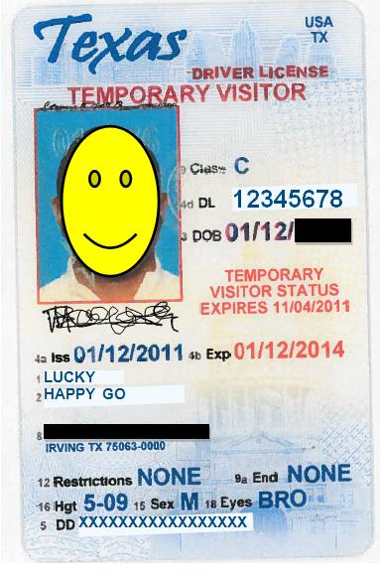
TEMPORARY VISITOR

Slide 7
Under 25
Must successfully complete an approved driver education course either through the school system or private
OR
Parent taught program

Slide 8
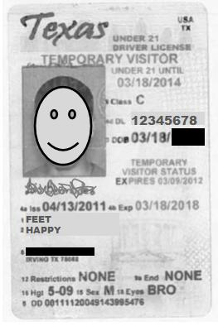
TEMPORARY VISITOR UNDER 21

Slide 9
UNDER 21
Phase One – applies to Learner’s Permit
  6 months
  Must be accompanied by LOFS 21 yoa w/ at least 1 yr experience
Phase Two – applies to Provisional
  Under 17 yoa
    No more than 1 passenger under 21 yoa (family members ok)
    Parent/guardian must be “in sight” if between midnight to 5 am exception is work or job related
    No wireless communication device, except emergency
    Restriction should state “TRC 545.424 applies until MM/DD/YY”
  Annual renewal w/proof of school attendance or GED
Under 21

Slide 10
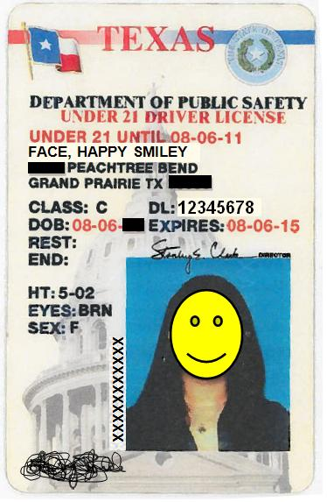
UNDER 21

Slide 11
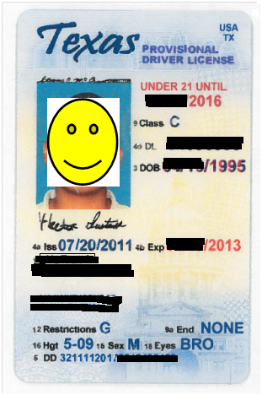
Provisional DL

Slide 12
OTHER TYPES OF DRIVING PRIVILEGES
DIC 24 – Statutory warning incident to DWI
  Authorizes 40 days of driving privileges when DL is confiscated
  May be longer if DL suspension is appealed
  Privilege is stated on the DIC 24 form
Occupational
  Order from court must be carried on the person
  Order designates limitations

Slide 13
EXEMPTIONS
Military personnel while operating an official motor vehicle in the scope of service
Operating a road machine, farm tractor, or implement of husbandry on a highway (does not apply to a commercial motor vehicle)
Licensed (U.S. or Canada) nonresident on active duty in the armed forces
Licensed (U.S. or Canada) spouse or dependant child of licensed nonresident military personnel

Slide 14
RESIDENT VS NONRESIDENT
Resident – physically resides in Texas at a specified location
  Not DOMICILE
Nonresident – “not a resident of this state”
  Officer recommended question
    Is this the address where you live full-time?

Slide 15
OUT-OF-STATE DRIVER’S LICENSE
(VISITORS)
16 yoa or older
  Possession of DL w/ Class C or M
18 yoa or older
  Possession of DL w/ Class A or B (commercial DL)
Issued by their state of residence or Canada
Operating the type of vehicle their DL permits
Tex. Trans. Code § 521.030(a) & (b)

Slide 16
NEW RESIDENTS
May use DL from prior state of residence for up to 90 days
After 90 days must have a Texas DL
Prosecution should allege “resided in this state for more than 90 days”
  Defense is then required to prove by preponderance of the evidence that residence was less than 90 days
Tex. Trans. Code § 521.029

Slide 17
VIOLATIONS
NO DRIVER’S LICENSE
  Operate motor vehicle on a highway in this state (unless exempted)
  Does not possess a driver’s license issued by this state (or another jurisdiction)
    Issue is the existence of a DL not whether it is valid (different issue)
  Tex. Trans. Code § 521.021
NO TEXAS DRIVER’S LICENSE
  Operate motor vehicle on a highway in this state (unless exempted)
  Does not possess a driver’s license issued by this state (or another jurisdiction)
  Prosecution should allege “resided in this state for more than 90 days”
  Defense is then required to prove by preponderance of the evidence that residence was less than 90 days
  Tex. Trans. Code § 521.029

Slide 18
Fail to Display DL
A person required to hold a TEXAS DL
  Have in possession while operating
  Display upon demand
    1st offense - $1 - $200
    2nd offense $25 - $500
    3rd offense $25 - $500 OR 3 days in jail OR BOTH
    Judge to report conviction to the department
  If shown at trial the person caused or was at in an ACCIDENT that results in serious bodily injury or death AND no proof of Financial Responsibility
    Class A
Defense if produces in Court a driver’s License valid at the time of the offense
COURT may assess $10 administrative fee for dismissal
DOES NOT APPLY TO OUT-OF-STATE DL- therefore dismissal fee does not apply
Tex. Trans. Code § 521.025

Slide 19
EXPIRED DRIVER’S LICENSE
Had a Texas Driver’s License
Operates a motor vehicle upon a highway
DL has expired
JUDGE may dismiss if DL renewed
  within 20 working days of offense or
  before defendant’s 1st court appearance, whichever is later
JUDGE may assess $20 administrative dismissal fee
Tex. Trans. Code 521.026

Slide 20
FAILURE TO REPORT ADDRESS CHANGE
Has Texas DL or ID card
Changes address of residence or name
Fails to report/submit request for change to TxDPS
WITHIN 30 DAYS OF CHANGE
COURT may dismiss with administrative fee of $20
  If corrected within 20 working days of offense
  COURT may also waive if in interest of justice
Tex. Trans. Code § 521.054

Slide 21
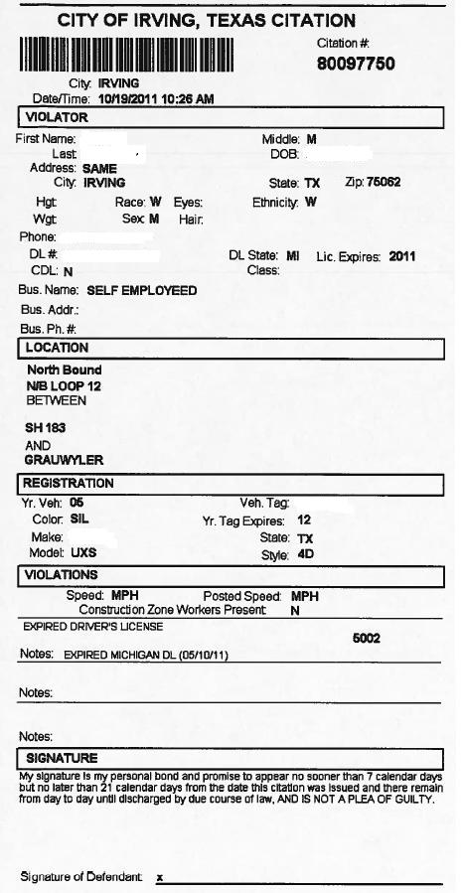

Slide 22
DL RESTRICTION/ENDORSEMENT VIOLATIONS
Possesses a Texas DL
Which has a restriction/endorsement requirement on the DL
Operating a vehicle on a highway contrary to the stated restriction or endorsement
COURT may dismiss with a $10 administrative fee if
  Restriction/endorsement removed because medically/surgically corrected before offense
  DPS removes requirement before first appearance
  Tex. Trans. Code § 521.221

Slide 23
DL RESTRICTION/ENDORSEMENT
RESTRICTION CODE
A With corrective lenses
B LOFS age 21 or over
C Daytime only
D Not to exceed 45 MPH
E No expressway driving
I M/C not to exceed 250 cc
J Licensed M/C Operator age 21 or over in sight
K Moped
L Vehicle w/o air brakes - applies to vehicles requiring CDL
M CDL Intrastate Commerce only
P Stated on license
Q LOFS 21 or over vehicle above Class B
R LOFS 21 or over vehicle above Class C
S Outside mirror or hearing aid
T Automatic transmission
U Applicable prosthetic devices
V Applicable vehicle devices
WPower steering
ENDORSEMENT CODE
H Hazardous materials - CDL only
N Tank vehicle - CDL only
P Passenger - CDL only
S School Bus - CDL only
T Double/triple trailer (CDL and non CDL)
X Combination of hazardous materials and tank vehicle - CDL only

Slide 24
DRIVING WHILE LICENSE INVALID
Operate motor vehicle on highway
  DL has been cancelled
  DL or Privilege is suspended or revoked
  DL expired during period of suspension
  DL denied renewal and no subsequent DL issued
  Tex. Trans. Code § 521.457

Slide 25
DWLI
Notice of Suspension
  Not a defense if not received and reason for suspension is because
    Criminal negligent homicide because of criminal negligent operation of a motor vehicle
    Evading arrest or detention and used motor vehicle in the commission of offense
    DWI, DWI w/child passenger, Intoxication Manslaughter
    Intoxication Assault and used motor vehicle in commission of offense
    Felony offense of a motor vehicle law
    Accident involving injury or death
    Offense under § 521.451 as it relates to fictitious DL or ID
    Offense under § 521.453 as it relates to under 21 fictitious DL or ID
    Manslaughter and used a motor vehicle in commission of offense

Slide 26
DWLI
Notice of Suspension
  Affirmative defense if did not receive ACTUAL notice
    ACTUAL notice is presumed if the notice was mailed in accordance with law
    Tex. Trans. Code § 521.457

Slide 27
DWLI
§ 521.292. Department’s Determination for License Suspension
  Drive while DL suspended, canceled, disqualified, revoked or application denied
  Habitually reckless or negligent driving
  Habitual violator (4 or more w/in 12 mos, 7 or more w/in 24 mos)
  Permitted unlawful or fraudulent use of DL
  Violation in another jurisdiction that would get DL suspended in Texas
  Convicted of 2 or more “restriction” offenses
  Responsible for accident resulting in serious bodily injury or serious property damage
  Holds “Provisional” license and has conviction for 2 or more moving violations within 12 months
  Fleeing or Attempting to Elude police (§ 545;.421)

Slide 28
DWLI
§ 521.294. License Revocation
  Generally related to safe operation of a motor vehicle, medical requirements, Failing to appear for traffic or alcohol related offense
§ 521.295. Notice of Department’s Determination
  Shall be sent by first class mail to the person’s address in the records of the department
  Notice considered received on the 5th day after the date notice is mailed
§ 521.296. Notice of Suspension
  State’s basis of suspension/revocation; right to hearing; procedure and time frame

Slide 29
COMMERCIAL DRIVER’S LICENSE
Effect of a conviction on CDL
  60 days disqualification
    2 serious traffic violations w/in 3 yrs OR
    1 violation at a railroad grade crossing
  120 days disqualification
    3 serious violations w/in 3 yrs OR
    2 violations at a railroad grade crossing w/in 3 yrs
    Tex. Trans. Code § 522.081

Slide 30
CDL
“Serious Traffic Violation” – Conviction from the DRIVING OF A MOTOR VEHICLE, other than parking, vehicle weight or vehicle defect
  Excessive speeding – 15 mph or more over posted speed limit
  Reckless driving
  A violation that relates to a fatal accident
  Improper or erratic traffic lane changes
  Following too close
  Violation of DL Requirements or Endorsements
  Tex. Trans. Code § 522.003
Two points will be assigned for each moving violation conviction
No points will be assigned for a conviction of speeding LESS than 10%
  This is in the general DL Points Surcharge section § 708.052(d) which appears to apply to ALL DL’s
Chapter 45.051 Deferred Disposition is not applicable to CDL’s

Slide 31
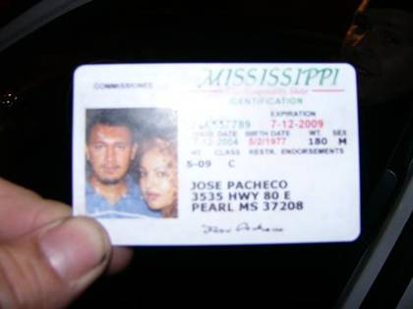
Running stop light = $100.00
DUI = $5000.00
Not wearing a seat belt = $50.00
Putting you & your girlfriend on your fake drivers license = PRICELESS

